Slide 1
Video Digitization
Digital Stewardship Curriculum

Slide 2
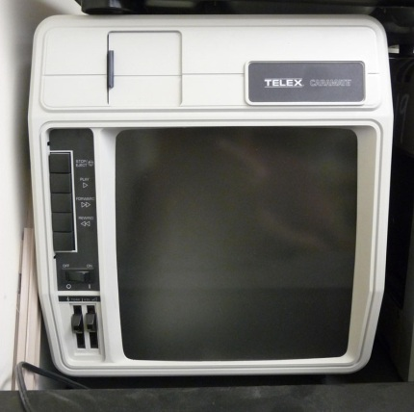
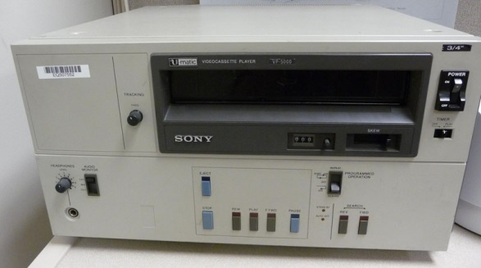
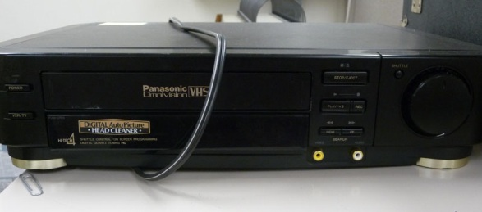
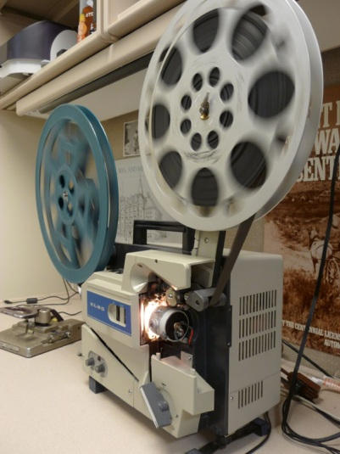
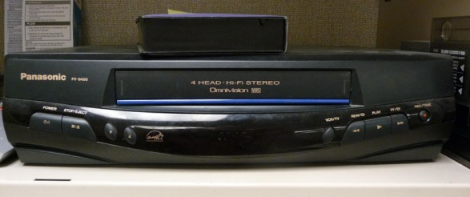
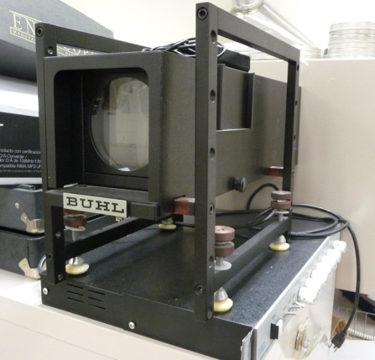
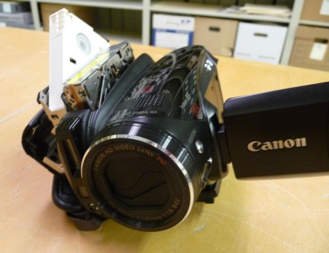
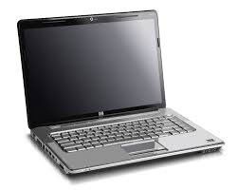
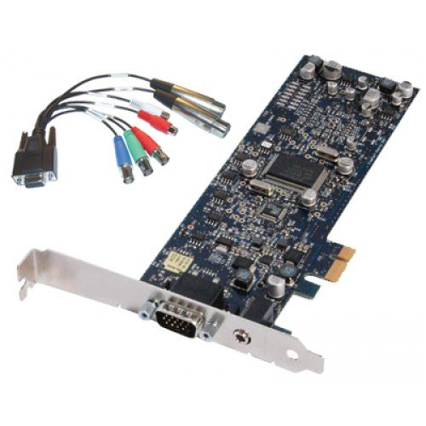
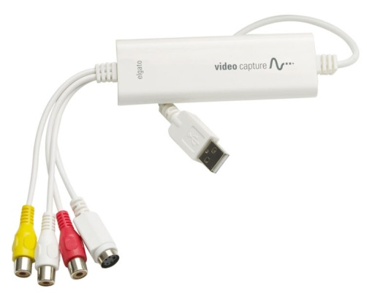
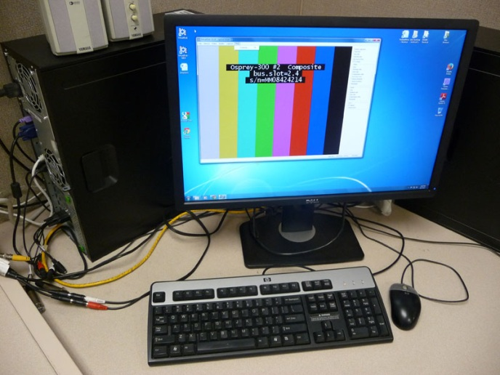
Playback device.
Intermediary hardware & software.
Digital recording device.

Slide 3
Playback devices.
What do you need?
What do you already have?
What can you scrounge?
What is worth buying?

Slide 4
A good computer, with good processing speed, a good amount of RAM, and good storage capabilities.
Digital recording device.

Slide 5
Three roles for intermediary software / hardware:
1. A recorder and connector, to get the image from the playback equipment and recorded in your computer .
Software to manage the digitization of the video/film.
Software to edit and/or convert formats of the original film.
Usually, 1 & 2 will come together.
Sometimes 2 & 3 will come together.
Intermediary hardware & software.

Slide 6
“Video Capture card”
(NOT “Video Card” and NOT “Game Capture Card”)

Slide 7
Starter level (?)…
Digitizes at 640 x (360 or 480)
Exactly meets minimum archival standards
= a decent starter option
About $80.

Slide 8
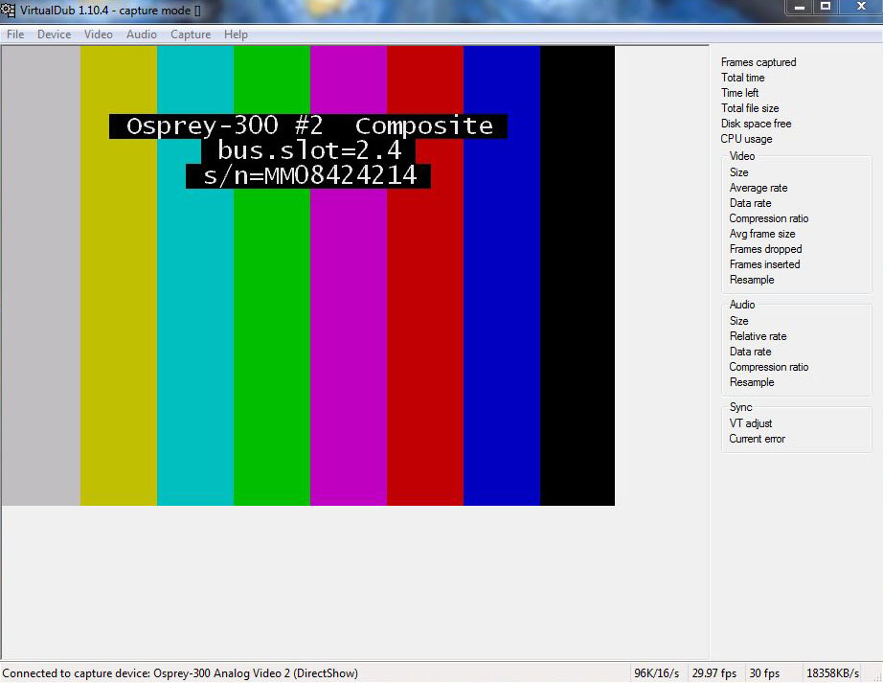
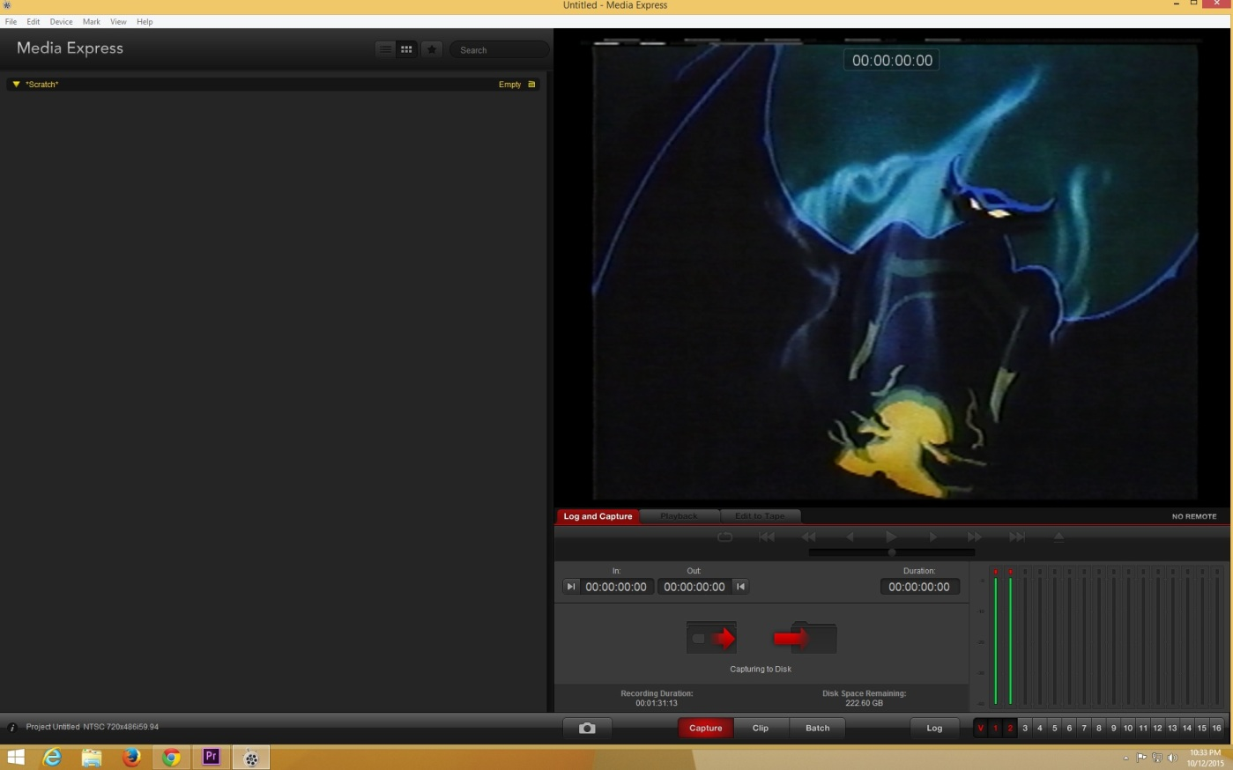
Software I
Something to capture your video.
WSU Libraries use VirtualDub or Media Express; there are many others.
There are many out there. Your video capture card will almost certainly come with one.
Notes:
Nice information at the right, including time/filespace remaining.
Only inputs as AVI – you need editing software for after.

Slide 9
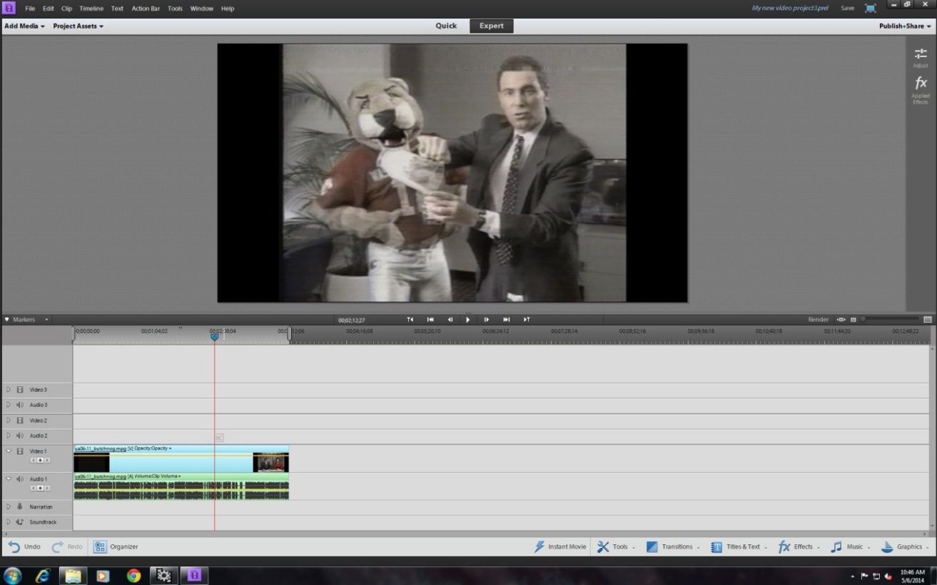
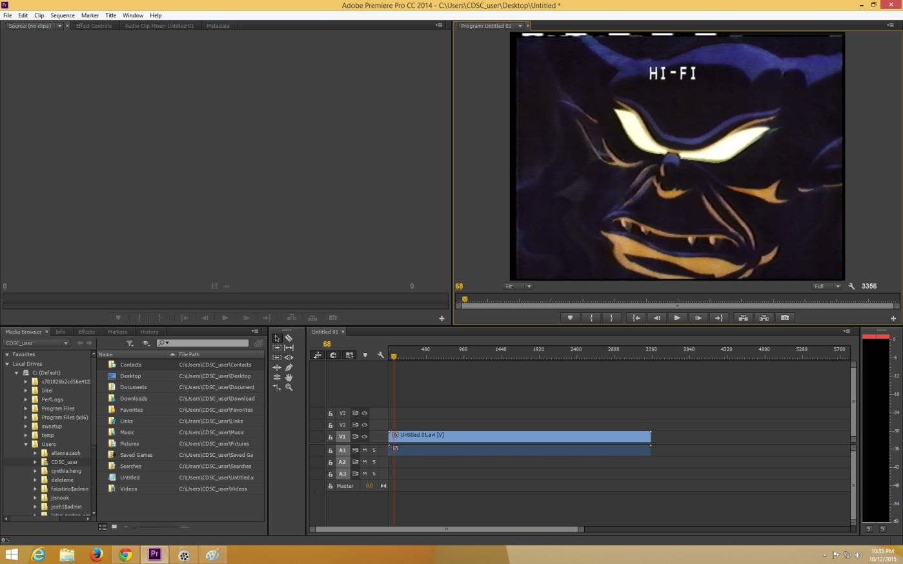
Software II
Something to edit your video, and probably something to convert your video’s file format.
If possible, find one piece of software which will do all the edits you need, and the file conversions you’ll need.
Notes:
Why more complex software might be good: greater editing capabilities, greater format conversion capabilities, greater output capabilities. Most all of those things can be done with individual pieces of freeware, but the minus to that is that you soon start stacking up individual pieces of freeware – eventually you may want something more all-purpose.

Slide 10
Finding video editing software:
There are lots of small freeware which do a few things.
Lots of online sources… either search for video editing software (or freeware) or look for someone who reliably compiles lists.
If you just need one particular function, consider looking for freeware which does just that. If you need multiple functions, purchase something!
Freeware is ‘free.’ You get what you pay for.
Again… make sure it meets your standards!
Notes:
Warning: many try to get you to install other things, or constantly plug you to buy something!

Slide 11
http://download.cnet.com/windows/video-editing-software/

Slide 12
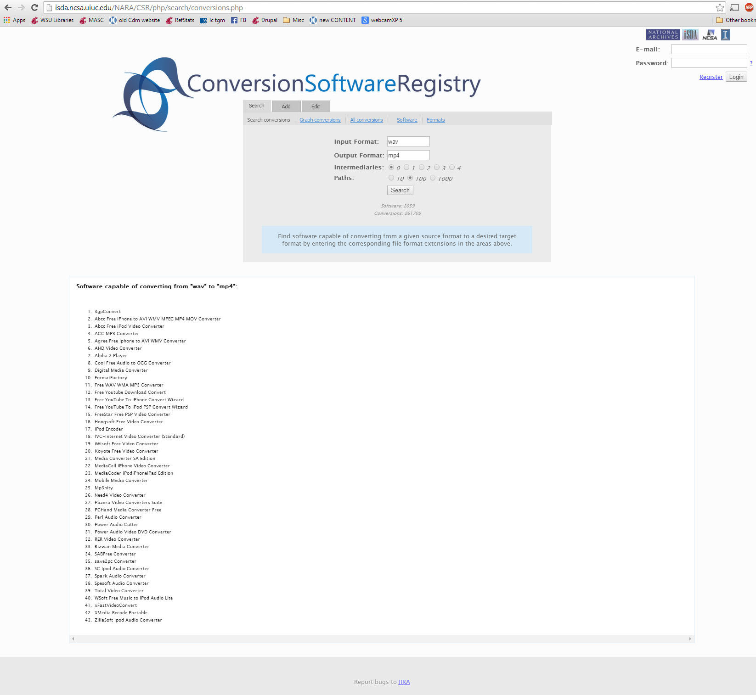
Conversion Software Registry
http://isda.ncsa.uiuc.edu/NARA/csrAbout.html

Slide 13
Two cautionary tales before we actually digitize something…
First:
Digitizing video can take a lot of processing power.
Editing/converting video can take a lot of processing power.
Any time you’re working with video, _DON’T_ do anything else on that computer which takes chunk of power!
Second:
Digitizing video can build up a lot of large files. Always work in a space which keeps your files visible (your desktop is perfect!), so you can be sure they get deleted when you’re done with them.

Slide 14
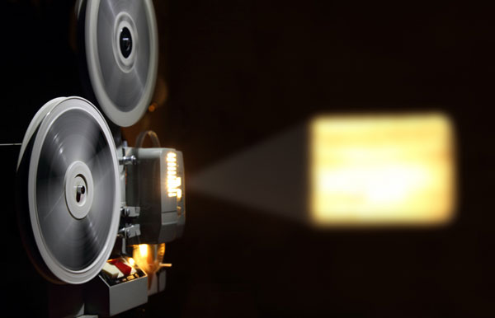
One final catch… these all assume your video/film is being output in an electronic format.
Great for VHS, laserdisc, or anything which is basically electronic information on a piece of plastic or on a piece of tape. What about film…
Notes:
This needs to be said – why can’t you just project it onto a wall and film it. I’m taking three slides to say it instead of using slide animations…

Slide 15
Why not just project it and film it?
You can, but…
Digital cameras take pictures at 30 frames per second (generally).
16mm projectors run at 24 frames per second (generally).
These need to be synched,
or you can get a strobelike effect.
Variable speed projectors.
Variable speed cameras.
Various pieces of equipment or software.
Notes:
Bright/fade strip shows loosely what your picture can do from using a camera to film a projected image.
Under the strobe pops in on a click so I can mention that while there are ways that these can be dealt with, they can be techno-scary (or at least require techno-work), and that the Elmo can be your friend if you can find one.

