Slide 1
Audio Formats: Care and Handling
Digital Stewardship Curriculum
Notes:
These slides provide a quick overview of Audio Formats, and some basic information about how to care for them.

Slide 2
Analog Audio Formats
Magnetic Audio Tape
  Cassettes, Open Reel
Grooved Media
  Records, Wax Cylinders
Optical Media
  CDs, minidiscs
Notes:
For audio formats, there are four main formats, Magnetic, Grooved, Optical, and Digital.
They each have their own unique care requirements.

Slide 3
Magnetic Media
Open reel, Cassettes, Digital Audio Tape, Wire Recordings
Composed of a base, binder and metal particles that hold the sound recording
Notes:
First, Magnetic Media.
Most common is your regular old cassette tape. But there are also older formats like open reel and wire recordings.
Except for wire recordings, these are all composed of some kind of tough base tape, and then metal flakes or particles adhered to the base.
Those metal flakes are magnetized and that is what captures the recording.
In the case of wire, the entire wire is magnetized.

Slide 4
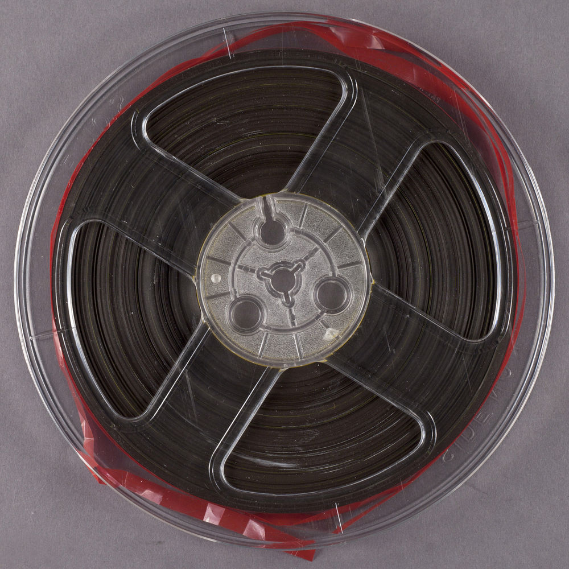
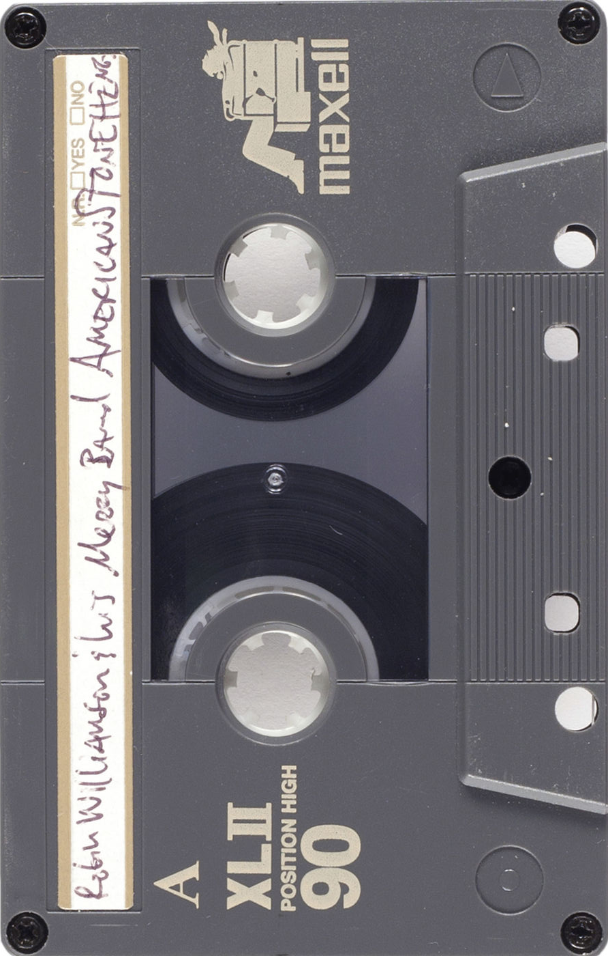
Notes:
Here we have and Open Reel, or Reel-to-Reel recording on the left,
And a Cassette tape on the right.
In principle they are very similar.
The open reel is just bigger and open, so it’s more delicate.
Images from https://psap.library.illinois.edu/collection-id-guide

Slide 5
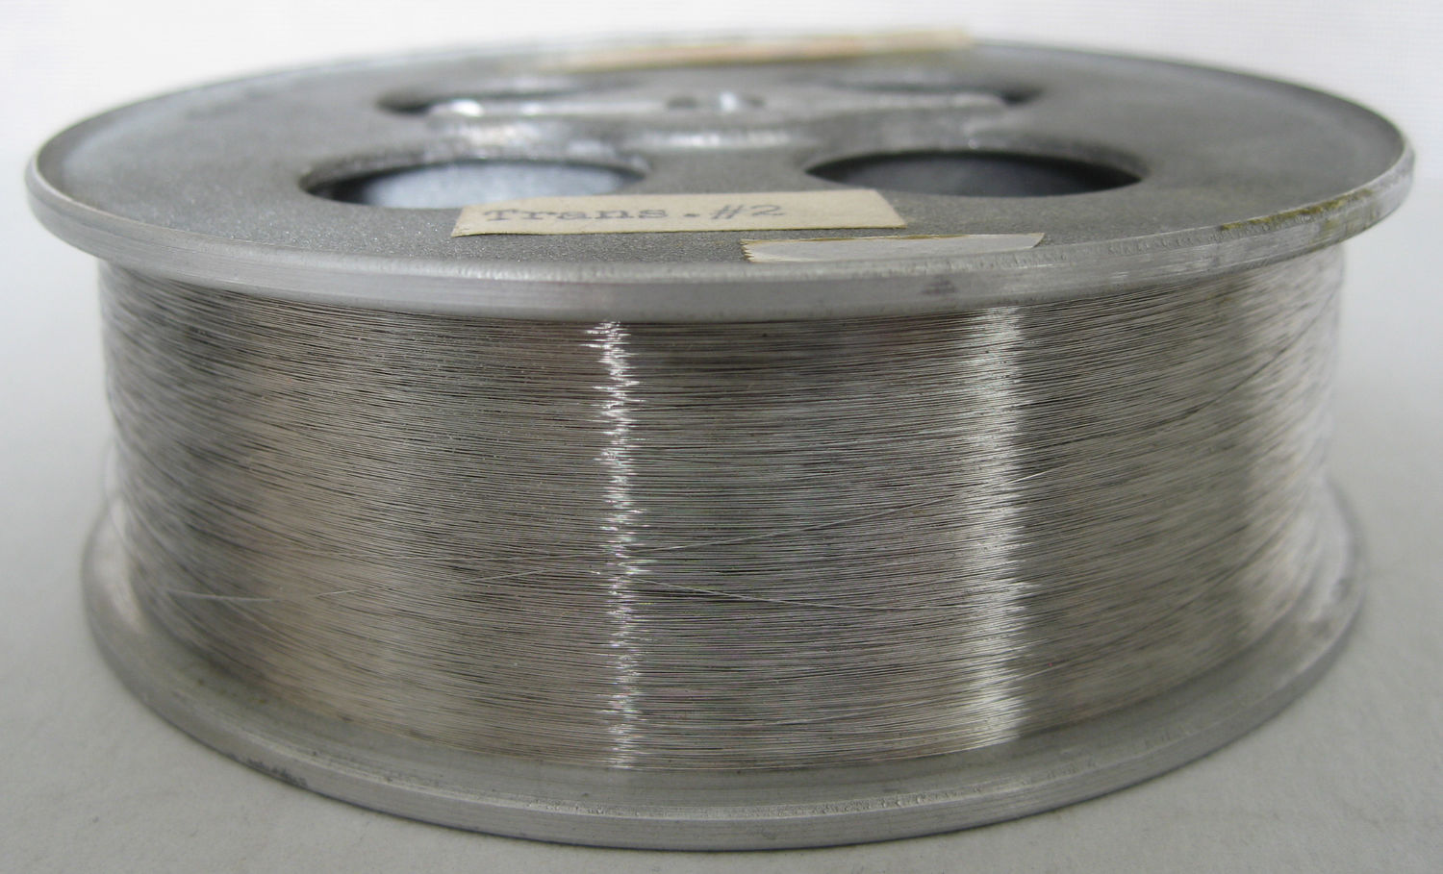
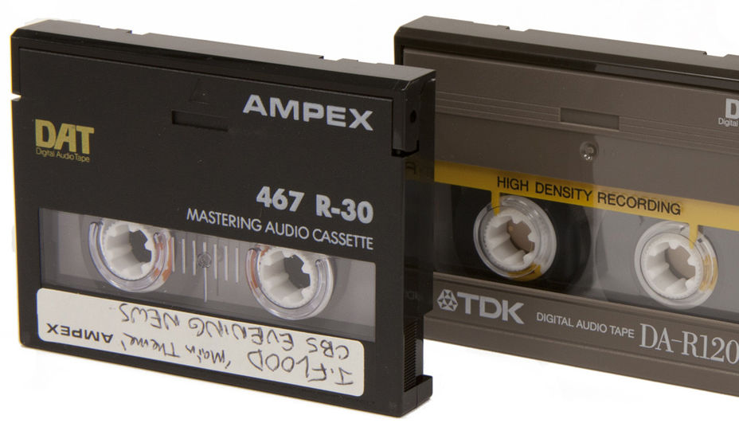
Notes:
Up on the left here is wire spool recording (side view). These are pretty rare.
They can get VERY tangled. If you have wire recordings, find a professional familiar with this format to help you.
Image by Flickr user Betsian, available under a Creative Commons Attribution-NonCommerical-ShareAlike license (CC BY-NC-SA 2.0)
And on the right are DAT cassettes. DAT stands for digital audio tape.
On the technical level they function more like a VHS cassette than anything else.
They’re about half the size of a regular audio cassette.
Image by Lori Dedeyan, available under a Creative Commons Attribution-NonCommercial-ShareAlike license (CC BY-NC-SA 2.0). Courtesy of UCLA Library Special Collections.

Slide 6
Magnetic Media Preservation
Lack of (working) playback equipment
Brittleness, physical damage
Demagnetization over time
Mold
Substrate and recording media delamination
Notes:
Always surprised at just how durable regular audio cassettes are.
The biggest problem is getting the equipment to work with them.
Really only one company manufactures a decent consumer-grade tape deck these days. And finding spare parts or a qualified technician is even harder - so now is kind of a crucial time to digitize audio tapes!
Some of the common preservation concerns around magnetic media are actually pretty easy to deal with.
Keep things cool, dark, and dry, and handle carefully.
Some materials may start to delaminate or suffer other damage, but if you’re careful and thoughtful, you can actually store these things pretty easily.

Slide 7
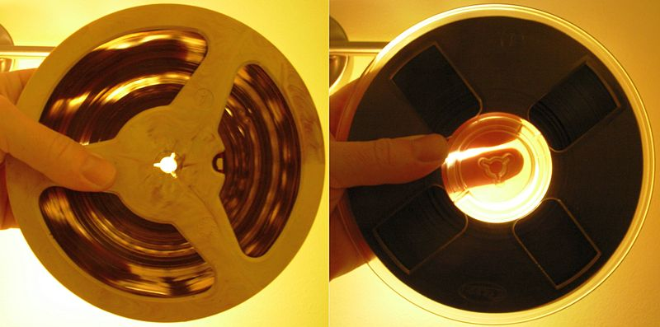
Open reel audio backing materials:
Acetate
Polyester
Notes:
“Magnetic audio reel-to-reel tapes: acetate backing (on the left) and polyester backing. Light can be seen coming through the tape windings of the tape with acetate backing. Acetate backing is chemically less stable than polyester backing.”
Jyrr / CC BY-SA (https://creativecommons.org/licenses/by-sa/3.0) https://commons.wikimedia.org/wiki/File:Magnetic-tape-acetate-vs-polyester-backing.jpg
Please note, open reel film is the OPPOSITE (light passes through polyester, while acetate is opaque).

Slide 8
Grooved Media
Wax Cylinders
Discs
  Vinyl
  Shellac
  Acetate (metal or glass)
Notes:
Next, grooved media!
Most likely we are all pretty familiar with vinyl records - LPs, EPs, 33s, 45s, etc…
That same format was also made out of shellac, metal and glass.
And there are also wax cylinder recordings which are older. They’re pretty neat, actually, and work basically the same as a record, just top to bottom, instead of outside-in.

Slide 9
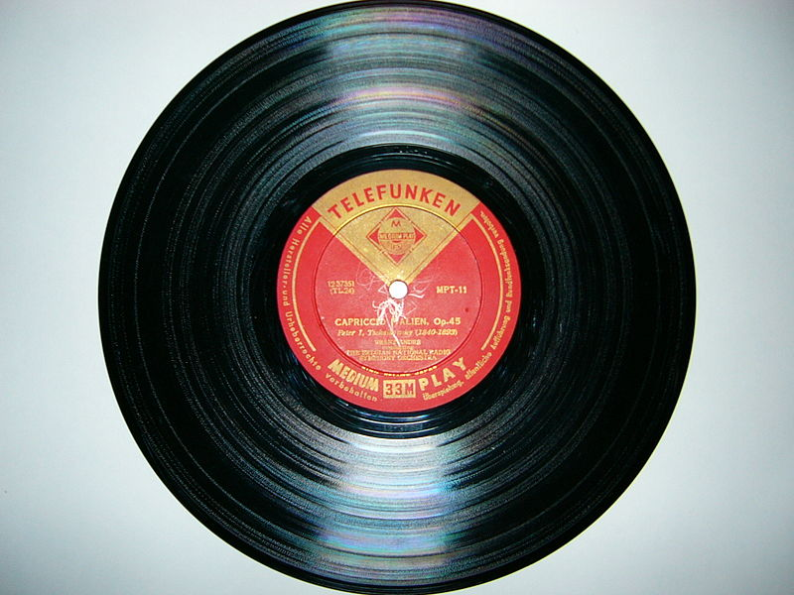
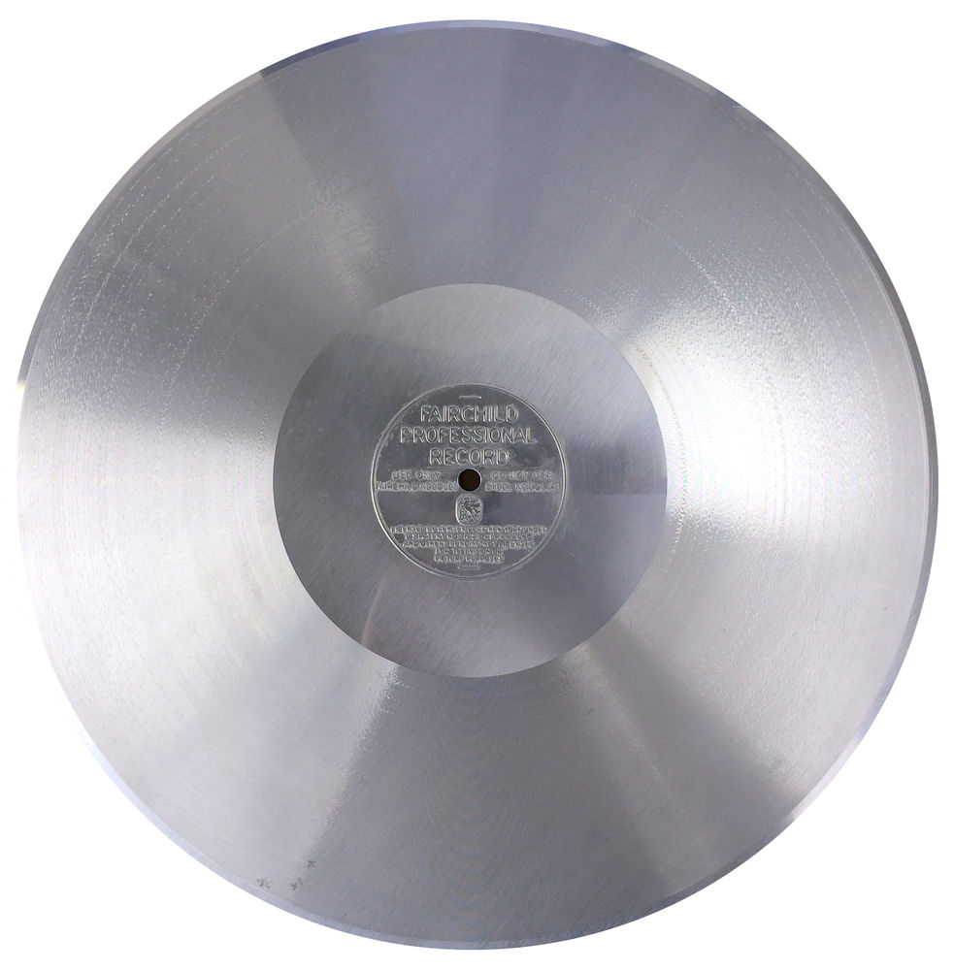
Notes:
Left is a Vinyl LP (33⅓rpm) record, measuring 12" in diameter. This should be familiar. 能無しさん / CC BY-SA (http://creativecommons.org/licenses/by-sa/3.0/) https://commons.wikimedia.org/wiki/File:Vinyl_record_LP_10inch.JPG.
Right in an Aluminum disc. Image courtesy of Aaron Coe, The Cutting Corporation.
Same principle, different material.

Slide 10
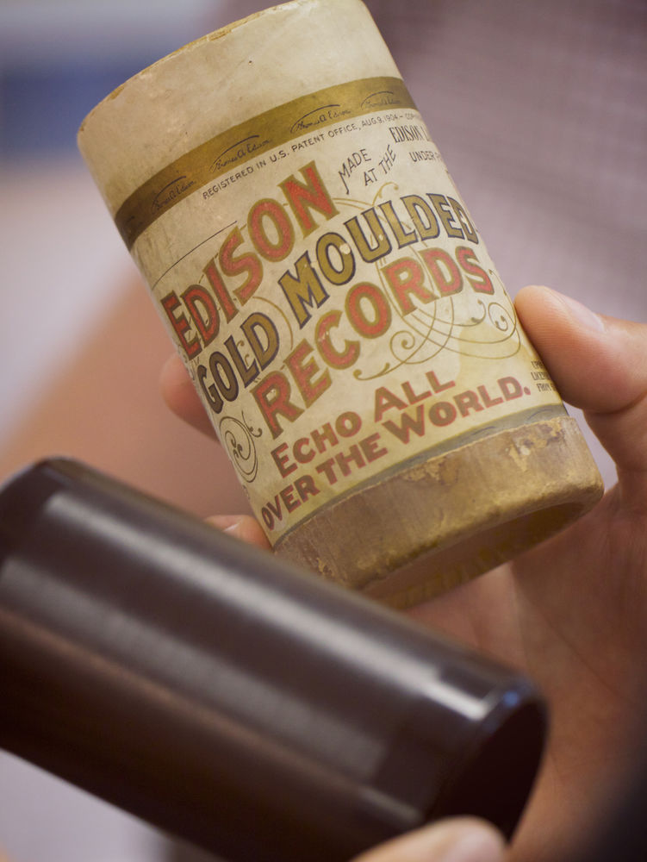
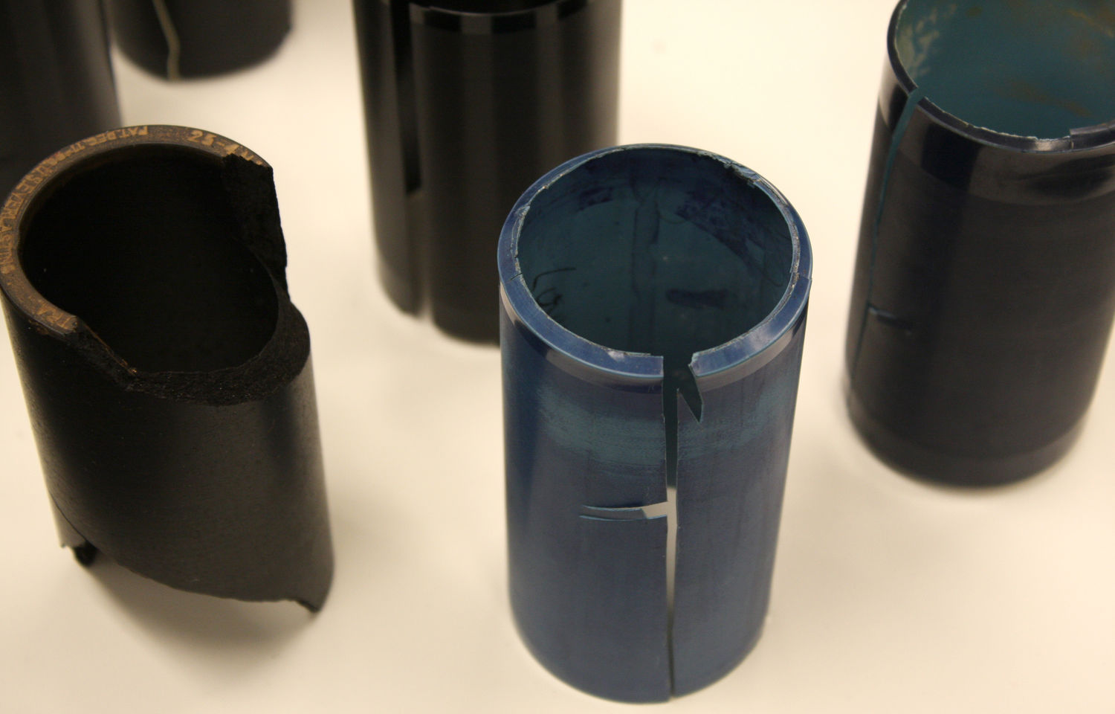
Notes:
Left are some Cracked and fragmented cylinders. This is a very common sight with wax cylinders.
IRENE is a technology used to digitize recordings made on wax cylinders.
Image by Flickr user Photo Phiend, available under a Creative Commons Attribution-NonCommercial-NoDerivs license (CC BY-NC-ND 2.0). Courtesy of Library of Congress Preservation division.
And on the right, and intact Wax cylinder with original box. Image by Flickr user Marcin Wichary, available under a Creative Commons Attribution license (CC BY 2.0).

Slide 11
Grooved Media Preservation
Lack of (working) playback equipment
Playback wears out the recordings
Wax Cylinders
  Very fragile
Discs
  Fairly fragile
  Delamination
Notes:
Unfortunately, grooved media is a lot more fragile than magnetic media.
Wax cylinders and most record types are prone to cracking or shattering.
Vinyl and shellac records in particular are at risk of delaminating and separating.
Also, since grooved media are played by basically dragging a needle through the grooves, they wear out with use.
In general, keep everything cool, and be careful with handling and storage.

Slide 12
Optical Media
Minidisc
CD
Notes:
A more recent format in the last several decades is optical media, specific to audio are minidiscs and CDs

Slide 13
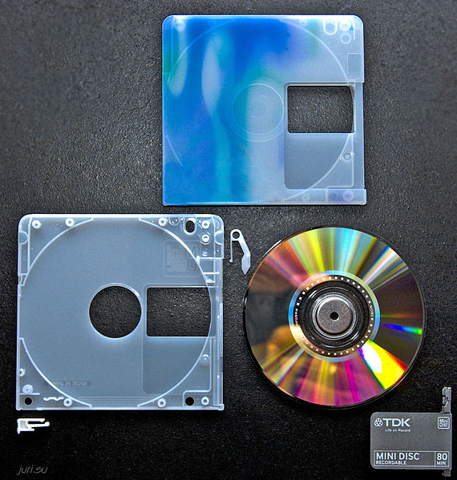
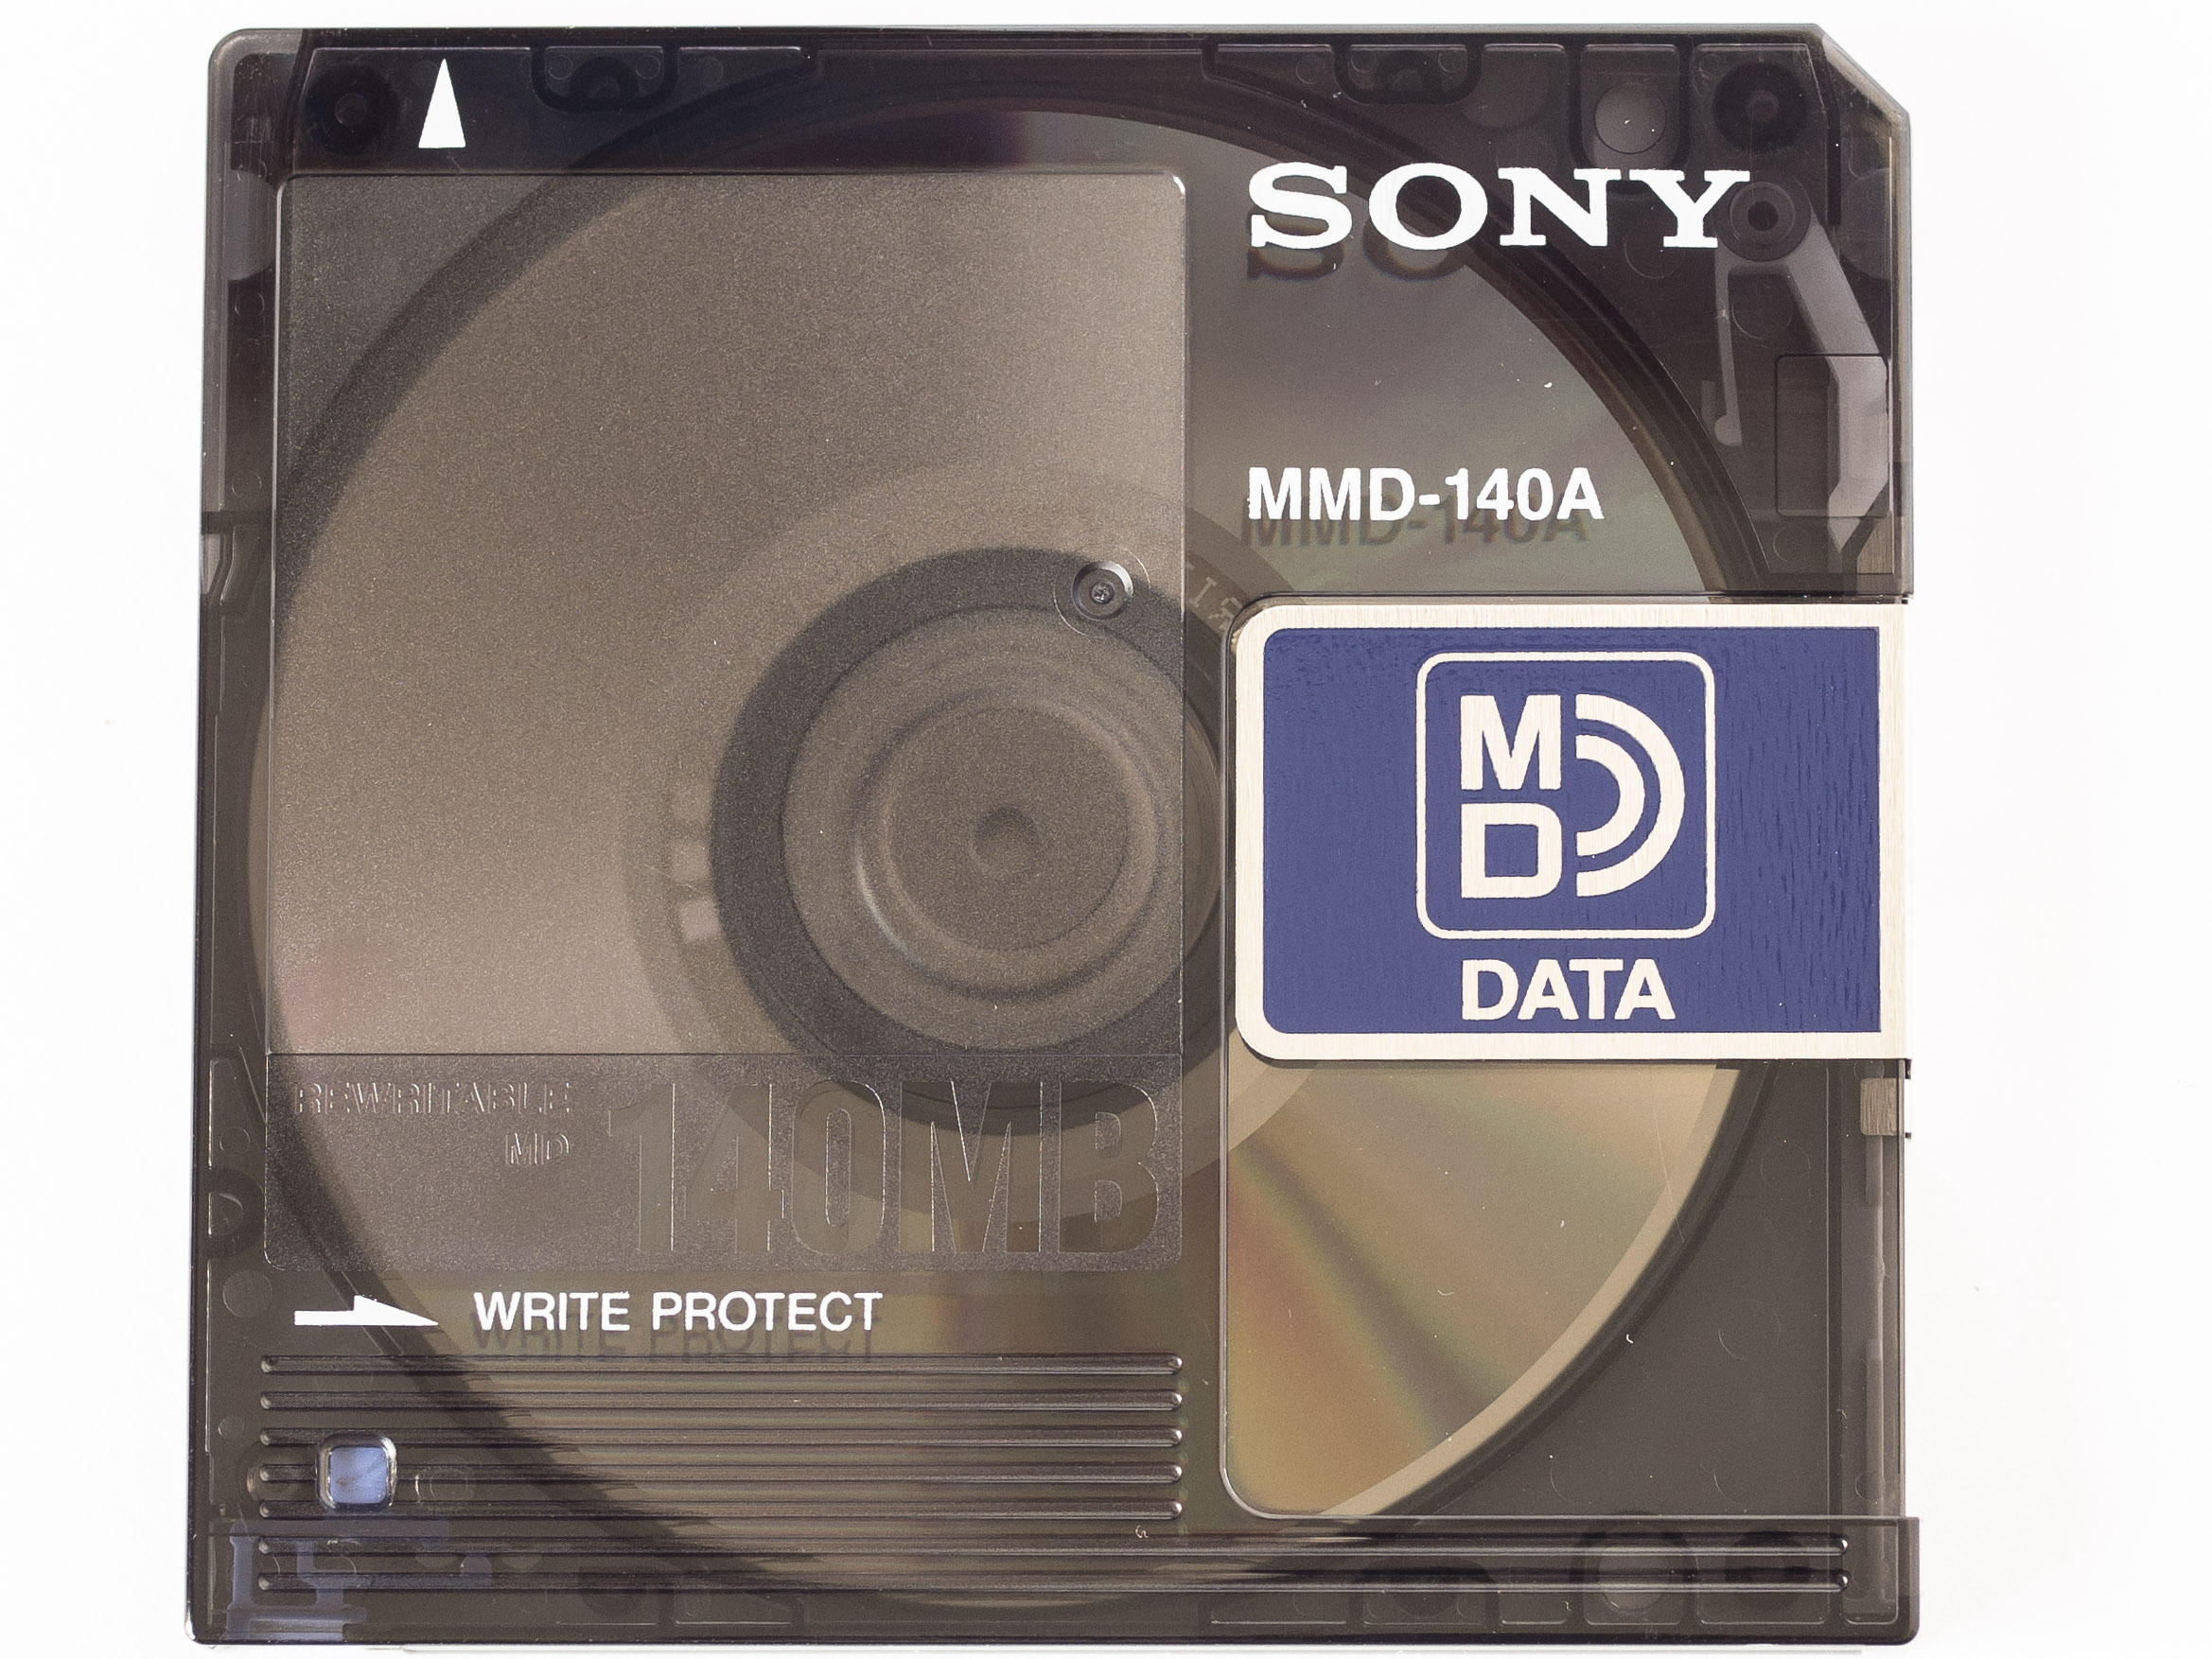
Notes:
These are some shots of a minidisc.
These really did not last long (1990s-2000s). They were popular in Japan, and some use in the United States.
Digitize as soon as possible, outsourcing may be recalled.
Jurireal / CC BY-SA (https://creativecommons.org/licenses/by-sa/3.0) https://upload.wikimedia.org/wikipedia/commons/1/16/Minidisc_disassembled.jpg.
Esteban García González / CC BY-SA (https://creativecommons.org/licenses/by-sa/4.0) https://commons.wikimedia.org/wiki/File:Minidisc_MD_data_(front).jpg.

Slide 14
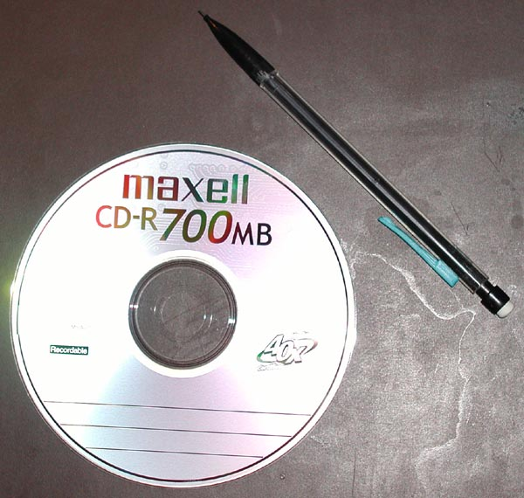
Notes:
The CD, the compact disc.
Light, kind of portable, cheap, generally played nice with computers and replaced the venerable mixtape.
They’re composed of layers of plastic and foil, and read by a laser.
Get files transferred off of CDs, as soon as possible, no digitization needed but digital organization is key.
CD image by Mormegil ( Creative Commons Attribution-Share Alike 3.0 Unported) https://commons.wikimedia.org/wiki/File:Maxell_CD-R_700MB_40x_20040321.jpg.

Slide 15
Optical Media Preservation
Lack of (working) playback equipment
Physical damage
  Scratching
  Corrosion
  Delamination
Spontaneous Failure
Notes:
Even though there are in theory golden DVDs that were marketed as lasting thousands of years, optical media are volatile. They don’t last and they are prone to spontaneously degrading or losing data.
Pretty standard preservation concerns…. but I say since it’s a digital media and is pretty easy to copy from a disc, get your content off these as soon as you can. They do not last as long as analog media.

Slide 16
Care, Handling, Storage of Analog
Don’t touch the recording media
  Handle discs by edges
Store in cool, dry, dark place
Handle with clean hands/gloves
Store media on-edge/upright
Use acid-free/archival cases to store
  Re-house if necessary
  Use the right size cases
Notes:
This is kind of a catch-all summary of the preservation needs for analog audio media.

Slide 17
Identification Resources
Preservation Self-Assessment Program (PSAP Collection ID Guide)
Museum of Obsolete Media
Field Audio Collection Evaluation Tool (FACET)
Library of Congress resources
Connecting to Collections
Notes:
Some of these resources may be helpful in your work.

Slide 18
Credits
Images credits listed on slides notes
Presentation template by SlidesCarnival.
Minicons by Webalys
This template is free to use under Creative Commons Attribution license.
These slides contain changes to color scheme and content.

Slide 19
Using this Resource
The Digital Stewardship Curriculum is an Open Educational Resource created by the Center for Digital Scholarship and Curation.
All presentations and resources created by the CDSC are licensed under a Creative Commons Attribution-NonCommercial-ShareAlike 4.0 license (CC BY-NC-SA). Please share, reuse, and adapt the resources and provide attribution to the Center for Digital Scholarship and Curation, Washington State University.

