Slide 1
Introduction to Digital Preservation and Storage
Digital Stewardship Curriculum

Slide 2
Digital Files
Donated, created
Digitized, copies
Recorded
Born digital records
Work with donors/others to accept best possible quality files
Still require processing, management
Inventory what you have, plan ahead for future work
Storage of digital files
Notes:
In your department, or outside and donated
May be digitized/converted
Or may have started off as digital files
Thinking about digital donations, working with donors becomes incredibly important. Easy to donate lots of unneeded or unorganized files. Sitting down with them and going through the files. BEST QUALITY - and your preferred formats. -working with donors to make sure you are getting ONLY what is needed
Work to organize and make sense of digital files
Think about physical and digital files in all policies, even if they are not being donated yet
You need a place to store files, for the long term

Slide 3
Digital Preservation
Long term storage and preservation of your digital files
Runs through all of your digital projects
Notes:
What is digital preservation?
Long term storage, management, and preservation
Ensure that all the work you put into digitizing will be saved for the long term!
Digital preservation should be a conversation throughout your department/institution - if not, you will have to start small and keep at it
Should be considering digital preservation in general, and with every digital project that you start

Slide 4
Documenting Digital Preservation
Documentation
Create a Digital Preservation Plan
Create a Digital Preservation Policy
Add into workflows and practices
Can’t just “set it and forget it”
Update, research, monitor
Notes:
Documentation
A Digital preservation plan that includes all parts of saving and preserving files, managing files, checking files - making sure it all works together and is carried out
See the SHN Resources Activities to Include in a Digital Preservation Plan and Digital Preservation Plan Worksheet
A policy is a written version of this information, that ties into institutional and departmental goals
See the SHN resource Developing a Digital Preservation Policy
Your workflows and practices are what gets carried out day-to-day, the information from your plan and policy must be applicable to daily/weekly/monthly/yearly actions to implement effective digital preservation
All of this documentation and implementation must be updated as technology and approaches change and evolve
Similar to digitization projects - the most time goes into the planning (this planning requires time up front, but will help sustain the project)
Your plan - not just created once and complete...like with your other policies, it must be revisited (especially with changing technology- updates)
As hardware, software, security changes, your plan must also stay up to date

Slide 5
Team Effort
Find others to bring into the conversation
Fit your needs into what already exists
Maintain communication
Balance responsibilities
Notes:
Luckily, you aren't alone! You either have other people in your institution that should be involved OR you can reach out to others in similar situations (institutions of all sizes struggle with these issues) - make a team!
You might also be joining a conversation that has already been started
To do this,...need to FIND OUT what already exists
When going to get funding from outside agencies or within your own organization it is imperative have a conversation about what your organization already has in place, so any new funding can be put to the best use.
Don’t want to re-do anything that already is working well!
Or duplicate work done in two separate departments
Have initial conversations, and then continue -- - how do people check in (meetings, conference calls?)
Want to make sure all responsibilities are covered - who is in charge of what? Make sure the long term preservation needs are understood
Since DP can get very complicated, and is unique to each situation, we created a Pyramid of Digital Preservation...

Slide 6
Notes:
Broke down digital preservation into 3 essential parts that any Digital Preservation Plan will have to involve
FIRST, the most important foundational piece

Slide 7
Notes:
Storage is the base of our pyramid -
Making sure that content is stored safely and securely for long term preservation
You might not be doing this work! You might have an IT department, or a person on your staff who is in charge of storage, technology, computers….But that doesn’t mean that you don’t have a responsibility to make sure that it is being carried out, and your files are securely preserved.

Slide 8
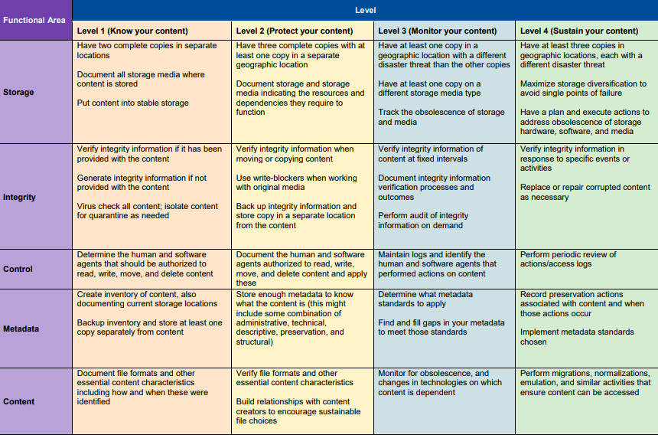
Notes:
Another wonderful resource for understanding digital preservation, starting out with some basics and improving over time is the National Digital Stewardship Alliances Levels of Digital Preservation
For more about the different levels of preservation, check out: https://ndsa.org/publications/levels-of-digital-preservation/

Slide 9
Storage
Storage space for content
Integrate with IT
What does your IT department already have set up?
Consider types of storage
Multiple layers
Notes:
Get what you need for your digital content, AND what will be created in the future
Ideally all of your long term preservation files can be stored together and organized in a meaningful way
Talk to IT, they may be the ones setting you up, or may prefer a certain type of storage, figuring out funding
Many options for storage - all storage options have pros and cons - make a decision that will fit best for you (and try to avoid flash drives/single hard drives)
Think about how your backups fit in with each other
Workflows for backing up content, multiple places for backups - fail safes if one is destroyed

Slide 10
The 3-2-1 Rule
Notes:
This concept is something that we like to repeat as a baseline for setting up digital storage. “The 3-2-1 Rule”

Slide 11
3 Copies
2 Types of Storage
1 Different Geographic
Location
Notes:
Have 3 copies of any valuable information
Store 2 on at least different types of media
Store 1 in a different geographic location
We will explain each of these more

Slide 12
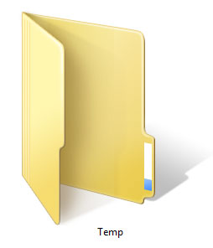
3 Copies
Preservation quality files
Choose files for long term preservation
Not in active use
Access/derivative copies usually not a priority
1
2
3
Notes:
Have 3 copies of any valuable information
These are your highest quality, preservation files that need to be saved in the long term
Not just office files
Select what gets saved
These files should not be in active use
If you have multiple versions of files - like access copies for web upload, these are not usually preserved - because you are prioritizing that space for the PRESERVATION files

Slide 13
Versions of Files
Preservation master copies
Access copies
Created from preservation masters
Smaller
Lower quality
Other derivatives
Notes:
When thinking about LONG TERM storage - having those different versions of your files (master file, access, copy, edited copies) organized is really important. So you know which files you need to add to long term storage.
Long term storage, best quality that you can afford -- those are your preservation masters - these files will dictate how much space you need to plan for
Access copes
Derivatives - exhibits, flyers, thumbnails online
AGAIN - your preservation copy is the one you are worried about in the long term

Slide 14
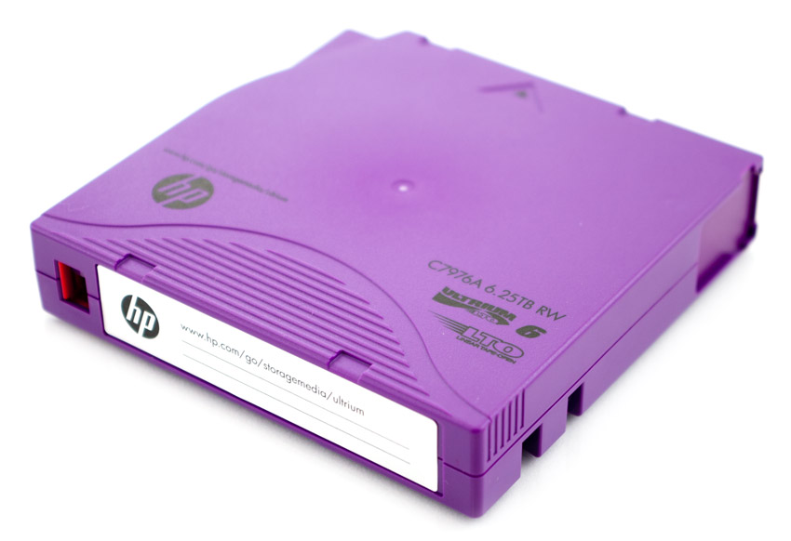
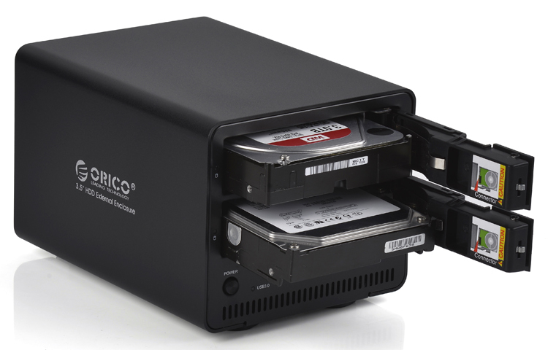
2 Types of Storage
At least two different types of storage media
Manageable
Fault tolerant
Notes:
2 types of storage
At least two different types of storage media
For your three storage locations - you can set it up however you like, but having at least two types of storage makes it a safer setup, in case a certain format turns out to be not viable
So you might have two raid hard drive systems (1st and 2nd copy), and then also back up to cloud storage (3rd copy),
Or a network server (1st copy), and two RAID hard drive systems (2nd and 3rd copy)
Or as pictured in the image - RAID storage (1st copy) LTO tape (2nd copy) and cloud storage (3rd copy)
Manageable - you should be able to easily maintain and oversee the storage, or easily be able to work with IT to manage
Fault tolerant - you don’t want to worry about drive failure, so pick storage that has been tested, reviewed highly, and you can trust
And swap out according to how long the storage media lasts

Slide 15
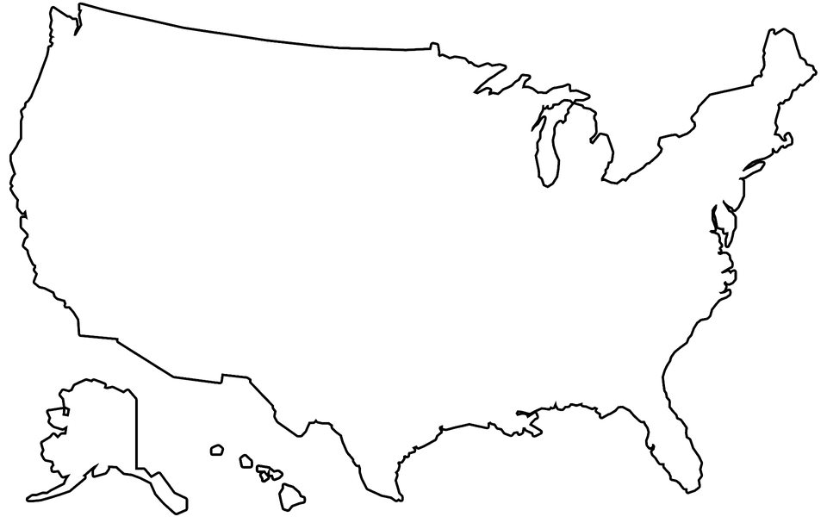
1 Different Geographic
Location
Different “disaster zone”
Protect against natural disasters
Option: cloud storage
Notes:
Then, if possible, have one storage location in a different disaster zone (avoiding a natural disaster that might destroy other storage)
Think about what can affect your area
Cloud storage can be a good option for this, but you are not required to use cloud storage
Some consortiums, Universities and other institutions look into partnering with each other to exchange storage space
Other more simple ideas might be bringing a hard drive home with you, if you live in a different location from the other storage

Slide 16
Types of Storage Media
hard disk drives
flash drives
RAID hard drive
cloud/hosted storage
CDs or DVDs
SSD (solid state drives)
LTO Tape
Network Attached Storage
Notes:
Here are some different types of storage,
External hard drives - not a matter of if they will fail, but when(and need to be replaced every 2-3 years)
Flash drives - temporary storage - like the ones we have for this program [avoid using these!]
RAID hard drive - Redundant Array of Independent Disks - multiple hard drives together, more fault tolerant
Cloud storage AKA hosted storage,
CDs, DVDs - these are a legacy format, were used for preservation at one point, but not anymore [avoid using these!]
SSD - similar to hard drive, with no spinning disc -longer life 3-5 years
LTO tape - systems that IT would need to manage
NAS - server
Knock a few off the list right away:
Flash drives - fail easily, carry viruses easily (and are easily lost or misplaced)
CDs or DVDs- obsolete, not used anymore - many new laptops no longer have an optical drive built in, media can degrade without warning

Slide 17
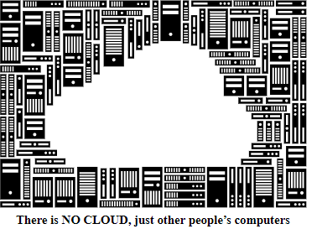
Cloud Storage
Notes:
Cloud storage and hosted storage
Paying someone else to host your storage - contract
These files still take up space and energy to maintain, have environmental impact and cost
May have restrictions on this in your community - of storing files and information
PROS/CONS
Pros: can be cheap to store, can pick a storage location in another area (geographic region/disaster area different from yours.
Cons: depending on company can be expensive to get data out again on a quick turnaround
You may have heard of Google Drive or Dropbox
Amazon glacier
Microsoft azure
Carbonite
Cloud image: Markus Meier, FSFE / CC BY-SA (https://creativecommons.org/licenses/by-sa/4.0) https://commons.wikimedia.org/wiki/File:FSFE_There_is_no_cloud_postcard_en.svg
Background image: The National Archives (UK) / CC BY (https://creativecommons.org/licenses/by/3.0) https://commons.wikimedia.org/wiki/File:A_view_of_the_server_room_at_The_National_Archives.jpg

Slide 18
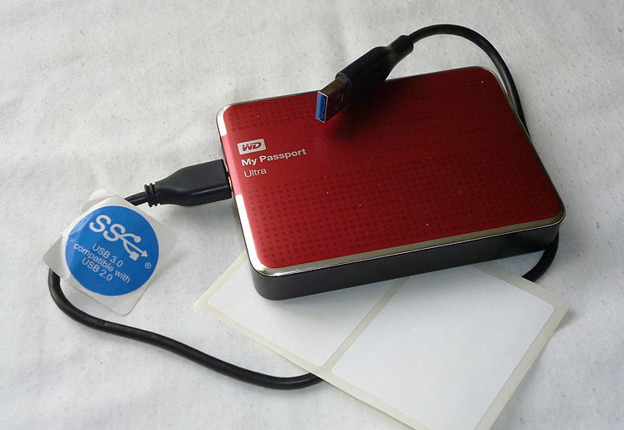
External Hard Disc Drive
Notes:
External HDD - hard disc drive
Relatively inexpensive
But if you just have one, and it fails, you are out of luck
Riskier than others, need to REPLACE 3-5 years
Plug in, drag and drop - easy enough to use after setup
Armchair / CC BY-SA (https://creativecommons.org/licenses/by-sa/4.0) https://commons.wikimedia.org/wiki/File:Typical_External_Hard_Drive.JPG

Slide 19
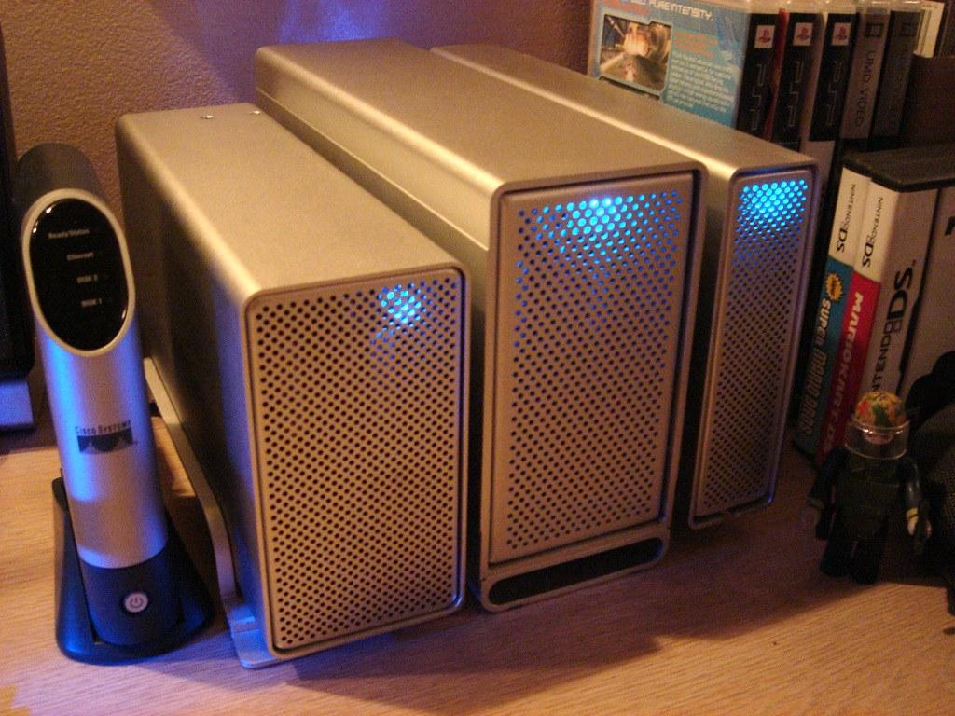
External RAID enclosure
Notes:
External RAID enclosure.
Multiple hard drives
More expensive
Redundant backups - less risk of failure -- if one fails, another will have backed up (still need to replace)
Ex: Synology diskstation (2 8tb drives = 4 tb)
Western Digital
Lacie
Kevin Lim Unboxing OWC Mercury Elite Pro RAID enclosure https://creativecommons.org/licenses/by-nc-sa/2.0/ https://www.flickr.com/photos/inju/193066937

Slide 20
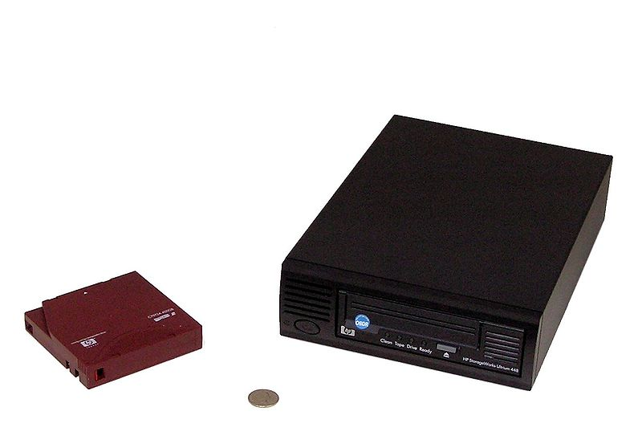
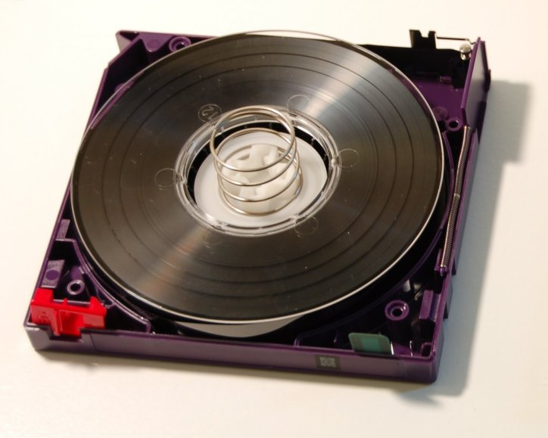
LTO Tape Storage
Notes:
LTO Tape storage
Cheap media, need equipment to read/write,
Need someone who knows how to run the equipment (tape reader) - that staff is expensive infrastructure
Would probably want IT to handle
Austinmurphy at English Wikipedia / CC BY-SA (https://creativecommons.org/licenses/by-sa/3.0) https://commons.wikimedia.org/wiki/File:LTO2-cart-wo-top-shell.jpg
User Trimbo on en.wikipedia / CC SA (http://creativecommons.org/licenses/sa/1.0/) https://commons.wikimedia.org/wiki/File:LTODriveWithTape.jpg

Slide 21
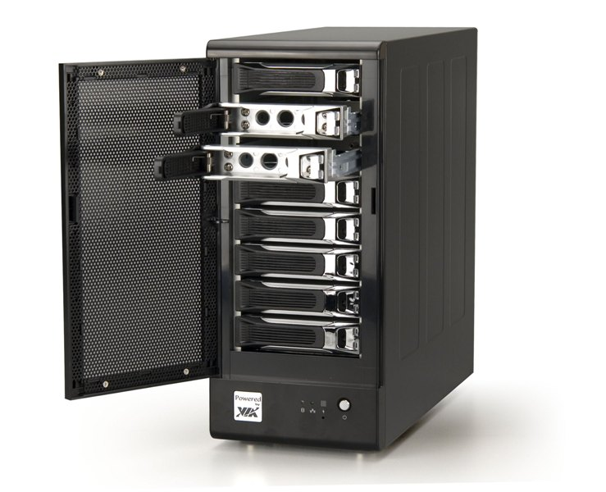
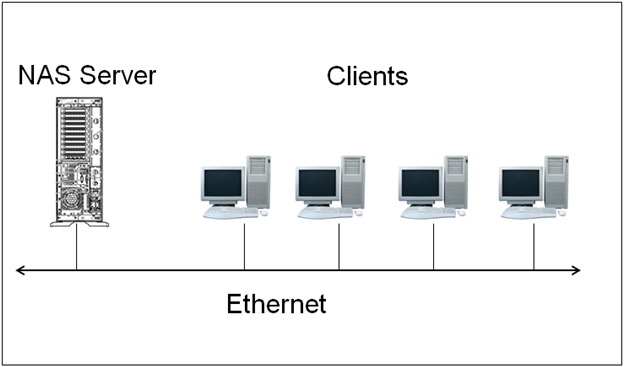
Network Attached Storage,
or Storage Server
Notes:
Network Attached Storage or a Storage Server
IT would probably handle
VIA Gallery from Hsintien, Taiwan / CC BY (https://creativecommons.org/licenses/by/2.0) https://commons.wikimedia.org/wiki/File:Network_Storage_Server-_VIA_NSD7800_(angle_view_with_case_open)_(3179536746).jpg

Slide 22
Digital Preservation:
First Steps:
Have at least one backup copy of important files
Create and update an inventory of digital files
Start talking with IT, or others
Storage for digital files
Notes:
Think about what you currently have - is there anything that you can’t afford to lose? Backup
Document what digital collections you have - create an inventory
Start conversations - your department, your supervisors, administration, IT department
In an ideal world everyone could have all those resources to support your work
We understand that things aren’t always ideal
Think of WHO is involved with storage of digital files, think about how to talk and with them
If that is just you, that’s ok too, because you have us to talk to
Levels of Digital Preservation Preparedness document

Slide 23
Digital Preservation:
Second Steps:
Transfer data off of outdated media
Decide which file types you will use for various formats
Define security of files
Estimate future storage needs
Notes:
Get your files off of thumb drives, CDs, floppy disks - these are at risk!
Figure out file types - what are the recommended file types for the formats you have
Think about internal security and access to files - who currently has access? Who should have access?
Prevent human error
Prevent malicious actions
Forecast what you will create - understand how much space you need currently and in future
Can be hard to know how much storage you need, but there are ways of estimating…
Digital Rebellion
Audio - The Audio Archive
Photograph - NAU

Slide 24
Over the next months:
Discuss with people in your organization (or make time to plan by yourself) - decide WHO to include
Take stock of WHAT you already know
List things that you want to FIND OUT about Digital Storage and Preservation
Digital Preservation Questions Worksheet: Part 1: Storage
Notes:
Complete the SHN resource Digital Preservation Questions Worksheet: Part 1 to get some helpful questions and discussion started around this topic. Bring others into the conversation

Slide 25
Discuss or Reflect
What are a few top concerns you have about digital storage and preservation?
Who else in your department, organization, or community should be involved in digital storage and preservation planning?
Notes:
Take 20-30 minutes and discuss with others, or reflect by yourself and take notes
What are a few top concerns you have about digital storage and preservation?
Does your current digital storage setup pass the “3-2-1” rule?
Is there anything you are particularly worried about?
Are there any past events like data loss or corruption?
Who else in your department, organization, or community should be involved in digital storage and preservation planning?
Who are your allies?
Who has skills that would be helpful?
Who has access to funding or grant writing skills?
Who in leadership or administration do you need to speak with?

Slide 26
Credits: Images
Slide 3: Save icon Font Awesome by Dave Gandy https://fortawesome.github.com/Font-Awesome Data Center CC Amber Case; Flickr https://creativecommons.org/licenses/by-nc/2.0/
Slide 6-7: Center for Digital Scholarship and Curation, Lotus Norton-Wisla, Michael Wynne, Alex Merrill
Slide 8: NDSA image https://ndsa.org/publications/levels-of-digital-preservation/
Slide 14: External hard drive CC Armchair; Wikimedia Commons https://creativecommons.org/licenses/by-sa/4.0/deed.en
Slide 17: Cloud image: Markus Meier, FSFE / CC BY-SA (https://creativecommons.org/licenses/by-sa/4.0) https://commons.wikimedia.org/wiki/File:FSFE_There_is_no_cloud_postcard_en.svg Background image: The National Archives (UK) / CC BY (https://creativecommons.org/licenses/by/3.0) https://commons.wikimedia.org/wiki/File:A_view_of_the_server_room_at_The_National_Archives.jpg
Slide 18: Armchair / CC BY-SA (https://creativecommons.org/licenses/by-sa/4.0) https://commons.wikimedia.org/wiki/File:Typical_External_Hard_Drive.JPG
Slide 19: Kevin Lim Unboxing OWC Mercury Elite Pro RAID enclosure https://creativecommons.org/licenses/by-nc-sa/2.0/ https://www.flickr.com/photos/inju/193066937
Slide 20: Austinmurphy at English Wikipedia / CC BY-SA (https://creativecommons.org/licenses/by-sa/3.0) https://commons.wikimedia.org/wiki/File:LTO2-cart-wo-top-shell.jpg User Trimbo on en.wikipedia / CC SA (http://creativecommons.org/licenses/sa/1.0/) https://commons.wikimedia.org/wiki/File:LTODriveWithTape.jpg
Slide 21: VIA Gallery from Hsintien, Taiwan / CC BY (https://creativecommons.org/licenses/by/2.0) https://commons.wikimedia.org/wiki/File:Network_Storage_Server-_VIA_NSD7800_(angle_view_with_case_open)_(3179536746).jpg

Slide 27
Credits: Presentation
Presentation template by SlidesCarnival.
Minicons by Webalys
This template is free to use under Creative Commons Attribution license.
These slides contain changes to color scheme and content.

Slide 28
Using this Resource
The Digital Stewardship Curriculum is an Open Educational Resource created by the Center for Digital Scholarship and Curation.
All presentations and resources created by the CDSC are licensed under a Creative Commons Attribution-NonCommercial-ShareAlike 4.0 license (CC BY-NC-SA). Please share, reuse, and adapt the resources and provide attribution to the Center for Digital Scholarship and Curation, Washington State University.

