Slide 1
Digital Preservation: File Integrity
Digital Stewardship Curriculum
Notes:
This Digital Preservation: File Integrity presentation builds on the SHN resource Introduction to Digital Preservation and Storage

Slide 2

Digital Preservation
Long term storage and preservation of your digital files
Part of all of your digital projects
Collaborative work with IT, Admin, etc.
Notes:
Review on general digital preservation concepts
Ensure that all the work you put into digitizing will be saved in the long term!
Digital preservation should be a conversation throughout your department/institution - if not, you will have to start small and keep at it
Should be considering digital preservation with every digital project that you start

Slide 3

Documenting Digital Preservation
Documentation
  Create a Digital Preservation Plan
  Create a Digital Preservation Policy
  Add into workflows and practices
Can’t just “set it and forget it”
Update, research, monitor
Notes:
Documentation
A Digital preservation plan that includes all parts of saving and preserving files, managing files, checking files - making sure it all works together and is carried out
See the SHN Resources Activities to Include in a Digital Preservation Plan and Digital Preservation Plan Worksheet
A policy is a written version of this information, that ties into institutional and departmental goals
See the SHN resource Developing a Digital Preservation Policy
Your workflows and practices are what gets carried out day-to-day, the information from your plan and policy must be applicable to daily/weekly/monthly/yearly actions to implement effective digital preservation
All of this documentation and implementation must be updated as technology and approaches change and evolve
Similar to digitization projects - the most time goes into the planning (this planning requires time up front, but will help sustain the project)
Your plan - not just created once and complete...like with your other policies, it must be revisited (especially with changing technology- updates)
As hardware, software, security changes, your plan must also stay up to date

Slide 4
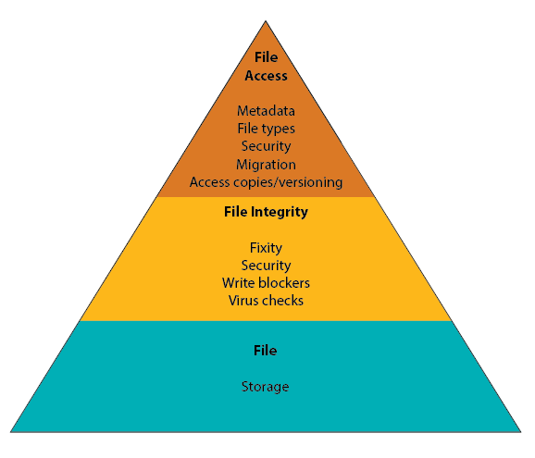
Notes:
Three Essentials of Digital Preservation Pyramid
Broke down digital preservation into 3 essential parts that any Digital Preservation Plan will have to involve
You can look at this pyramid broadly - as an outline of topics that you should plan to learn more about, address in meetings and conversations within your organization, and include in policies.
You can also look at it more in detail, to plan for a workflow for each subtask

Slide 5
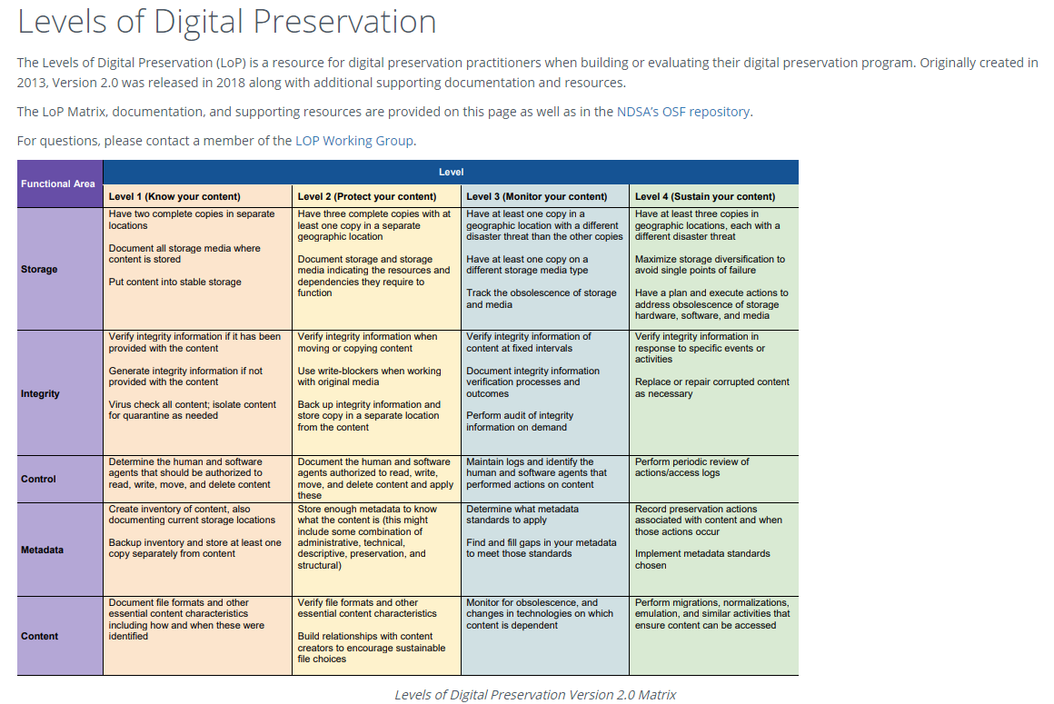
https://ndsa.org/publications/levels-of-digital-preservation/
Notes:
Our pyramid was based (in part) on the National Digital Stewardship Alliances Levels of Digital Preservation - here you can actually see suggested steps to add to a workflow https://ndsa.org/publications/levels-of-digital-preservation/
They have this grid divided into four levels (columns)
Know your content
Protect your content
Monitor your content
Sustain your content
You can start small and build up more and more management and preparedness
Then on the left you can see the rows are these different “functional areas”
Storage
Integrity
Control
Metadata
And Content
See also, the SHN resource Levels of Digital Preservation Preparedness

Slide 6

The 3-2-1 Rule
Notes:
Review of 3 -2 - 1 rule
3 copies of content to be preserved in the long time
Stored on at least 2 types of digital storage media
1 copy should be located in a different disaster area (geographic region)
We call it a rule, but it is really a guideline, your IT departments may have another way that they describe their system of storage and backups, but those concepts are important to include. Making sure you have that minimum in place, or something else that covers it.

Slide 7
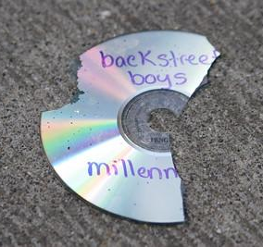
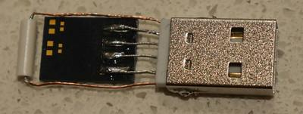
Types of Storage Media
hard disk drives
flash drives
RAID hard drive
cloud/hosted storage
CDs or DVDs
SSD (solid state drives)
LTO Tape
Network Attached Storage
Notes:
Here are some different types of storage as a review
Remember:
Flash drives - fail easily, carry viruses easily
CDs or DVDs- obsolete, not used anymore - many new laptops no longer have an optical drive built in, media AND DATA can degrade without warning
Flash drive image: Miles Goodhew Attribution 2.0 Generic (CC BY 2.0) https://www.flickr.com/photos/m0les/18582870504
CD image: Brian Teutsch Backstreet Broken Attribution 2.0 Generic (CC BY 2.0) https://www.flickr.com/photos/brianteutsch/129913509

Slide 8

Digital Preservation File Integrity
Ensuring your file is viable, usable, and secure
Ensuring your file has not changed over time
Notes:
Ensure that all the work you put into digitizing will be saved in the long term!
Digital preservation should be a conversation throughout your department/institution - if not, you will have to start small and keep at it
Should be considering digital preservation with every digital project that you start

Slide 9
Notes:
File integrity - making sure the file you save and manage stay unchanged, secure, and authentic.

Slide 10
Definitions in File Integrity
Fixity / fixity check
  Stability of digital files over time, tools to monitor fixity using a checksum or digital signature.
Security
  Ensure data cannot be viewed or altered by those without authorization.
Write Blockers
  Tools to prevent alteration or corruption of original digital files upon transfer/ingest.
Virus Scans
  Software processes to detect the presence of viruses in files and systems.
Notes:
Files can degrade WITHOUT warning, on any storage media (some are more dangerous than others) (BIT ROT)
Fixity - fixity checks are how you monitor this issue
Write Blockers allow you to transfer files from another storage media onto your computer without being able to write to the original storage media. There are both hardware and software write blockers.

Slide 11
Integrity - People and Questions
Who do I need to talk to?
IT Department
Staff in your department
Others?
What roles are related to file integrity?
Those responsible for collections management and digital storage
  Digitization and ingest of born digital
Those responsible for system or network security
Those responsible for collection and department security
Notes:
Staff in your department need to know problems to look out for, and the correct procedures for preventing and dealing with issues
Admin, staff that are responsible for digital collections management - eg: department head or collections manager
IT, administration, or if you have someone who handles technology in your department

Slide 12
What do I need to know or find out?
Fixity of files on primary storage media and backups:
  Does your dept./IT already check? If not, set it up.
Security:
  Who has access/permissions to files? Are security logs set up and reviewed?
Virus checks:
  Are regular checks run? What computers and when?
Donations of digital files:
  What is our process when a new born digital collection comes in?
Write blockers:
  Are they used? When?
Notes:
These are topics that you should add into your vocabulary and knowledge base, and then start adding into your digital preservation plan and workflows

Slide 13
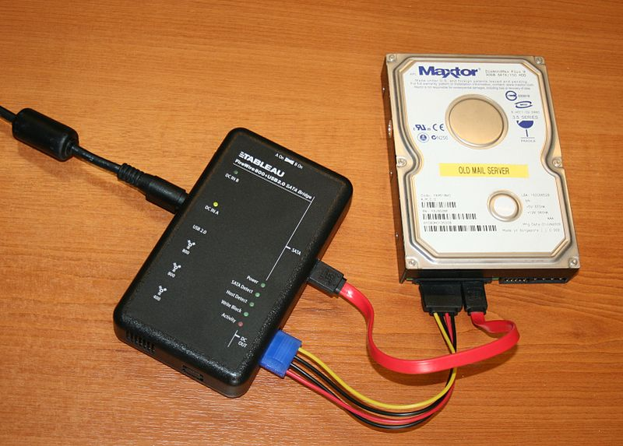
Write Blockers
A digital forensics tool, used to establish authenticity of digital collections and prevent changes during transfer.
Hardware based
Software based
Notes:
Write blockers are a digital forensics tool, used to establish authenticity of digital collections and prevent changes during transfer.
They would fit into a digital files/media accessioning plan - to establish authenticity
Give you more certainty that you or your computer will not accidentally change the file when plugging in a drive or copying over
Hardware - need appropriate connectors (Hardware seems preferred if this is a regular part of your workflow)
Weibetech $350 http://www.cru-inc.com/products/wiebetech/usb-3-0-writeblocker/
Digital Intelligence - Tableau
Software - more variables, more complicated
BitCurator
Let you transfer data from a drive without creating the possibility of accidentally damaging the drive contents.
Can only read and copy, can’t delete or modify
Write Blockers were developed in law enforcement and criminal investigation - where it was really important that authenticity can be proven
ErrantX / Public domain https://commons.wikimedia.org/wiki/File:Portable_forensic_tableau.JPG

Slide 14
DP Activities - File Integrity
Initial Activities
  Inventory existing digital content
  Assess security permissions
  Research tools, equipment, staff, other policies you may want to use in your organization, meetings/conversations
  Create a Digital Preservation Plan that ensures file integrity
Upon Ingest or File Creation
  Run virus checks
  Run fixity checks
Notes:
For file integrity, there are
For more information, see the SHN resource Activities to Include in a Digital Preservation Plan

Slide 15
DP Activities - File Integrity (cont.)
Regularly
  Run fixity checks
  Manage files within your Digital Preservation plan/schedule
  Update software as needed
Less frequently
  Research new tools, equipment, or policies that you may want to use in your organization
Disaster response
  Assess what loss or damage has occurred, follow emergency plan
  Restore from backups
Notes:
For more information, see the SHN resource Activities to Include in a Digital Preservation Plan

Slide 16
Policies and Plans
Digital Preservation Plan
Digital Preservation Policy
Quality Control Workflows
Digital Workflows
  Digitization
  Born Digital
Agreements with IT/other departments
Digital Stewardship Lifecycle
Notes:
Where does digital preservation and file integrity information appear in policies and plans?
You may not have ALL of these policies, plans, and agreements in place right away
A good place to start is a digital preservation plan and workflows
Expand from a section in your policy to a full document/larger section
Important for staff working with digital content

Slide 17
BIT ROT
Data rot, data degradation, digital decay
Gradual corruption of computer data “accumulated non-critical failures in data storage device”
What does BIT ROT look like?
Notes:
Bit Rot - a risk to your digital collections
Other names: Data rot, data degradation, digital decay
Gradual corruption of computer data “accumulated non-critical failures in data storage device”, things that might not make the storage device inaccessible, but tiny failures and issues that build up and cause corruption in your data
Also affects software at the code level

Slide 18
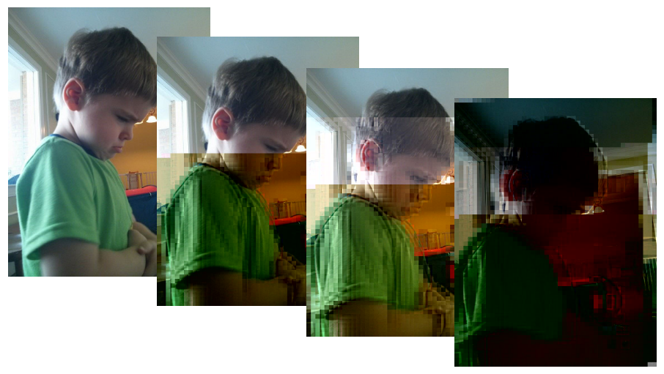
Original image
two bits flipped
three bits flipped
One bit flipped
Two bits flipped
One bit flipped
Notes:
Below are several digital images illustrating data degradation, all consisting of 326,272 bits. The original photo is displayed on the left. In the next image to the right, a single bit was changed from 0 to 1. In the next two images, two and three bits were flipped. On Linux systems, the binary difference between files can be revealed using cmp command (e.g. cmp -b bitrot-original.jpg bitrot-1bit-changed.jpg).
https://en.wikipedia.org/wiki/Data_degradation
Jim Salter / CC BY-SA (https://creativecommons.org/licenses/by-sa/4.0) https://commons.wikimedia.org/wiki/File:Bitrot_cascade.png
From left to right, we see the continuing degradation of a JPEG image as bits are flipped. The left image is the original; each succeeding image has one bit flipped from the last.
This serves as an example of how badly relatively small amounts of damage can degrade a JPEG file's visual presentation.
The full original files, which can be diffed to see the changes between them, are also available beginning at https://commons.wikimedia.org/w/index.php?title=File:Bitrot_in_JPEG_files,_0_bits_flipped.jpg.“”

Slide 19
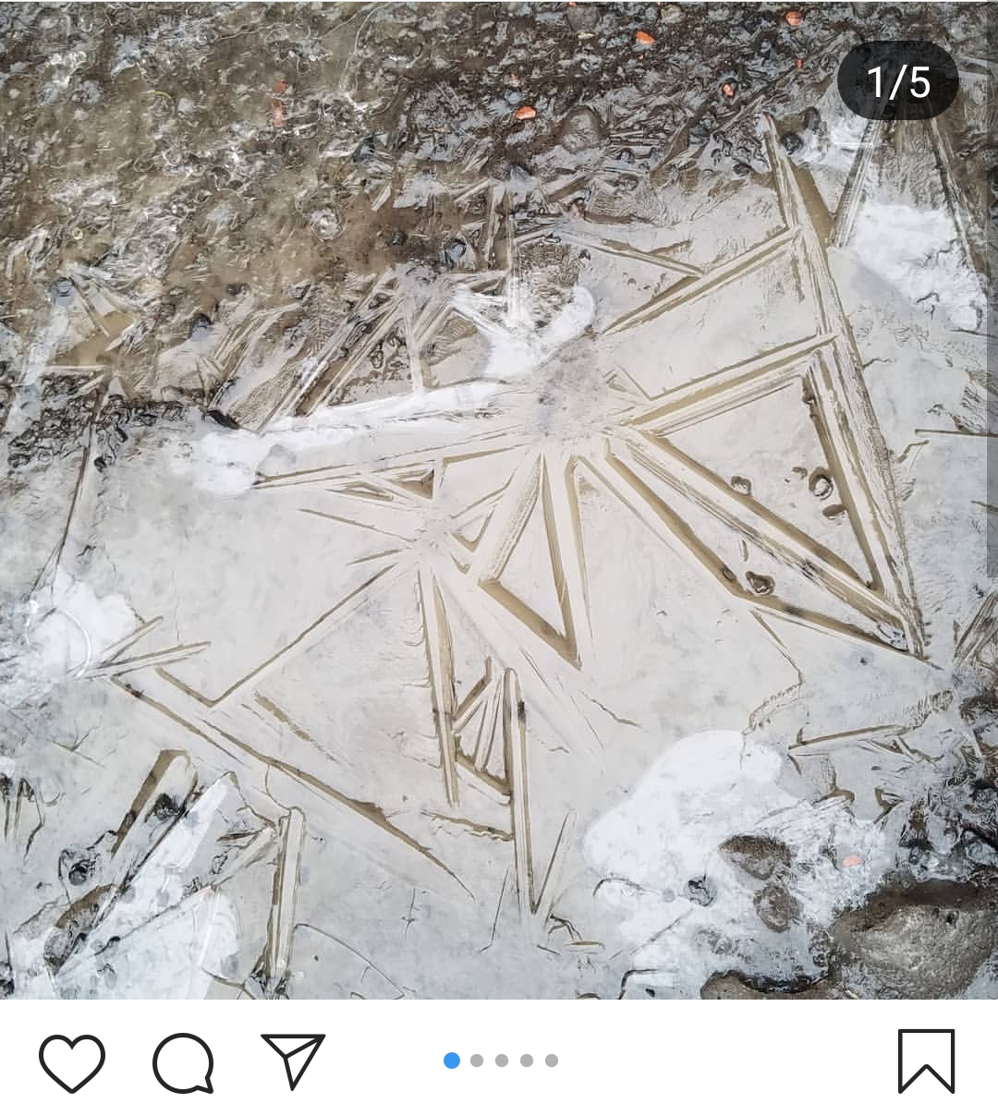
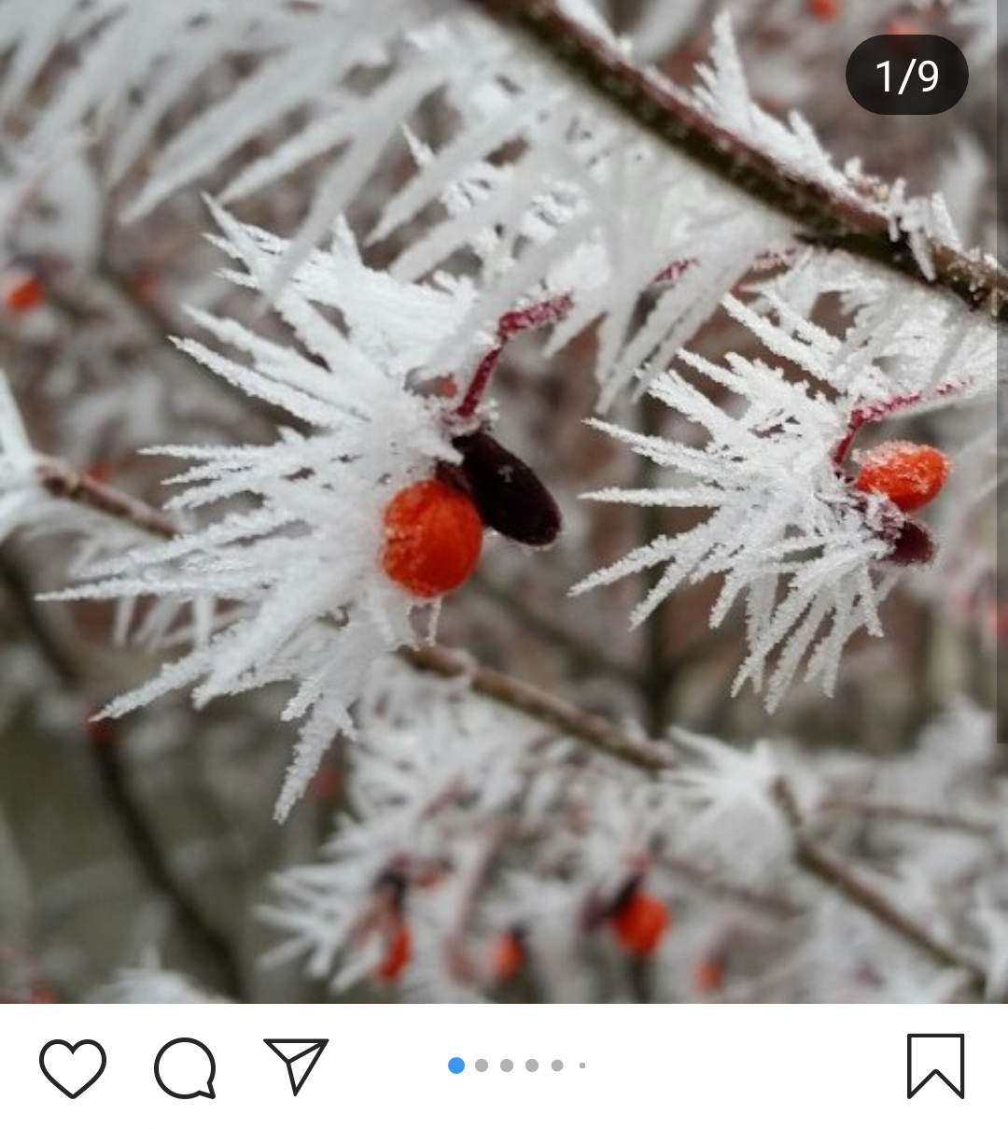
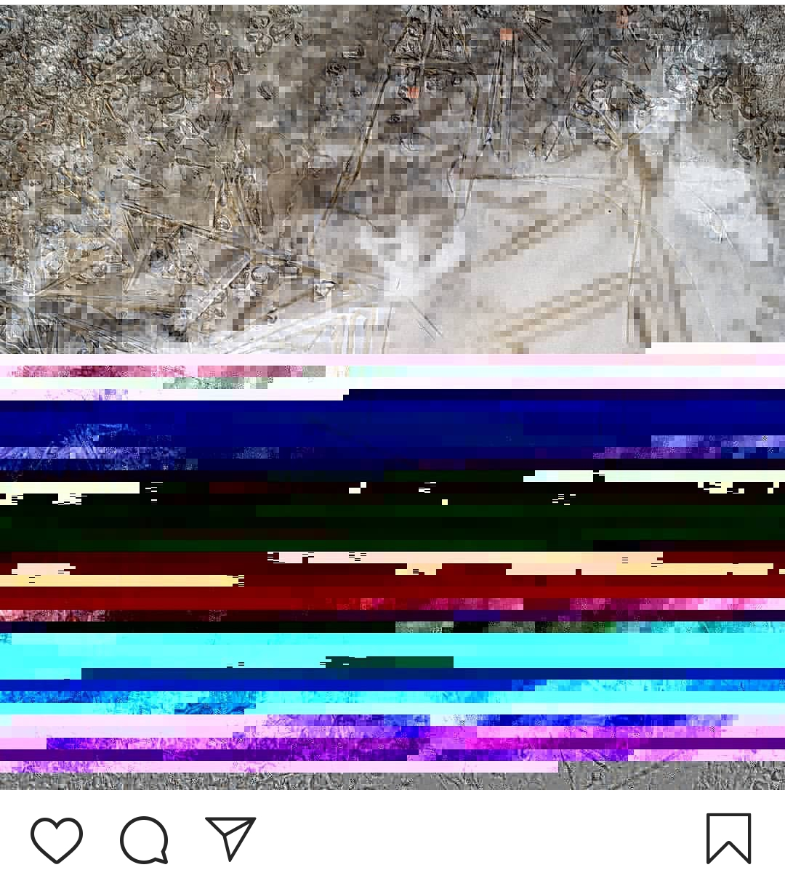
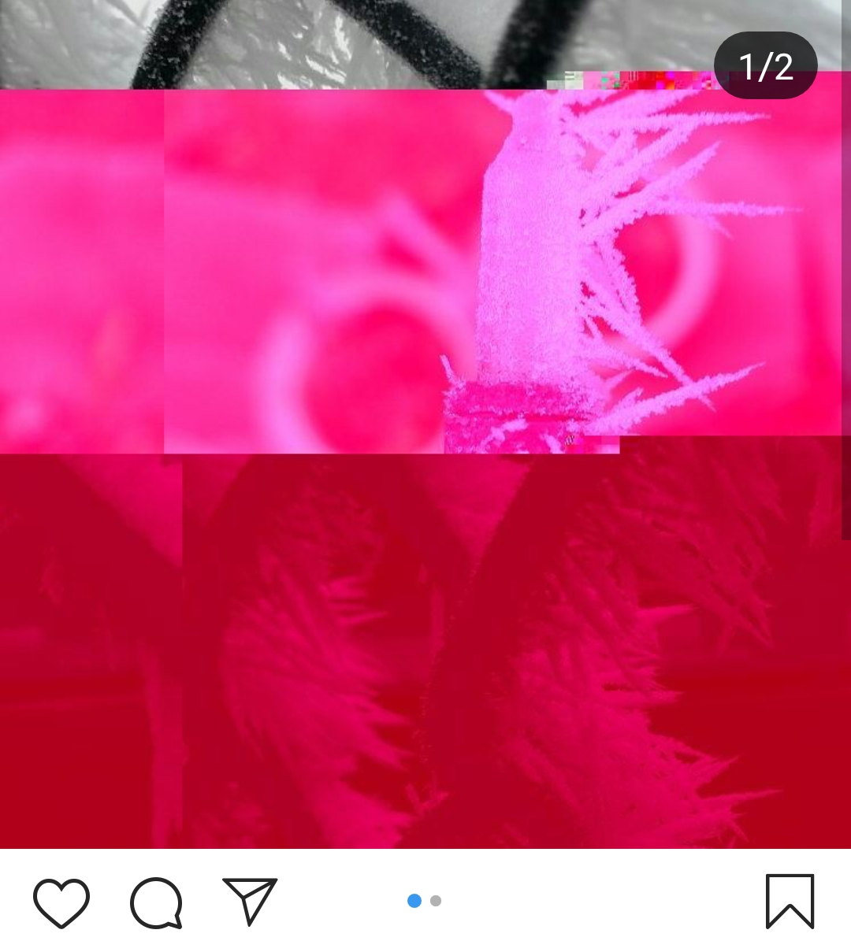
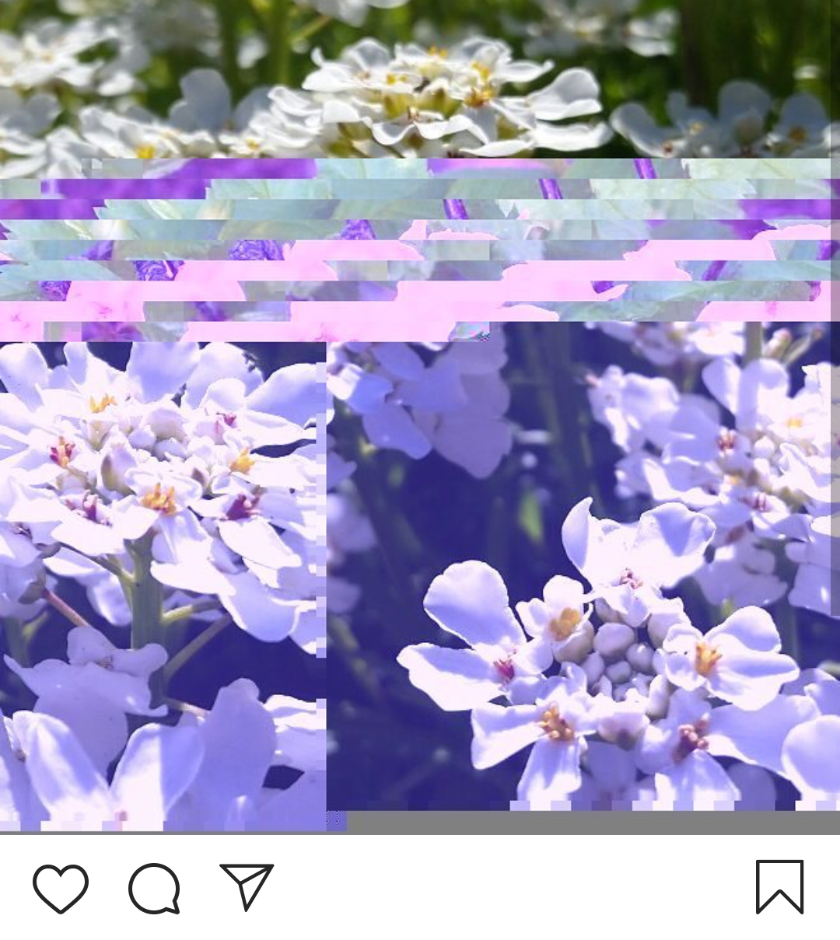
Notes:
Corruption of digital files
Example: instagram copies of posts saved on smartphone, appear pixelated, distorted, colors off
Lotus Norton-Wisla / CC BY-NC-SA (https://creativecommons.org/licenses/by-nc-sa/4.0/)

Slide 20
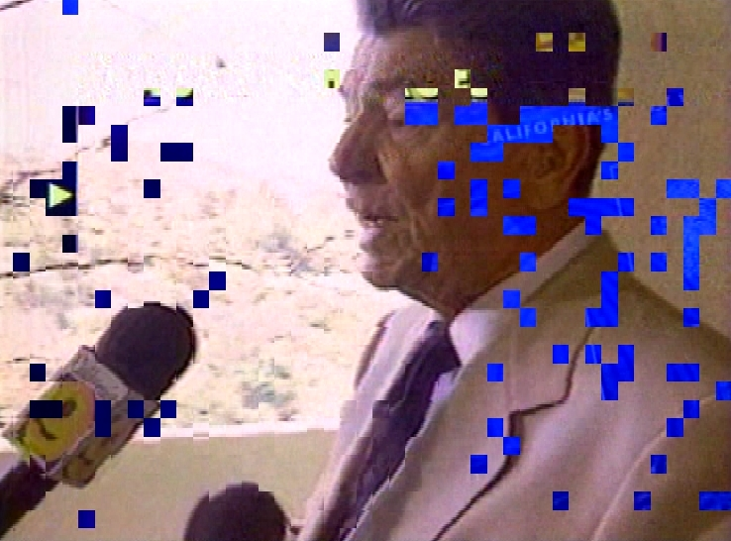
Notes:
Video - pixelation is a type of digital artifact also found in video
Flickr user Wlef70: “Transfer from Betacam SP analog video tape to MPEG-2 digital video created this digital artifact.”
Audio - digital artifacts - clicks and pops
Loss of structure - unopenable
Metadata - corruption of metadata
Wlef70 Reagan pixelated https://creativecommons.org/licenses/by-nc-sa/2.0/ https://www.flickr.com/photos/wlef70/8097509137/
More: Glitch Art
https://www.flickr.com/photos/r00s/3293434558

Slide 21
Levels of Fixity checking
Low effort, simple steps:
  Expected file size, expected file count
Moderate level of effort, high level of detail:
  Simple, lightweight freeware that does a fixity check using an algorithm
  We will use a tool called MD5summer in an activity
    MD5 hash algorithm - low level
High level of effort, high level of detail:
  More complex program (or digital preservation software package) that does a fixity check using more than one algorithm
  SHA1 or SHA256 hash algorithm - high level
Notes:
Low level of effort, low level of detail
Just gloss over Low level and SHA1, focus on what we will be learning (MD5Summer).
File fixity or integrity can be checked using one or a combination of several mechanisms.
The simplest forms of file fixity are expected file size and expected file count.
These checks are used on a regular basis when large amounts of files are being transferred between file systems.
These fixity tools are the easiest to perform, as these checks can be easily read without specialty software, but also generate the least amount detail about the integrity of the files being checked.
As you move up the food chain of fixity checking you see that with a little more effort you can get a high level of detail using a cryptographic hash algorithm.
The lowest level of hash algorithm is MD5, it has the ability to, at least in all of our cases, uniquely identify a file with a string of letters and numbers and is relatively lightweight when it comes to computer overhead.
The highest level of detail available is by using an SHA1 or SHA256 has algorithm…… these two algorithms have a higher level of detail because each file is represented by a longer string of letters and numbers…..
The differences between the MD5 and the SHA is the difference between a 300DPI scan and a 600 or 700 DPI scan. To illustrate what a HASh algorithm does we will use a few normal english phrases…..and push them against a hash algorithm

Slide 22
When do we check for file fixity?
(aka when do we run our checksum tool?)
Best Practice:
Create/Check upon creation of object
Check on a change event (transfer or a recovery event)
Check on a regular interval (monthly, etc..)
Notes:
Need fixity info integrated into a larger Digital Preservation Plan! If your files degrade, you need to find out and act BEFORE that file is backed up incorrectly.

Slide 23
Where is file fixity information stored?
Alongside technical or preservation metadata
Within fixity logs generated by your fixity checking software
Within the digital object itself
Notes:
It can be treated as a part of the technical or preservation metadata and stored within the metadata record in the repository or content management system where the digital object resides.External fixity logs can be generated by software packages that include all component parts of a fixity check, the location of the file on the filesystem, the resultant hash of that file, the last time fixity was checked for that file and whether it passed. The screenshot below is from a Fixity report generated by the Fixity software distributed by the AVPreserve.
Some folks try to store fixity information within the object itself. This is a complicated endeavor as it means the fixity check must only select certain parts of the file to feck file integrity or a wrapper based file format like MXF could be used. This is not for the faint of heart.

Slide 24
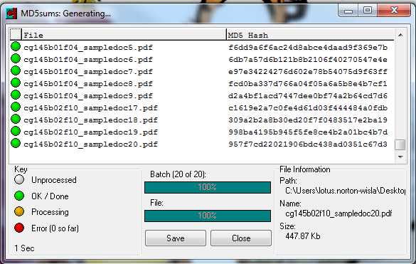

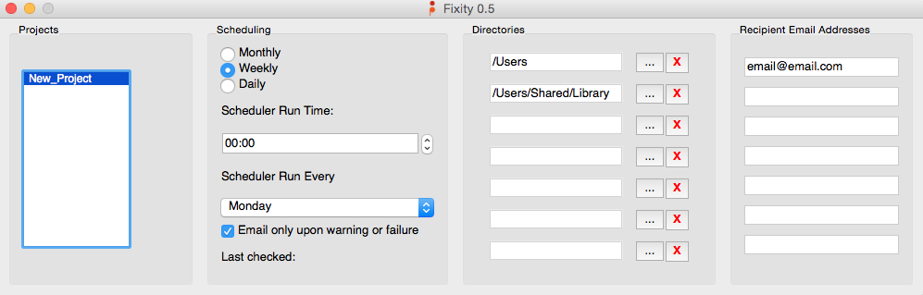

MD5Summer
Fixity
Notes:
These are come free tools to start testing out fixity software and understanding how you might create and verify checksums in your own institution.
Available on the SHN - demonstration of MD5Summer http://www.md5summer.org/
Available on weareavp.com - demonstration and webinar on Fixity

Slide 25
Digital Preservation Standards
OAIS Model (ISO 14721:2012)
  Open Archival Information System reference model
  Conceptual framework, widely accepted
TRAC
  Trustworthy Repositories Audit & Certification
Audit and Certification of Trustworthy Digital Repositories (ISO 16363:2012)
NDSA Levels of Preservation
  National Digital Stewardship Alliance
PREMIS
  PREservation Metadata: Implementation Strategies
Notes:
These are some important concepts to learn more about, reference in your policies and plans, and base your own actions and thinking on - though you will have some things that are specific to your own institution and needs

Slide 26
Other Resources
NEDCC - Digital Preservation Assessment
Digital POWRR https://digitalpowrr.niu.edu/
NCDCR http://digitalpreservation.ncdcr.gov/
The Signal blog https://blogs.loc.gov/thesignal/
Digital Preservation Q&A https://qanda.digipres.org/
Digital Preservation Coalition http://dcponline.org
National Digital Stewardship Alliance http://ndsa.org
https://groups.google.com/forum/#!forum/digital-curation
Listservs on Digital Preservation Topics (ALA, SAA, code4lib)
The Digital Archives Handbook: A Guide to Creation, Management, and Preservation
Notes:
Here are some places to learn and stay informed. The digital preservation community is growing, and it is a good idea to keep updated on this information.
UK resource: https://www.jiscmail.ac.uk/cgi-bin/webadmin?A0=digital-preservation

Slide 27

Discuss or Reflect
What are a few top concerns or questions about file integrity?
Do you currently have a way to monitor fixity of files?
Notes:
Take 20-30 minutes and discuss with others, or reflect by yourself and take notes
What are a few top concerns you have about digital file integrity and preservation? Based on what you have learned so far.
Is there anything that you already do in your institution to maintain integrity of files?
Is there anything you are particularly worried about?
Have you ever seen examples of “bit rot” or data degradation in your work or personal files?
Do you think that using a write blocker is a low or high priority for your department?
Do you currently have a way to monitor fixity of files?
If yes, how is this done?
Would it be helpful to add on anything to your process?
If not, how might you start monitoring file fixity?

Slide 28
Over the next months:
Think about WHO has access to file storage
Take stock of WHAT you already know about file integrity
List things that you want to FIND OUT about file integrity and preservation
Digital Preservation Questions Worksheet Part 2: File Integrity
Notes:
Complete the SHN resource Digital Preservation Questions Worksheet Part 2: File Integrity to get some helpful questions and discussion started around this topic. Bring others into the conversation

Slide 29
Credits: Images
  Slide 4: Center for Digital Scholarship and Curation, Lotus Norton-Wisla, Michael Wynne, Alex Merrill
  Slide 5: NDSA image https://ndsa.org/publications/levels-of-digital-preservation/
  Slide 7: Flash drive image: Miles Goodhew Attribution 2.0 Generic (CC BY 2.0) https://www.flickr.com/photos/m0les/18582870504; CD image: Brian Teutsch Backstreet Broken Attribution 2.0 Generic (CC BY 2.0) https://www.flickr.com/photos/brianteutsch/129913509
  Slide 13: ErrantX / Public domain https://commons.wikimedia.org/wiki/File:Portable_forensic_tableau.JPG
  Slide 18: Jim Salter / CC BY-SA (https://creativecommons.org/licenses/by-sa/4.0) https://commons.wikimedia.org/wiki/File:Bitrot_cascade.png
  Slide 19: All images: Lotus Norton-Wisla / CC BY-NC-SA (https://creativecommons.org/licenses/by-nc-sa/4.0/)
  Slide 20: Wlef70 Reagan pixelated https://creativecommons.org/licenses/by-nc-sa/2.0/ https://www.flickr.com/photos/wlef70/8097509137/
  Slide 24: www.md5summer.org ; www.weareavp.com

Slide 30
Credits: Presentation
Presentation template by SlidesCarnival.
Minicons by Webalys
This template is free to use under Creative Commons Attribution license.
These slides contain changes to color scheme and content.

Slide 31
Using this Resource
The Digital Stewardship Curriculum is an Open Educational Resource created by the Center for Digital Scholarship and Curation.
All presentations and resources created by the CDSC are licensed under a Creative Commons Attribution-NonCommercial-ShareAlike 4.0 license (CC BY-NC-SA). Please share, reuse, and adapt the resources and provide attribution to the Center for Digital Scholarship and Curation, Washington State University.

