Slide 1
Mukurtu CMS Introduction
Digital Stewardship Curriculum

Slide 2
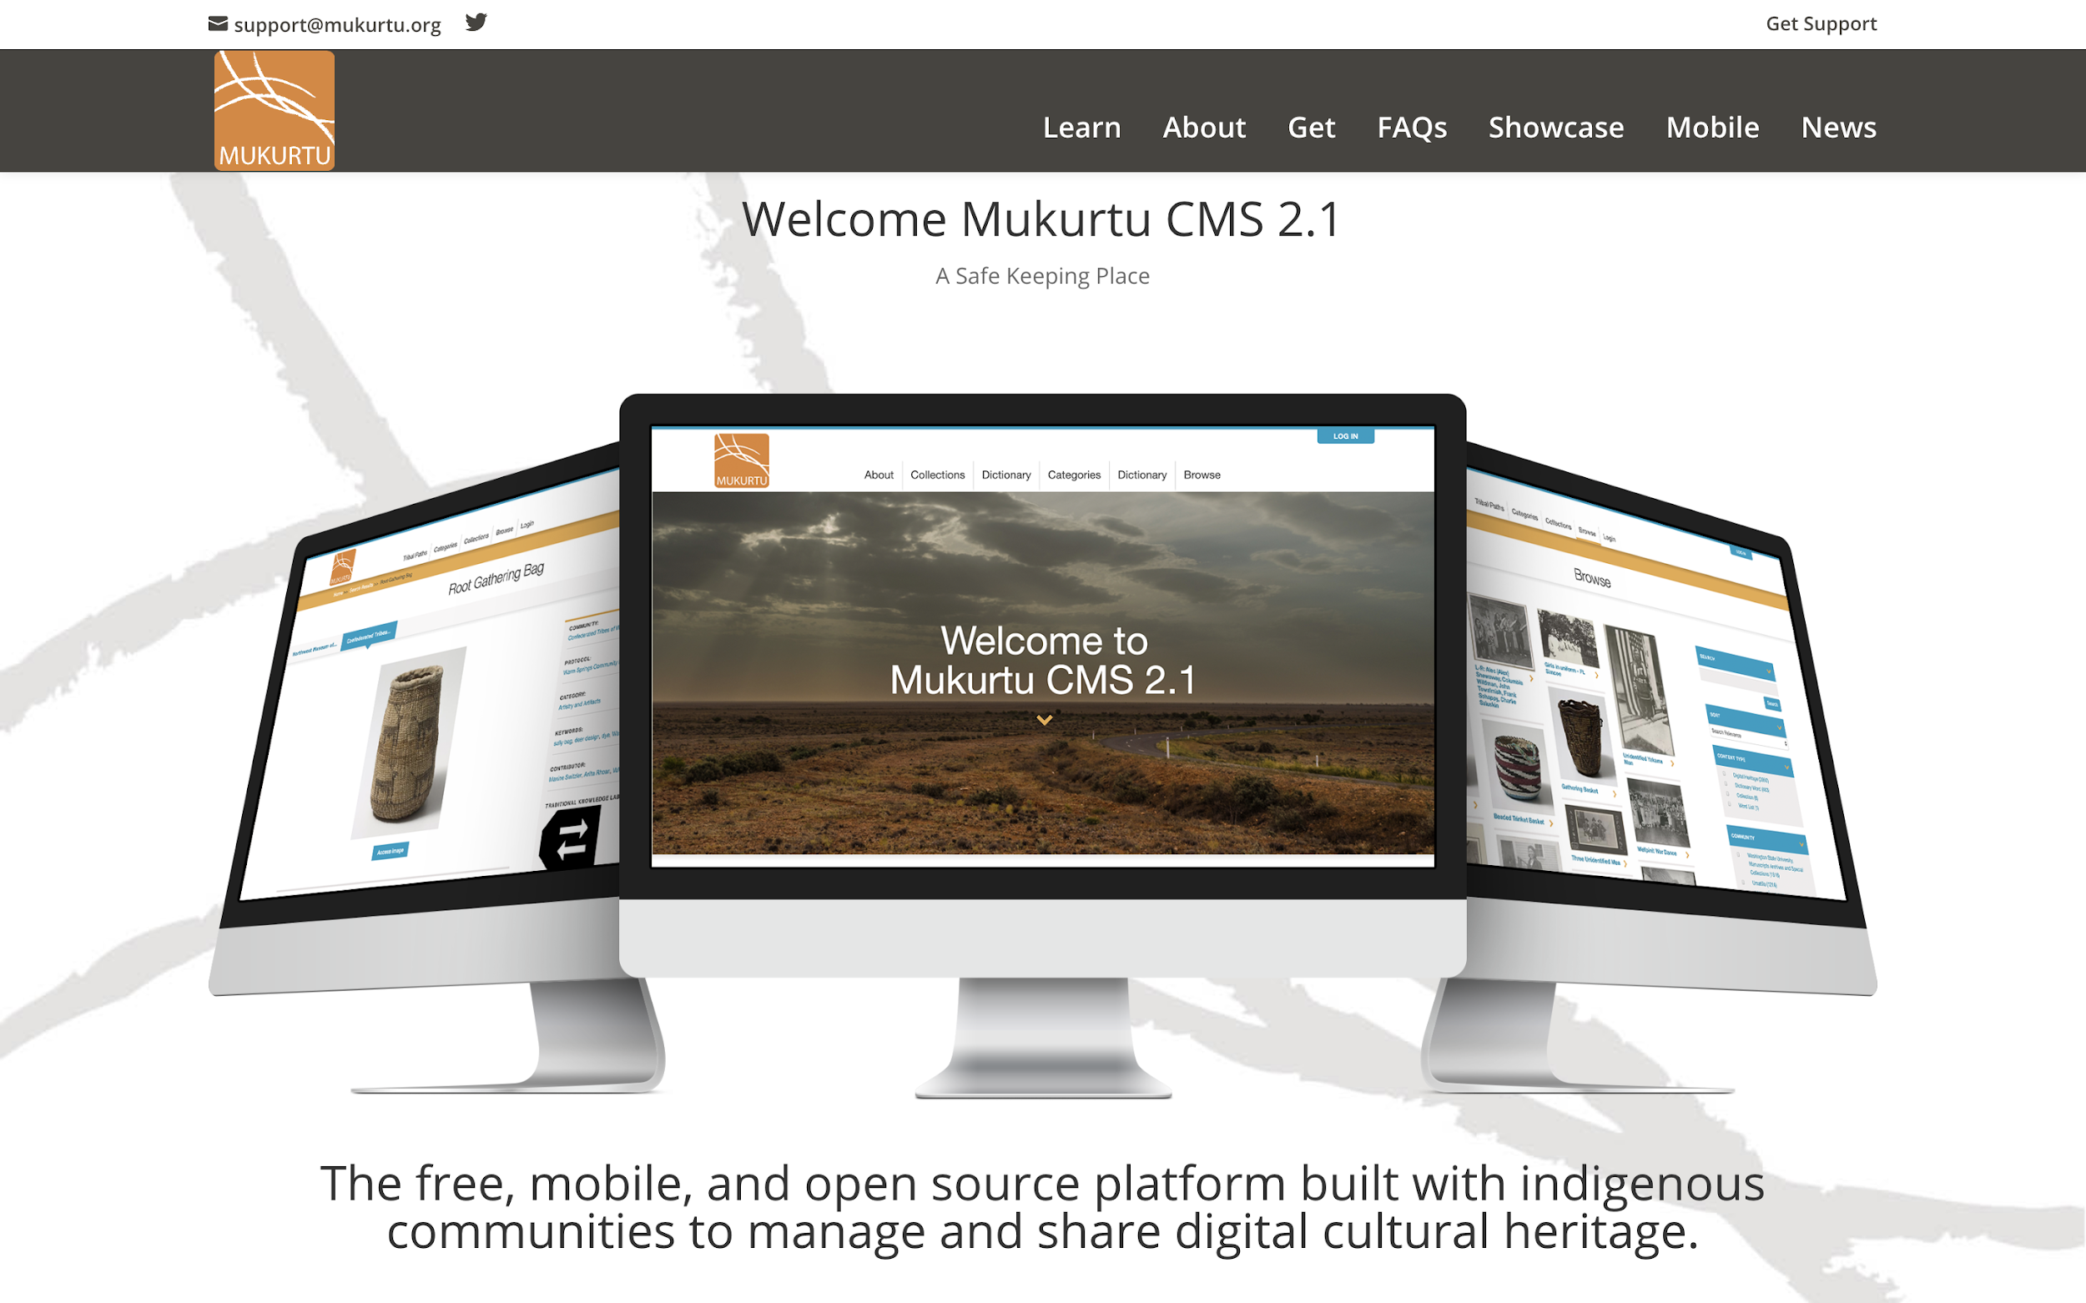
Notes:
Mukurtu CMS is a grassroots, open-source project aiming to empower communities to manage, share, narrate, and exchange their digital heritage in culturally relevant and ethically-minded ways.
A bit more specifically, it’s developed as an access platform that exists within a larger digital preservation ecosystem.
Ideally users of Mukurtu CMS are following archival or digital preservation best practices to keep their material safe, and Mukurtu is one way to provide users access to that material.

Slide 3
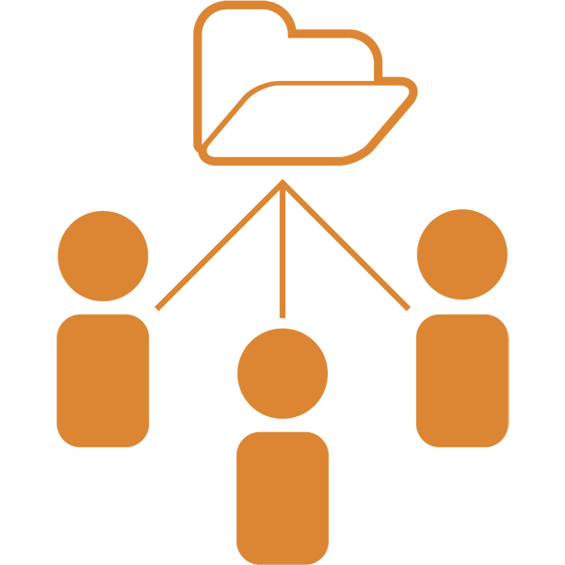
Mukurtu Core Features
Cultural Protocols
Community Records
Roundtrip
Traditional Knowledge Labels
Notes:
Mukurtu has some core features that set it apart from other platforms – We’ll come back to most of these in more detail as we go:
Flexible cultural protocols— that allows you to determine access
Extended Community records to provide layered knowledge and narratives
A suite of tools we call “roundtrip” that provide non-proprietary import and export
And finally, the Traditional Knowledge Labels, which Lotus will cover later in depth.

Slide 4
Mukurtu Then and Now
Notes:
Some background on how Mukurtu began so you can get idea of our priorities and principles— what shapes not just the platform, but our commitment to its underlying philosophy and along the way
The hope is that you’ll see not just HOW Mukurtu works but WHY it works the way it does.
Mukurtu grew from...

Slide 5
Notes:
Collaborations with the the Warumungu Aboriginal community in Central Australia.
In 1995 when Dr. Kimberly Christen was a graduate student she began working with a group of Warumungu women. The women invited her to record songs and stories about their homelands and traditions with the express intent of passing these recordings on to their children and grandchildren. They specifically asked her to record audio and video of places they were raised, stories of their ancestors, songs about their countries, and the many languages they spoke.

Slide 6
Nyinkka Nyunyu Art
and Culture Centre
Tennant Creek, N.T., Australia
Gand opening
Nyinkka site
Notes:
By 2002 when Dr. Christen was writing her dissertation, she was also working with community members and traditional owners as they were building the Nyinkka Nyunyu Art and Culture Centre in town
The Centre is built on the site of a very important ancestral dreaming track — that of the Nyinkka — or the spiky tailed goanna.
As part of this collaboration, they were creating long term exhibits
As part of that, they had been to several national archives and museums

Slide 7
Warumungu community members
South Australian Museum
Notes:
At these archives and museums, they viewed Warumungu materials with the goal of repatriating some of these physical materials for the community.
On one trip back from the National Archives in Darwin the group (including Dr. Christen) decided to stop at a former missionaries house—many of the community members remembered him fondly from his time in Tennant Creek in the late 70s and early 80s. It turned out that he was in possession of the entire collection of photos from the church from the 1930s-1980s.
This was a community history that no one in the community had actually ever seen before.
With some trepidation, Dr. Christen loaded the 700 images on to my laptop and the group took them back to Tennant Creek.

Slide 8
Notes:
As she took these photos around to people’s homes and camps, it became evident that these digital images needed to be managed in a similar way to physical materials— in particular, as she sat with Michael Jampin Jones an elder in the community (second from left in the picture here)— he made it clear that these photos needed to be managed within the existing social and cultural protocols the community ALREADY has for viewing and circulating cultural materials.
In the community archive room at Nyinkka Nyunyu Jampin had already implemented an offline system for ensuring these protocols were followed

Slide 9
Analog Permissions
Nyinkka Nyunyu Art and Cultre Centre, Tennant Creek, NT, Australia
photo by Kimberly Christen
Notes:
These protocols exist in daily interactions, and sometimes in physical ways too.
You can see here it is clear from this file cabinet that contains archival materials that PERMISSION APPLIES > this is for MEN ONLY.
This is a community protocol for knowledge access, exchange, and circulation.
Mr Jones wanted this same notion of permissions and community access for the digital materials the center was getting back, and for materials they would continue to receive and produce.
That’s where Mukurtu came in…

Slide 10
continuum of access and obligations
death
kin group
open
closed
gender
ritual status
country
Notes:
In Aboriginal English Warumungu people will say that rituals or places, knowledge or information, may be open or closed, but these are rarely all-or-nothing statements
Instead their is a continuum of access and use based on several factors including: death, ritual status, one’s country, kin group and gender. All of these factors interrelate to determine VARIED and MULTIPLE types of access
So for example, some songs may only be accessible to and only sung by women of a particular kin group and initiated in certain ritual knowledge
or a waterhole may be only used and cared for by members of groups who share ritual responsibility and ancestral knowledge to maintain the site...and so on…
the point is that these factors combine to produce the protocols for seeing, hearing and acting RESPONSIBLY…
Jampin named the platform they were creating together “Mukurtu”

Slide 11
Mukurtu:
‘A Safe Keeping Place’
dilly bag
South Australian Museum
Notes:
Mukurtu means dilly bag in Warumungu — Mr Jampin Jones chose this as the name for the archive because they are safe keeping places managed by the elders.
The name was used for the Warumungu archive, but also granted for use with the platform as a whole and it is that notion of a safe keeping place — using LOCAL PROTOCOLS FOR ACCESS based on COMMUNITY RELATIONS — that drives the foundation of the site.

Slide 12
Notes:
The original Mukurtu Wumpurrani-kari archive was a stand alone system built with Warumungu protocols for viewing and circulating cultural materials — beginning with that first set of photos from the missionary.

Slide 13
Notes:
their “My Family Items” page— It was crucial that all materials be associated with families because family is a main factor in the circulation of knowledge and the community wanted to reflect that in the archive.
For all the material in the site we used these protocols to define access

Slide 14
Notes:
We called these sharing protocols to define how each item could be viewed and circulated.
For each item (and we started with those 700 photos from the missionary) we attached protocols the community defined:
men or women only,
elders only
which family or families and finally what
country [physical places in the landscape] and these could be mixed and matched so you can have very granular levels of access— say, for example only elder women from two families.

Slide 15
Notes:
In addition to access the community also wanted to be able to add knowledge — to share their own stories about these photos that they had never seen
For each image, people who have access can add their own stories, as well as information about the photos such as people’s names and country names and community affiliations.

Slide 16
Notes:
Similarly, people who have permission can add more information
You can see the list of comments here and you can see that they are attributed to specific people which was important that knowledge be named
It was very important for the community to be able to create place where dialogue could happen about these community and family histories.
The design of this first iteration of Mukurtu put into place existing cultural protocols in a digital environment.
Around this same time Dr. Christen was at WSU and started working more closely with our Native Programs office and the Plateau Center for American Indian Studies [next]

Slide 17
Notes:
In 2008, the Native American Advisory board approached Dr. Christen and Libraries colleagues about providing access to Plateau materials that were held in WSU in our libraries, archives and special collections.
This work was a based on an MOU that WSU has with 12 tribal nations in the quad state region
We have seen many communities use MOUs as a way to guide collaborations with non-Native institutions to gain access to materials using Mukurtu.
In this case, we began by listening to the Native American Advisory Board when they described how they wanted ACCESS to their collections. Specifically what they wanted was a multi-tribal portal (had to be inclusive) and the Portal that had to be
online (tribal members across states could access)
include library/museum/and archival collections (one stop shop)
incorporate many types of Native knowledge about the content at the item level
Had to foreground Tribal decision making over content and access
To begin then, we worked with tribal representatives to define the pathways for content to be accessed [next]

Slide 18
Notes:
It was essential to ground the collections in their homelands. The representatives we worked with chose the Columbia river as the backdrop to foreground their connectedness as Plateau peoples.
And each nation has its own path for their tribal content to highlight their sovereignty as individual nations.
Tribal administrators —chosen by their own internal governing principles — then manage and curate content that is related to them, and they decide to share content across communities as they choose.
So each tribe has a community page

Slide 19
Notes:
Here you can see the Coeur d’Alene Tribe’s page.
The community page allows each tribe to define their community path…

Slide 20
Notes:
A Tribal Path can include individual welcomes in text and audio or video - hearing the language and seeing the land, water and trees are a powerful reminder that the all this material is PART of this landscape and part of the community.
There are also lists of current protocols for access (right)…this shows the PUBLIC ACCESS protocol—that is, there is no default to public access for any content, tribes decide how they want to share — and PUBLIC is one way of sharing.
So in order to follow tribal protocols for access, before any digitization of content, we at the Portal project started with the physical materials.

Slide 21
Notes:
Our workflow is defined by a collaborative curation model that begins with tribal members selecting materials to be digitized from local, national and regional archives— we do not digitize or display any content without approval.
For us Mukurtu is more than a digital archive platform, it encompasses all aspects of the initial impetus from Michael Jampin Jones— that is to provide a safe keeping place. Part of that is focusing on community voices and knowledge and respecting the process of defining what SHOULD and SHOULD not be digitized.

Slide 22
Digital Heritage Items

Slide 23
DIGITAL HERITAGE ITEMS
Media assets + metadata
Community records
Relationships between content
Notes:
Digital Heritage(DH) items are at their core a combination of media and metadata to tell a story — they move beyond the notion of one item or one record to allow for more context and relationships.
They can be a wide range of media formats (several options for image, audio, video, and documents), and the metadata schema is an extended Dublin Core that we call Mukurtu Core.
Crucially, DH items allow for many layers of narration, and the interrelation of content across the site.

Slide 24
Notes:
This is what we call a what we call a digital heritage item in Mukurtu and on the top you can see tabs for each record for this one basket, in this case there are 2 records.
This basket is currently housed at the NW MAC, it was chosen by the Warm Springs community to be digitized for inclusion in the Portal. Here we see the museum record, and it has pretty standard museum metadata on right:
the title “root gathering bag” and a
a rights field with the Museum as the rights holder, and a fairly standard description “round, twined, cylindrical bag. Hemp and cotton weft…with animal figures”
Through a process of collaborative curation with Confederarted Tribes of Warm Springs community members, we get a community record, so as we tab across the top (the current screen shows the NW MAC record, and the next will show the Confederated Tribes of Warm Springs community record)

Slide 25
Notes:
We come to the Warm Springs record, now we have
a title added by the tribal reps, “Wasco Man Basket”
the…community named “confederated tribes of WS”
protocols for access — in this case PUBLIC
keywords chosen to help community members find materials
contributors all named tribal members
And a TK label:in this case an attribution label so that it is not the Museum being named as the knowledge holder but the WS community
And finally cultural narratives and Traditional Knowledge by named community members. Importantly, in these fields you can add audio/video.

Slide 26
Notes:
Can view the video here recorded with Arlita Rhoan, Maxine Switzler, and Valerie Switzler https://plateauportal.libraries.wsu.edu/digital-heritage/root-gathering-bag-6
This is why I see Mukurtu as a social tool…it allows for and encourages dialogue and engagement while at the same time recognizing there are different cultural values and needs embedded in these invaluable materials.
Instead of hiding these relationships behind short, sterile descriptions and defaulting to open access, Mukurtu makes explicit that cultural belongings are a part of living traditions.
And an important part of this is to recognize and acknowledge that these materials often got into our institutions in dubious ways.

Slide 27
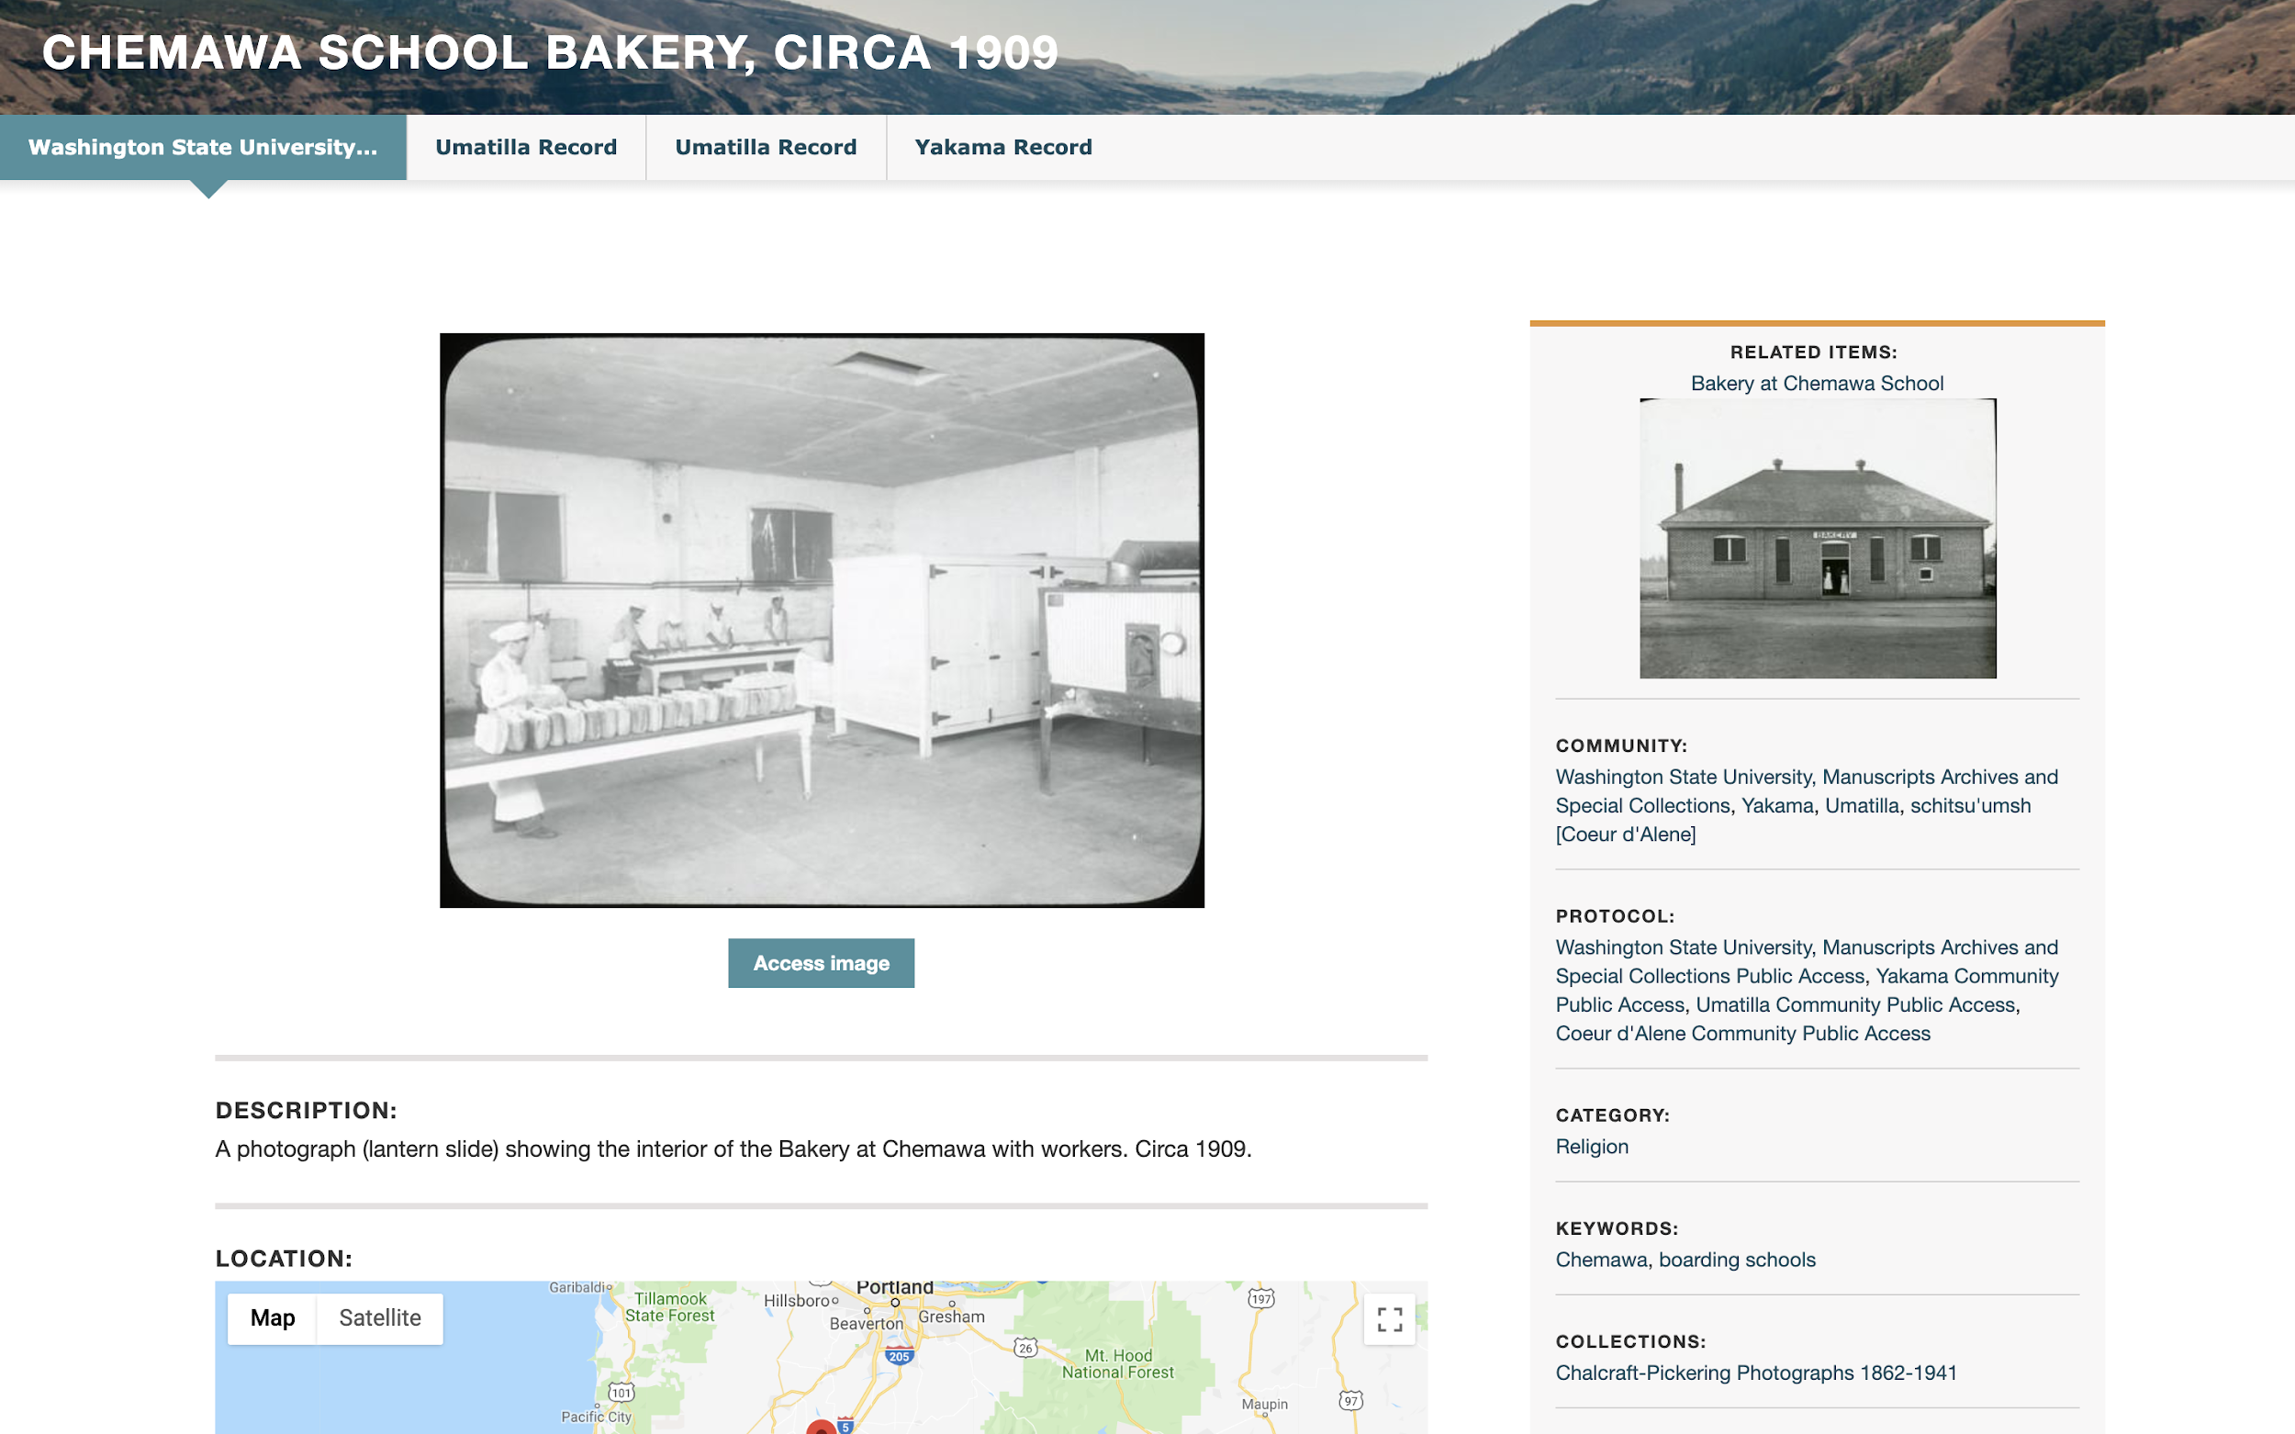
Notes:
One of the most important Mukurtu tools is Community records like we just saw with the Wasco Man basket.
This is from a set of 13 lantern slides from the Chemawa Boarding school which held Native children from across the country we see the University record — plus three tribal records two from different Umatilla elders who were at Chemawa as children and one Yakama woman.
NOTE each can have their own distinct protocols, so users may be able to see all, some, or none, depending on their permissions.

Slide 28
Notes:
In one of the Umatilla records we see the use of audio in the cultural narrative field
There is a recorded audio narrative from Percy Bingham, an Elder who lived at the Chemawa boarding school in his youth

Slide 29
Notes:
This is from the Huna Heritage Foundation in Alaska for the Hoonah community - they’re using their community knowledge as the primary record, and then adding contributions from other institutions as the community records…
This is a really important point. When we talk about “Community” records, that means a Mukurtu community. When planning a site, consider how this layout reflects the needs of your stakeholders and users.
This is the Hoonah record

Slide 30
Notes:
This is the Glacier Bay National Park Service record, which was shared on the site with permission and through collaboration and outreach by the HHF Director.

Slide 31
Communities, Cultural Protocols, Categories
Notes:
Within Mukurtu, we have what call the Three Cs…
Communities, Cultural Protocols, and Categories
These are structural elements that are required for every Mukurtu site — ALL digital heritage items are filtered through these

Slide 32
COMMUNITIES
CULTURAL PROTOCOLS
CATEGORIES
“Who”
Contributors and Users
“How”
Access and Sharing
“What”
Description and Discovery
Notes:
Communities are the WHO of Mukurtu. They are groups of contributors and users, and identify where content OR knowledge comes from.
Cultural protocols are the “HOW” of Mukurtu. They are how users access content provided by contributors.
Categories are the “What”. They are descriptive terms to enable discovery.

Slide 33
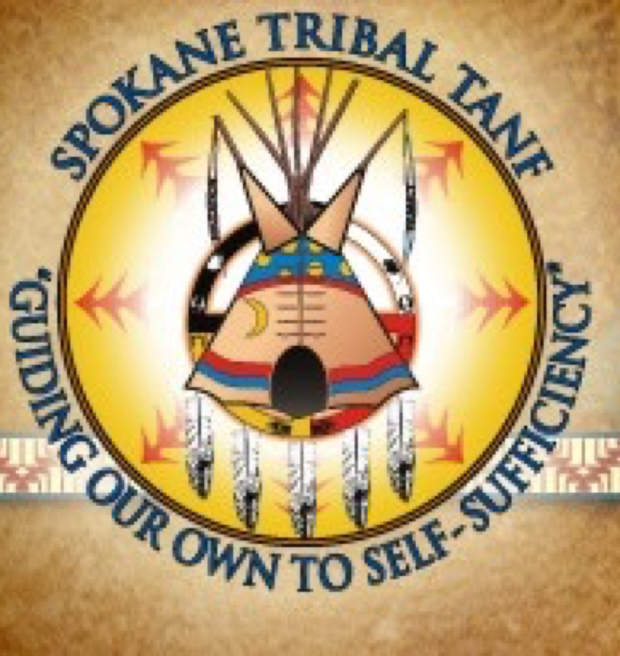
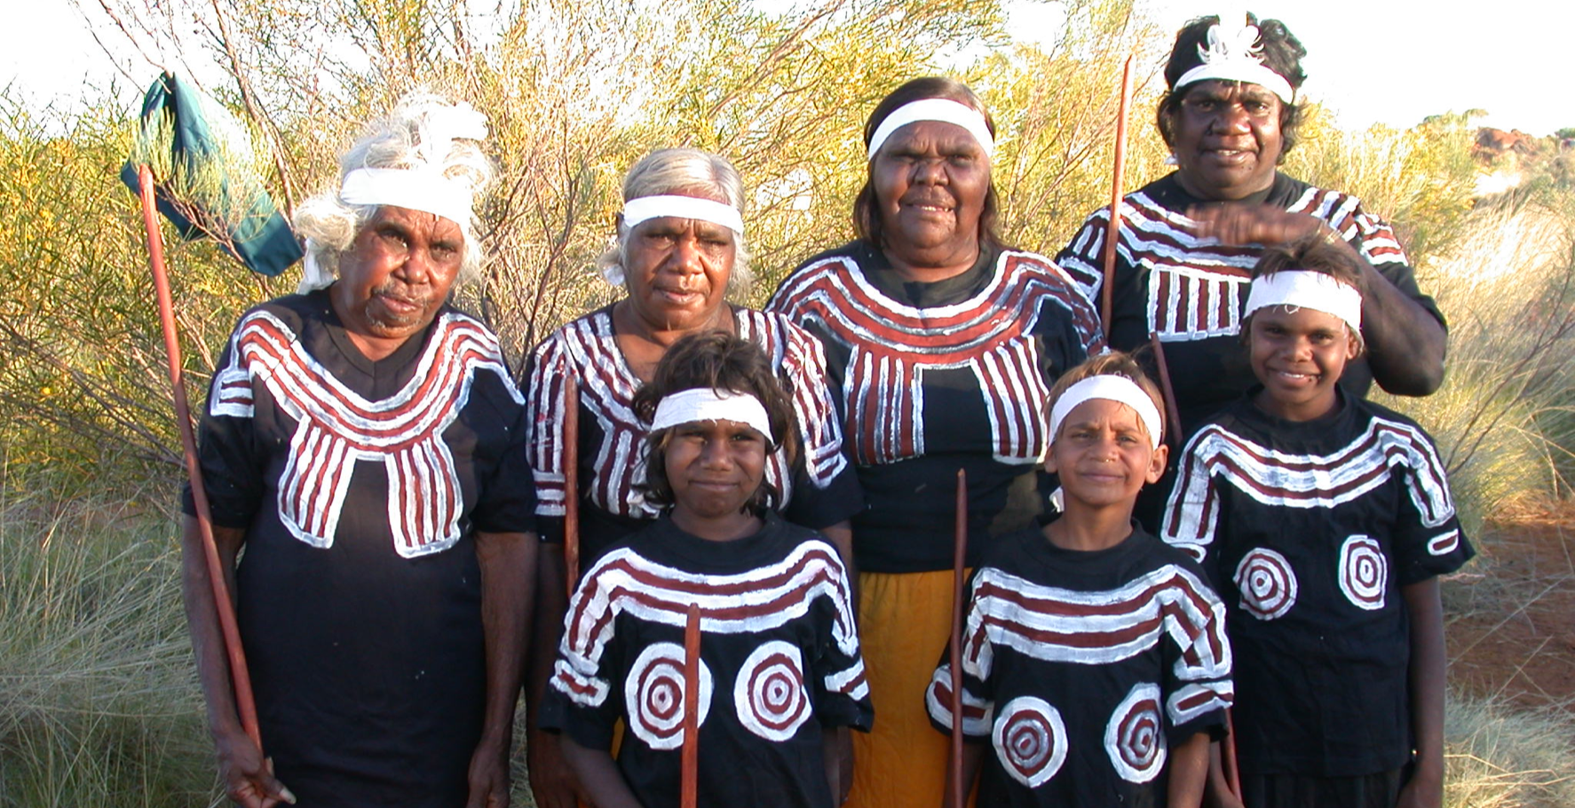
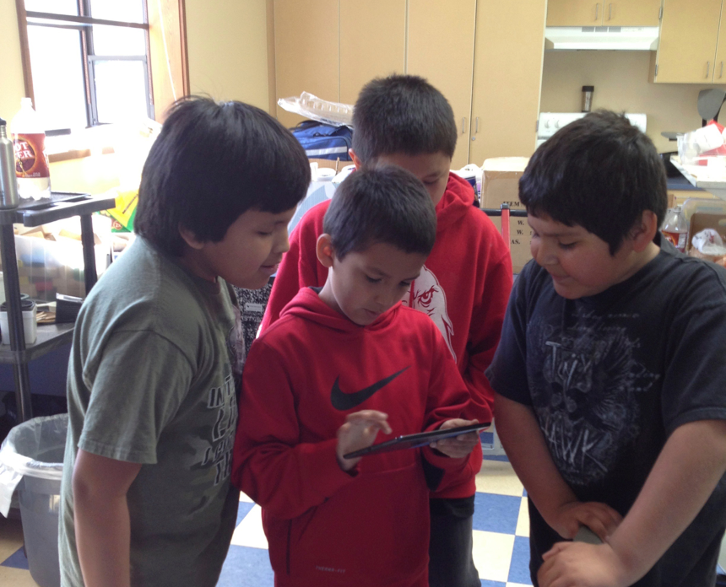
Communities
GROUPS OF SITE USERS AND CONTRIBUTORS
Notes:
Communities are groups of people contributing to a site— by providing content or knowledge.
Communities then, are, broadly speaking, groups of contributors who will determine what access is appropriate for their contributions. The Mukurtu meaning of big-C Community doesn’t necessarily directly map to tribal or native communities —
Communities can be large or small — a class, a family, a project team, as well as a clan, a tribal government department, scholars, donors, participating institutions. A site can have as many as needed, and most users will be members of more than one community.
We’ve seen sites where content only comes from a single tribe and only needed one community. We’ve seen sites based around hundreds of families. It’s always flexible.

Slide 34
Notes:
For example in the PPWP….
Started with 3 communities for first two years then to 6 communities by year 6 and now in year 12 (2020) there are currently 8 participating tribes.
They are foregrounded here on the front page because as a conscious decision in our design phase— the Columbia river represents what unites all Plateau tribes and the tribes define their sovereign status.
But there are many more “communities” on the Portal on the back end

Slide 35
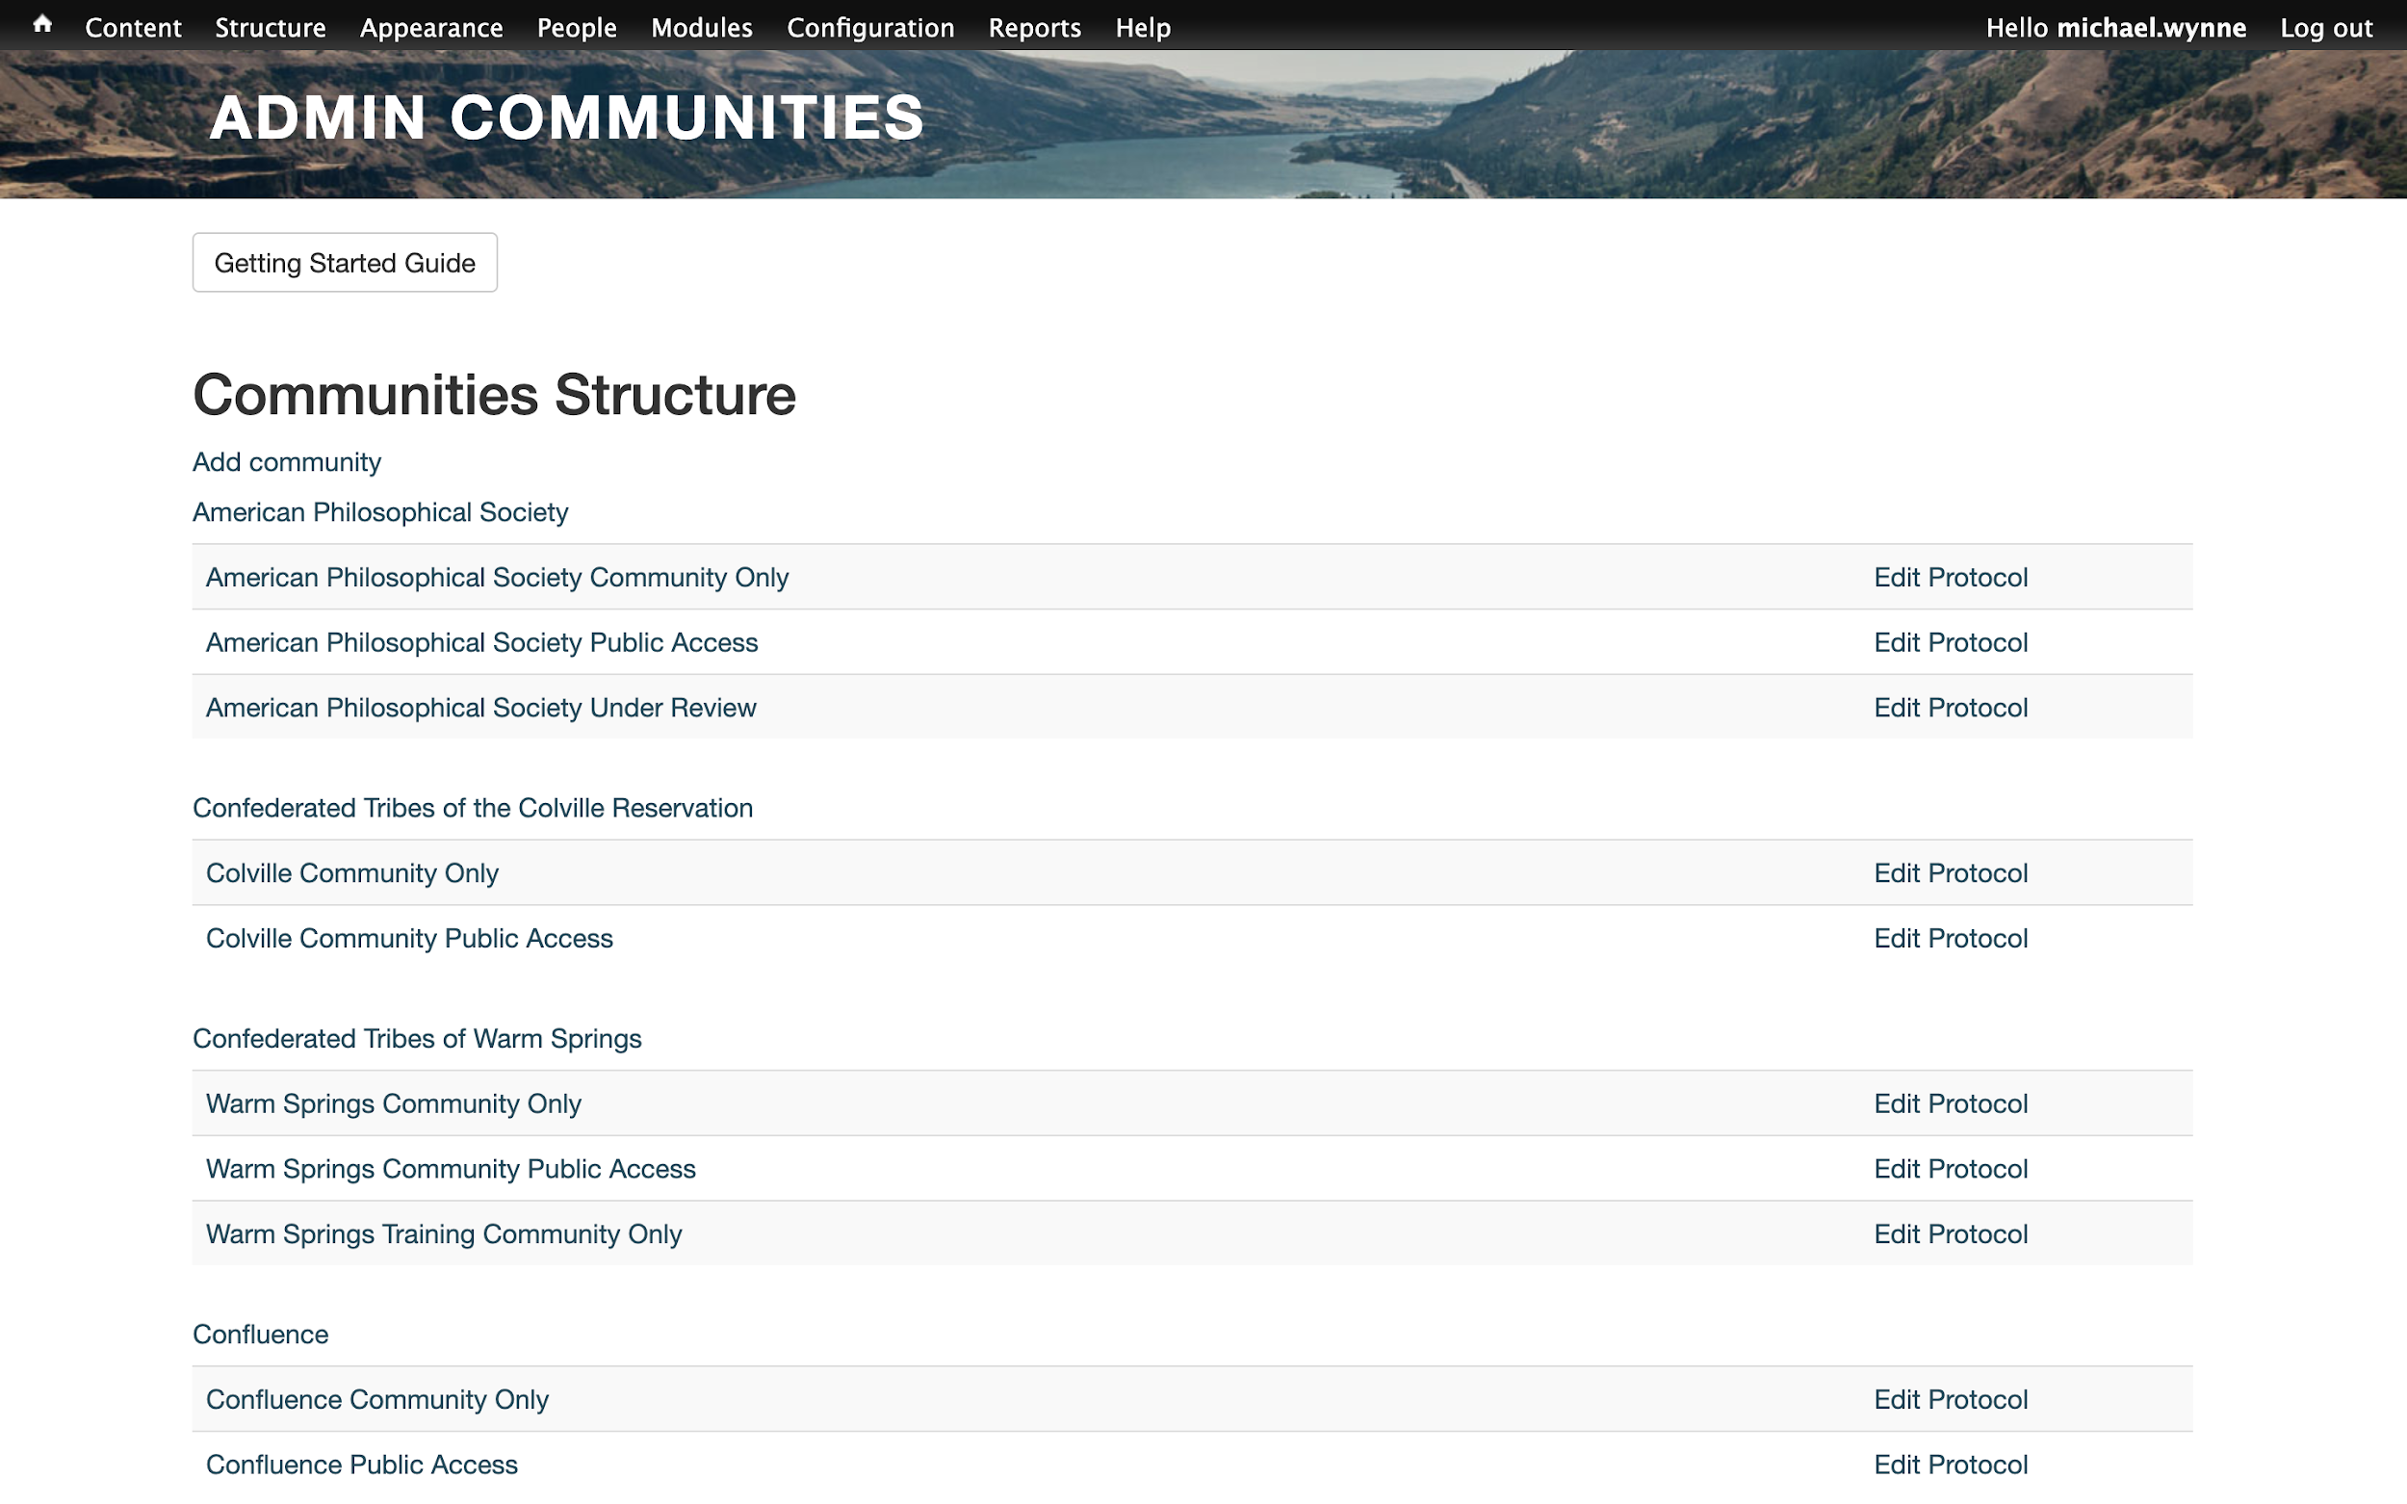
Notes:
APS and other institutions …
The point is you can define how or if communities are prominent on the site or more for administrative purposes to see who is adding content and knowledge in the site.
Communities can have their own pages and be displayed or not displayed, in ways that you choose

Slide 36
CULTURAL PROTOCOLS
THE ‘HOW’ OF MUKURTU SHARING
Notes:
Cultural protocols are how individual users access specific content.
We generally talk about protocols as types of sharing because setting protocols is not about Restricting access it is about DEFINING access in appropriate ways…
This is a physical examples of a protocol. A display in Australia was masked over until it could be replaced because a person in the photo had passed away
Think back to that physical filing cabinet at the Nyinkka Nyunyu center
Protocols are the heart and soul of Mukurtu— they are what allows for the cultural values that exist offline to be embedded online…

Slide 37
Cultural Protocols
?
GENDER
SEASONAL
SACRED
COMMUNITY DEFINED
Notes:
Like communities, protocols are flexible.
Some Protocols we often see across indigenous communities worldwide are: gender-based, seasonal (eg: winter songs or stories), ceremonial or sacred… but one can create a protocol based around any group of users
Each Mukurtu community defines their own set of protocols – some have a lot, some have just a few as needed.

Slide 38
Notes:
One really important note is that “public access” IS a protocol. Here we can see that this art center (the contributors) have CHOSEN to share this item publicly. If it wasn’t a public protocol, I wouldn’t be able to find the page.

Slide 39
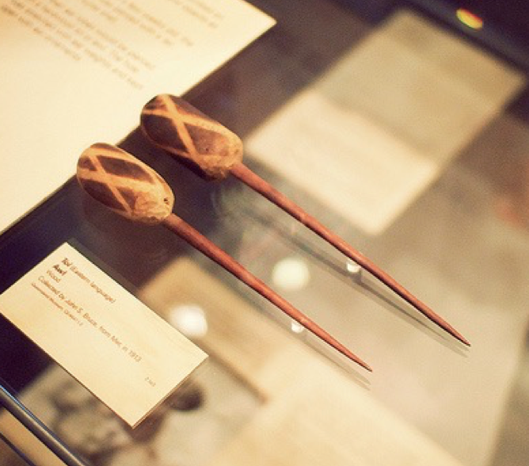
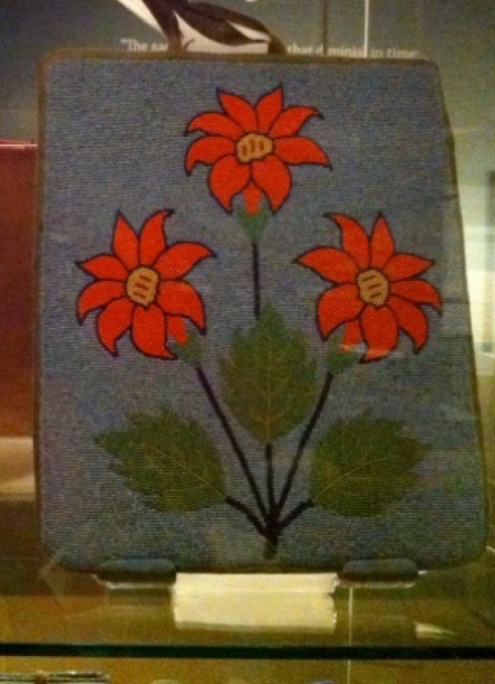
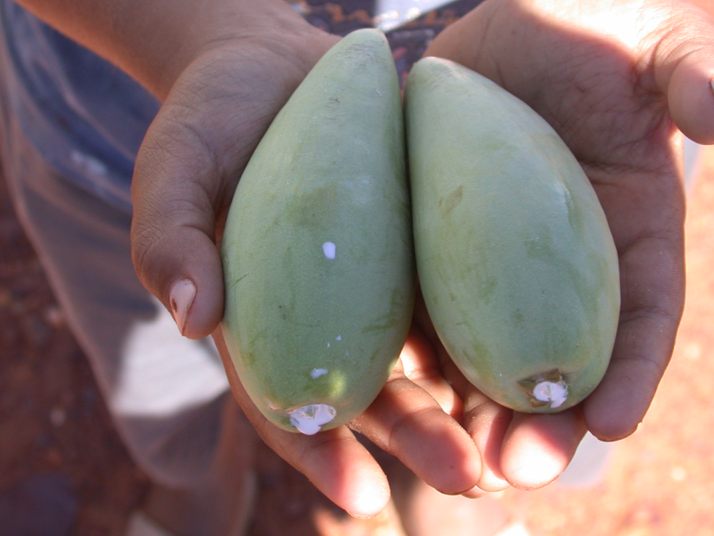
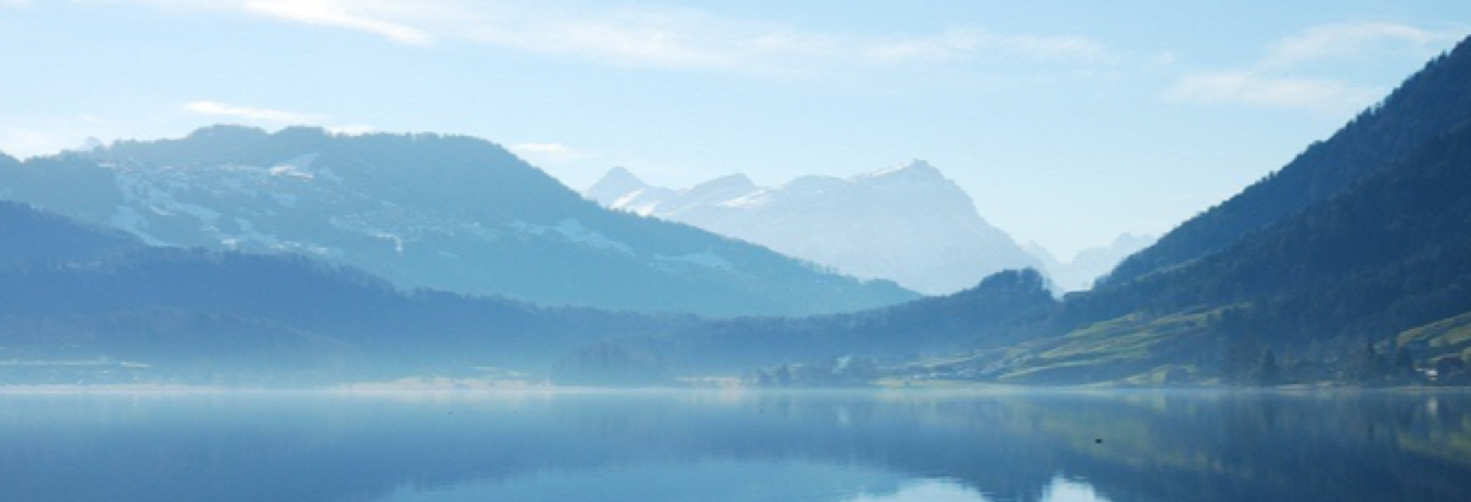
Categories
THE ‘WHAT’ OF MUKURTU CMS
Notes:
Finally, categories define what is meaningful to the communities you serve. These are ways to organize and define the materials within Mukurtu to help people search and browse.
In Mukurtu we don’t default to controlled vocabularies like those produced by the Library of Congress. They are all unique to each site.
Categories will vary with scope – we find most sites end up with around 10-15 categories, depending on their content and user needs.

Slide 40
Notes:
Coming back to the PPWP as one example, there are 12 categories… (started with 9 added over time up to 12…)
Note the general terms (religion, education), and some that have a more complex meaning (government to government relations)

Slide 41
Notes:
Another example of Categories is the Warumungu site.
They’ve chosen a different set of categories that are meaningful to their community. They’ve also chosen to provide an English translation of the Warumungu words.
The THREE Cs (Communities, Cultural Protocols, Categories) are flexible enough to adapt to each situation, and are the foundation of each Mukurtu site.

Slide 42
Mukurtu CMS in Action
Examples from other TALMs
Notes:
Here are a few examples of other tribal archives, libraries, and museums using Mukurtu, and some of their core features.

Slide 43
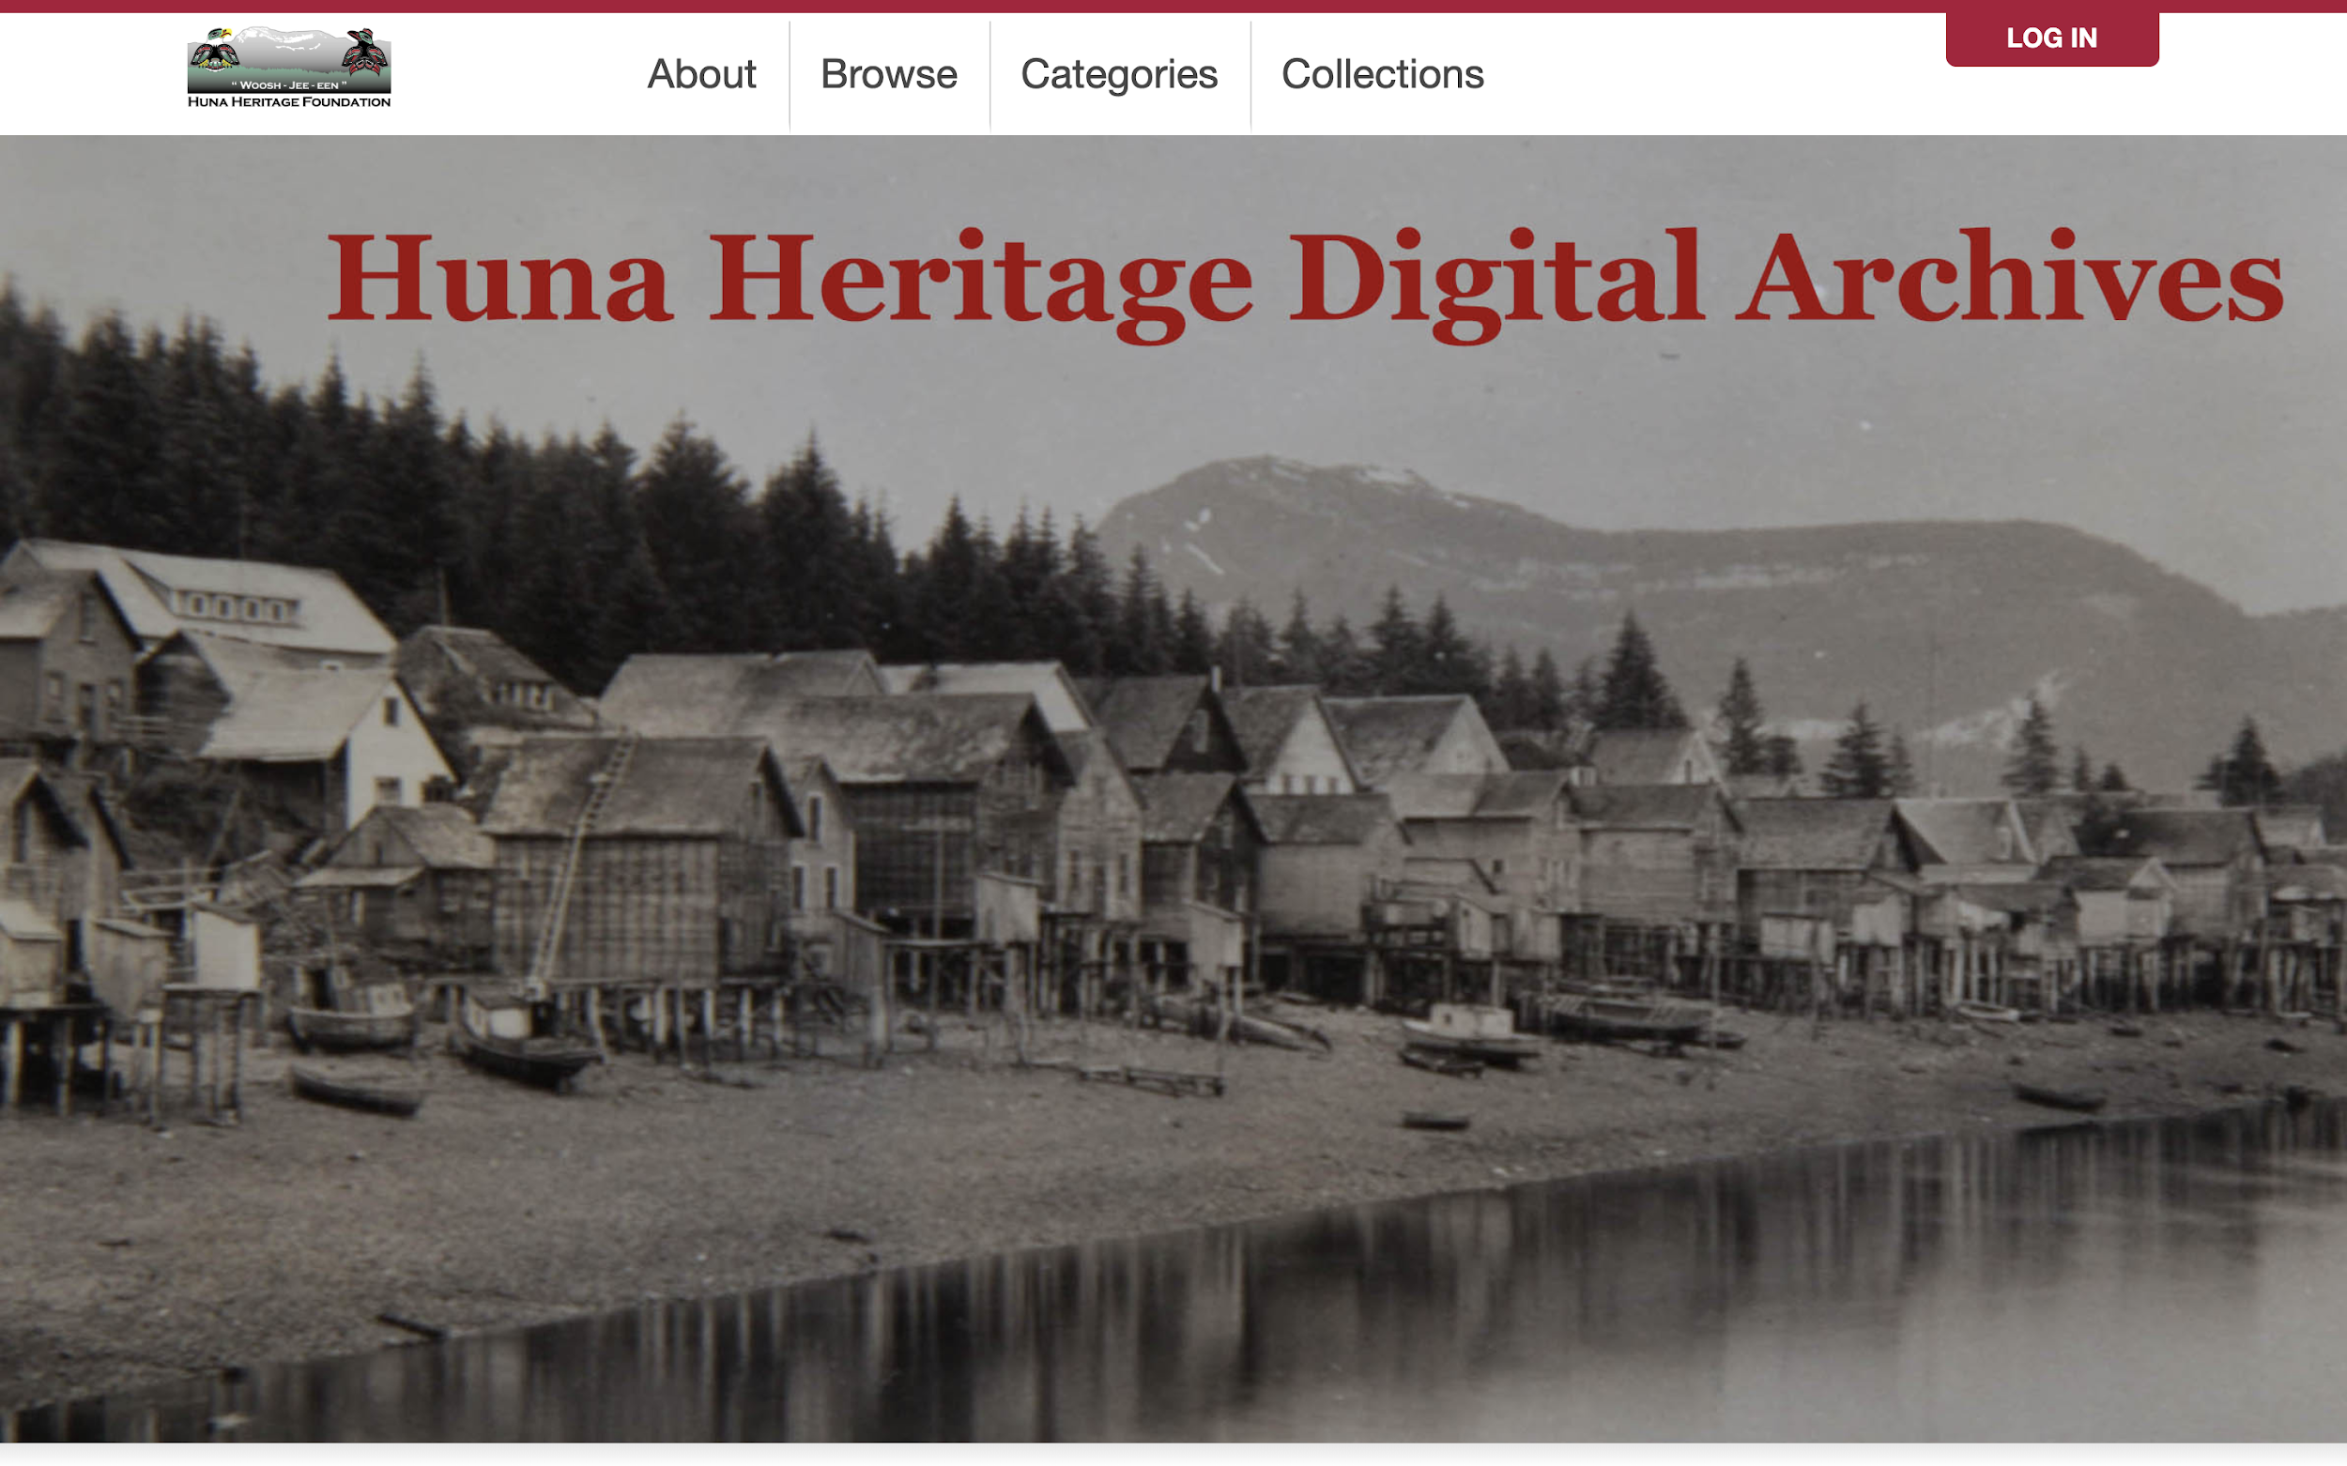
Notes:
Huna Heritage Digital Archives from the Huna Heritage Foundation.
Previous cohort members.
Content very much focused on community interests - major historical events, the Hoonah fishing fleet, and honoring their veterans.
Lots of outreach with community members to collect narratives.

Slide 44
Notes:
HHF frontpage also shows featured content block - highlighting specific digital heritage items.

Slide 45
Notes:
And their categories, for browsing/discovery, one more set of examples

Slide 46
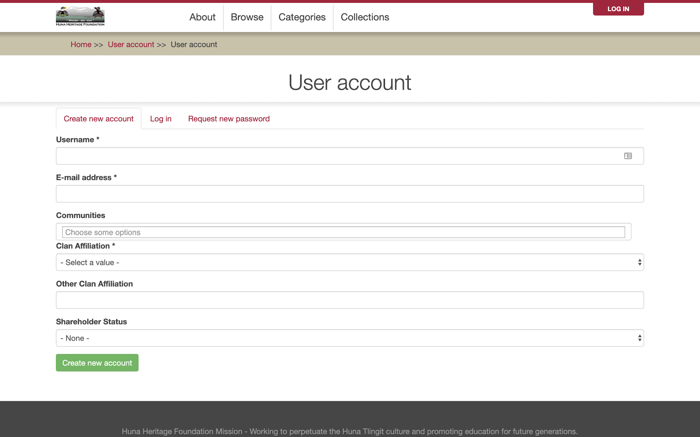
Notes:
They’ve also customized their user registration form to include Clan affiliation and Shareholder status so they can make more informed decisions when reviewing account requests

Slide 47
Notes:
Wurrppujinta Anyul Mappu, the site for the Warumungu community in central Australia
Here is there site-wide welcome.

Slide 48
Notes:
Next, a selection of featured items - in this case, linking to high-interest collections.
The site very much focused around access by families, but also has spaces for contributions from others - these are represented by Tracks, which are further divided.

Slide 49
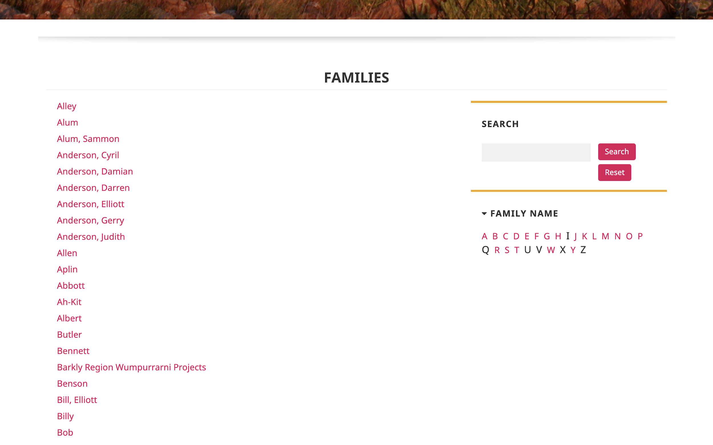
Notes:
Family Track
MWKA includes one community for each family (~240)

Slide 50
Notes:
Aboriginal Organizations track lists other contributing organizations - can control which users can access which parts of the site.

Slide 51
Notes:
Passamaquoddy Nation

Slide 52
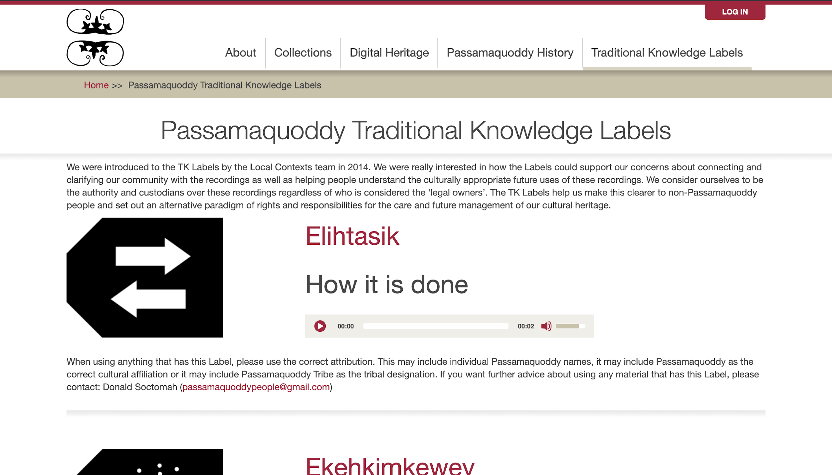
Notes:
Big site-wide focus on TK Labels

Slide 53
Credits
Presentation template by SlidesCarnival.
Minicons by Webalys
This template is free to use under Creative Commons Attribution license.
These slides contain changes to color scheme and content.
Images:
Slide 2: http://mukurtu.org
Slide 3: https://mukurtu.org/learn/
Slides 5-8: Photos by Kimberly Christen
Slide 9: Nyinkkya Nyunyu Art and Culture Centre, Tennant Creek, NT, Australia. Photo by Kimberly Christen

Slide 54
Credits continued
Slide 11: Dilly bag, South Australia Museum.
Slides 12-16: Mukurtu Wumpurrarni-kari Archive
Slide 17: https://native.wsu.edu/
Slides 18-20: https://plateauportal.libraries.wsu.edu/
Slide 21: Photos by Kimberly Christen
Slide 23: Graphic produced by the Center for Digital Scholarship and Curation
Slides 24-26: https://plateauportal.libraries.wsu.edu/
Slides 27-30 http://archives.hunaheritage.org/
Slides 32-33: Photos by Kimberly Christen
Slides 34-35: https://plateauportal.libraries.wsu.edu/

Slide 55
Credits continued
Slides 36-37: Photo by Kimberly Christen
Slide 38: MIRA Canning Stock Route Project
Slide 39: Photos by Kimberly Christen
Slide 40: https://plateauportal.libraries.wsu.edu/
Slide 41: Wurrppujinta Anyul Mappu
Slides 43-46: http://archives.hunaheritage.org/
Slides 47-50: Wurrppujinta Anyul Mappu
Slides 51-52: http://passamaquoddypeople.com/

Slide 56
Using this Resource
The Digital Stewardship Curriculum is an Open Educational Resource created by the Center for Digital Scholarship and Curation.
All presentations and resources created by the CDSC are licensed under a Creative Commons Attribution-NonCommercial-ShareAlike 4.0 license (CC BY-NC-SA). Please share, reuse, and adapt the resources and provide attribution to the Center for Digital Scholarship and Curation, Washington State University.

