Slide 1
Mukurtu CMS: Community Records
Digital Stewardship Curriculum
Notes:
These slides introduce an extended features that will give you another tool to enrich your digital heritage items - community records. More information is available at www.mukurtu.org/support
Community records are one way to provide multiple layers of knowledge and narration to digital heritage items.
They can also be used to ensure that those layers of knowledge are shared appropriately.

Slide 2
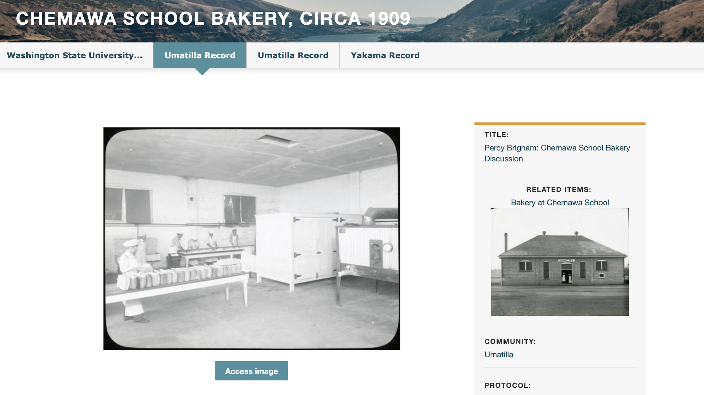
Notes:
This is an example from the Portal, and this highlights the fact that you can have as many community records as needed. https://plateauportal.libraries.wsu.edu/
This item has records from two different Umatilla tribal members, and one from a Yakama tribal member.
We want to note that on the Portal, you’ll see that on most items, the first record is from an institution, and then tribal records are added after. That’s part of the workflow for this specific site, but it doesn’t have to be that way.

Slide 3
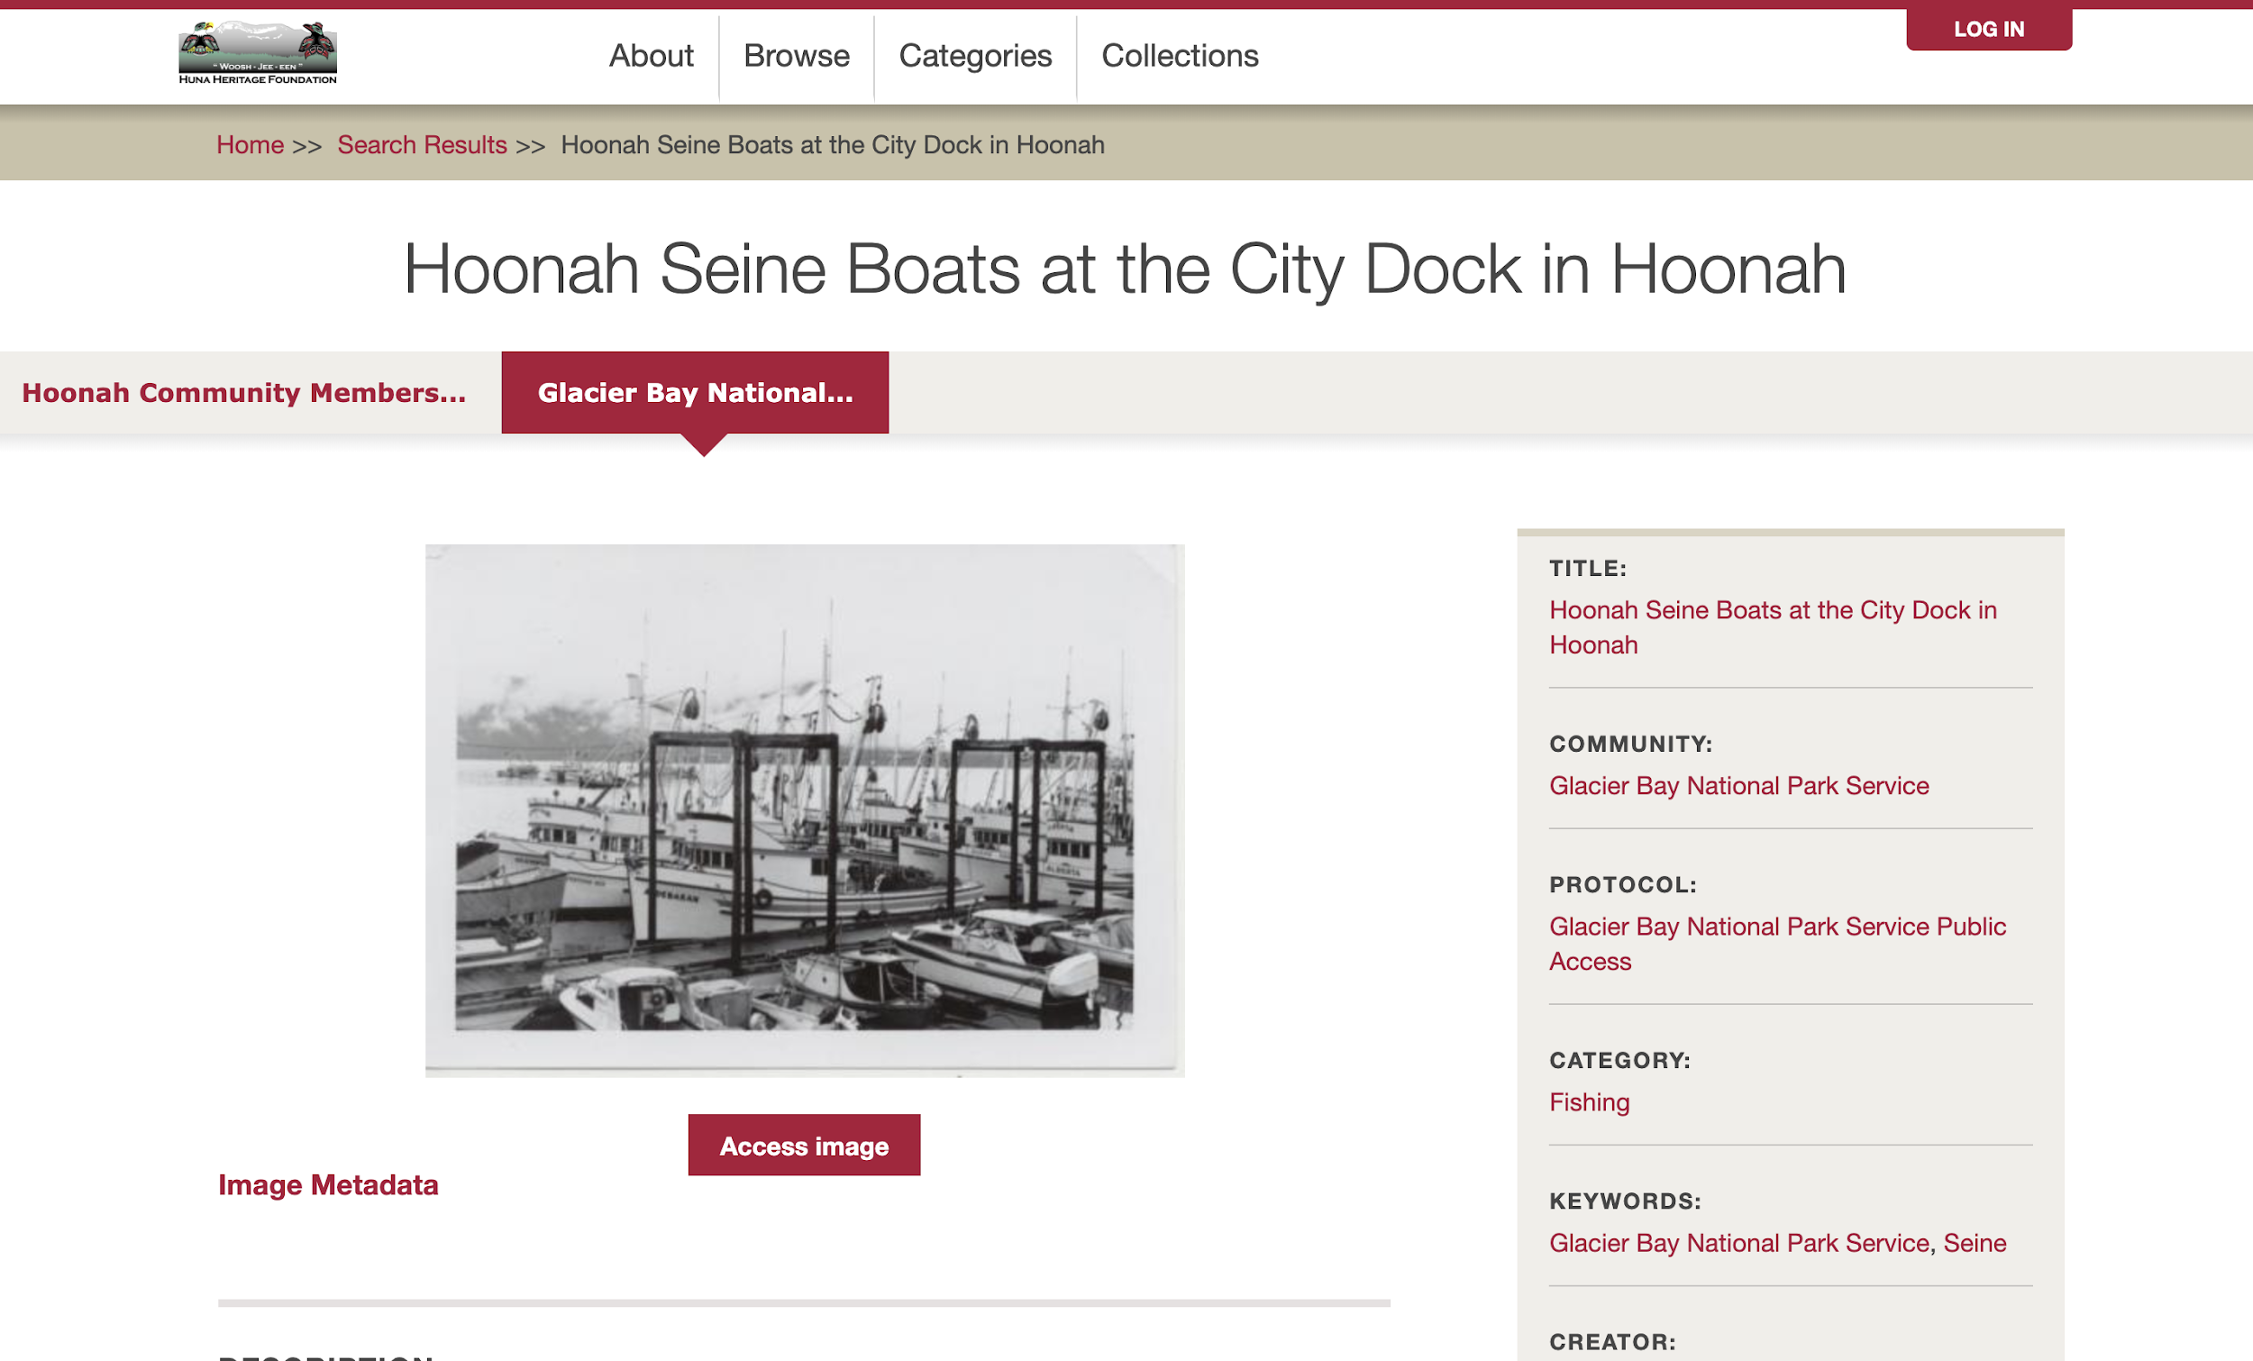
Notes:
Here you can see that the first record is from the Hoonah community, and then the next record added is from Glacier Bay National Park.
When we talk about community records in Mukurtu, it just means a record from a Mukurtu Community, and *not* necessarily from a community in the colloquial sense of a Tribal or Native community.

Slide 4
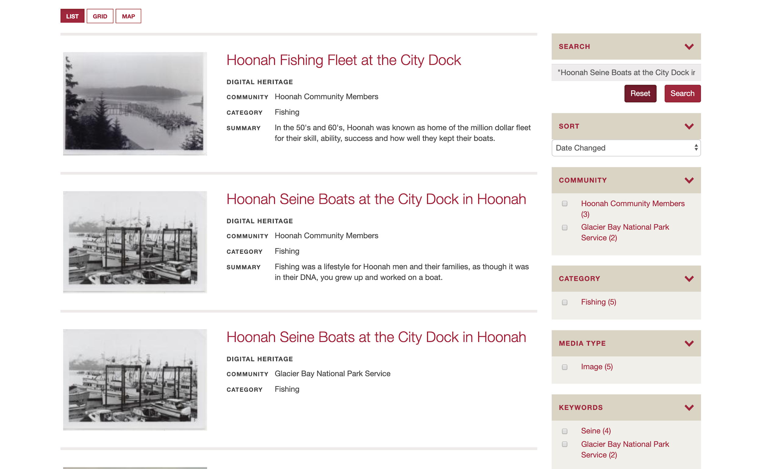
Notes:
One final thing to note is that you will see each of those records showing up in search results.
Some people can find this a bit disorienting, but it’s one way to make it really clear and evident where the information in each record comes from.

Slide 5
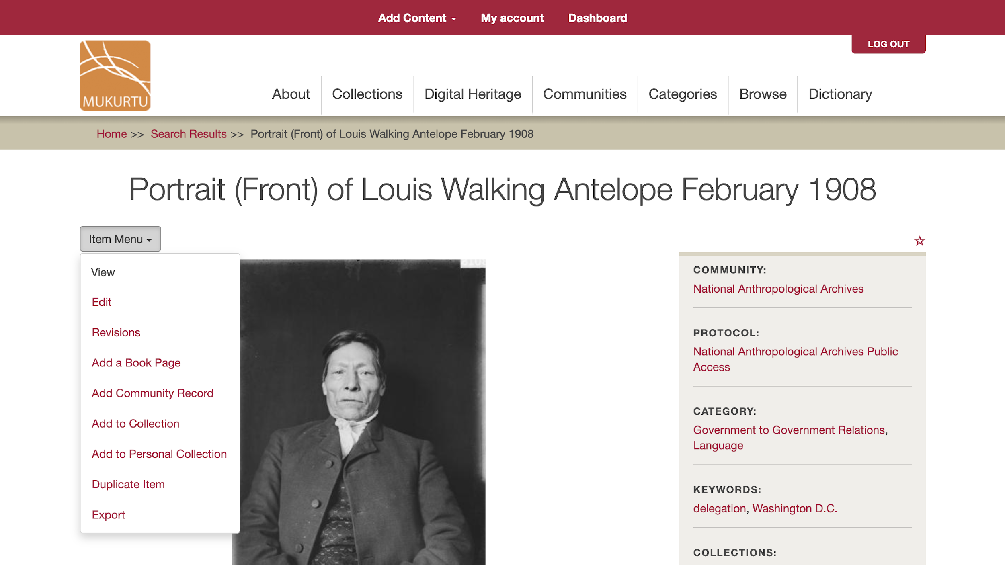
Notes:
To add a community record to an existing DH item, go to the item page, click Item Menu, and select Add Community Record from the dropdown menu.

Slide 6
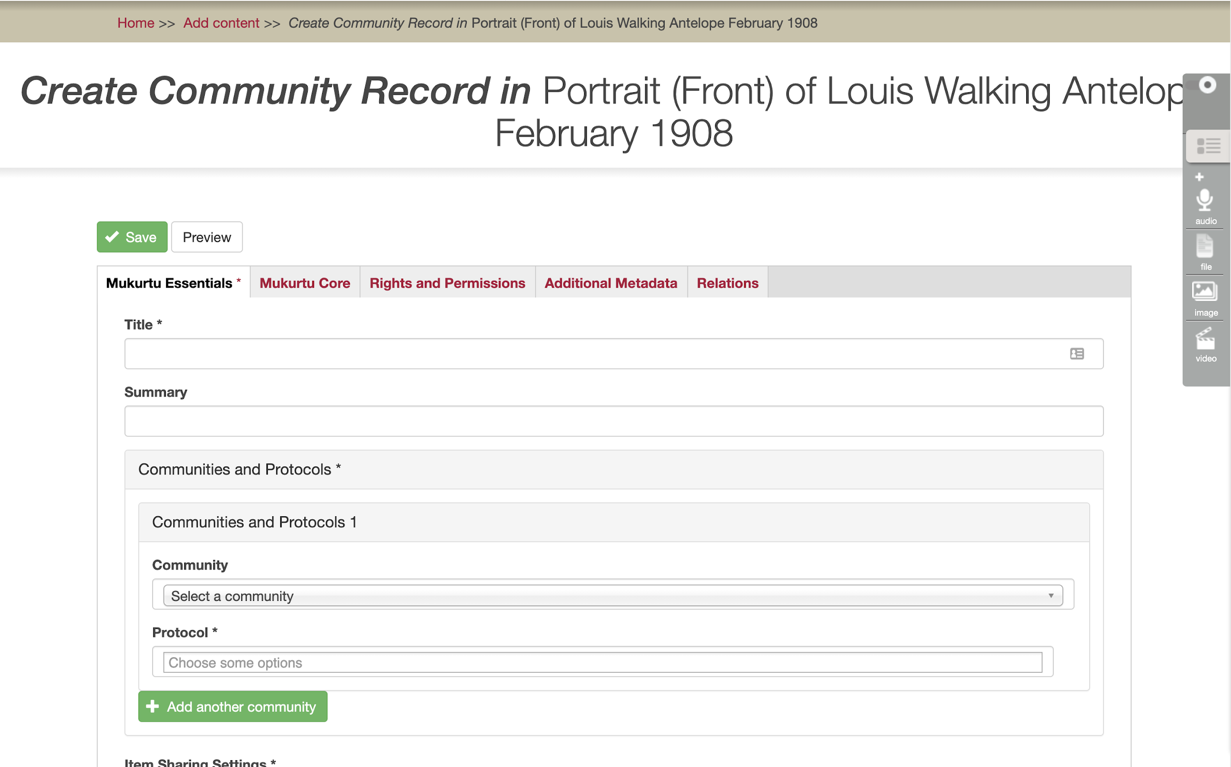
Notes:
From here you will see pretty much exactly the same interface as you did when creating a DH item. The only difference is that there is no Media Assets field, since that is the one thing shared between all records
You still need to include all your required fields: Title, Community, Protocol, and Category. Beyond that you can include any fields that you want to work with.

Slide 7
Credits
More resources at www.mukurtu.org/support
Screenshots from:
  https://plateauportal.libraries.wsu.edu/
  http://archives.hunaheritage.org/
This template is free to use under Creative Commons Attribution license.
Presentation template by SlidesCarnival.
Minicons by Webalys
These slides contain changes to color scheme and content.

Slide 8
Using this Resource
The Digital Stewardship Curriculum is an Open Educational Resource created by the Center for Digital Scholarship and Curation.
All presentations and resources created by the CDSC are licensed under a Creative Commons Attribution-NonCommercial-ShareAlike 4.0 license (CC BY-NC-SA). Please share, reuse, and adapt the resources and provide attribution to the Center for Digital Scholarship and Curation, Washington State University.

