Slide 1
Mukurtu CMS: Site Look and Feel
Digital Stewardship Curriculum
Notes:
There are a lot of things you can do do easily personalize the look and feel of your sites.
For the most part this is all accessible from the user interface, you don’t need to code or anything, just follow basic instructions.
These slides will show some examples of simple steps you can take to affect your site look and feel

Slide 2
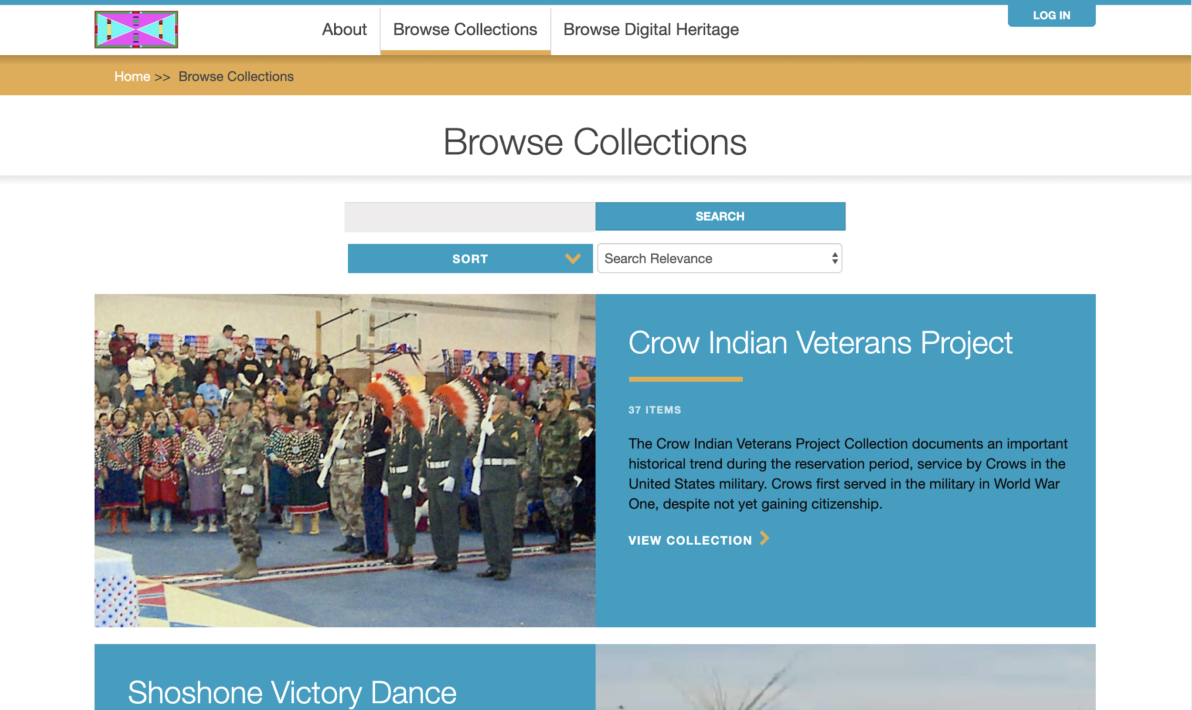
Notes:
Choosing between two colour schemes -
Bone and red theme available
Blue and gold theme, shown here.

Slide 3
Notes:
Changing your site logo - replacing the Mukurtu icon with something more personal.
Changing the navigation menu - adding or removing links and renaming links to best guide your users.
Of course customizing the hero image on the front page. One option is the full-bleed or full page hero image used here...

Slide 4
Notes:
This is the front page of the Unangax (Aleut) Heritage Library and Archive (UHLA) at the Aleutian Pribilof Islands Association, Inc (APIA)
They chose to do the full-bleed banner, using an image that one of their staff put together in Photoshop

Slide 5
Notes:
But you can also use a split-width image with more space for welcome text, like here on the Pokégenek Bodéwadmik site Wiwkwébthëgen.

Slide 6
Notes:
You can choose to display featured content on the front page of your site to really guide users to specific items or collections. We know some folks will rotate and change these seasonally, for example.

Slide 7
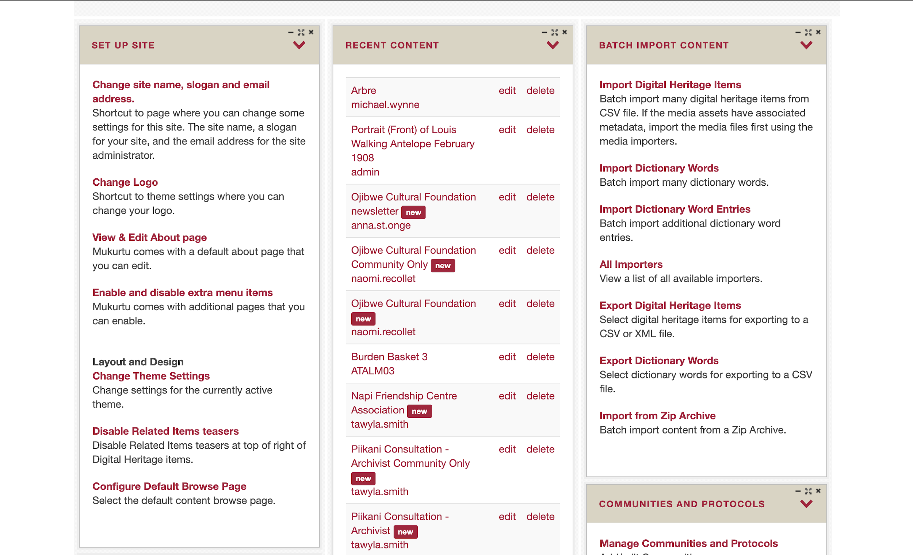
Notes:
There are lots of other changes you can make too, you can find most of the links on your dashboard in the Set up Site box.
More information and training is on our Mukurtu Support site.

Slide 8
Notes:
And we have video guides for all of these in the Site Look and Feel section of mukurtu.org/support

Slide 9
Credits
More resources at www.mukurtu.org/support
Screenshots from:
Little Big Horn College
https://passamaquoddypeople.com/
https://uhla.info/
https://www.wiwkwebthegen.com/
This template is free to use under Creative Commons Attribution license.
Presentation template by SlidesCarnival.
Minicons by Webalys
These slides contain changes to color scheme and content.

Slide 10
Using this Resource
The Digital Stewardship Curriculum is an Open Educational Resource created by the Center for Digital Scholarship and Curation.
All presentations and resources created by the CDSC are licensed under a Creative Commons Attribution-NonCommercial-ShareAlike 4.0 license (CC BY-NC-SA). Please share, reuse, and adapt the resources and provide attribution to the Center for Digital Scholarship and Curation, Washington State University.

